Slide 1
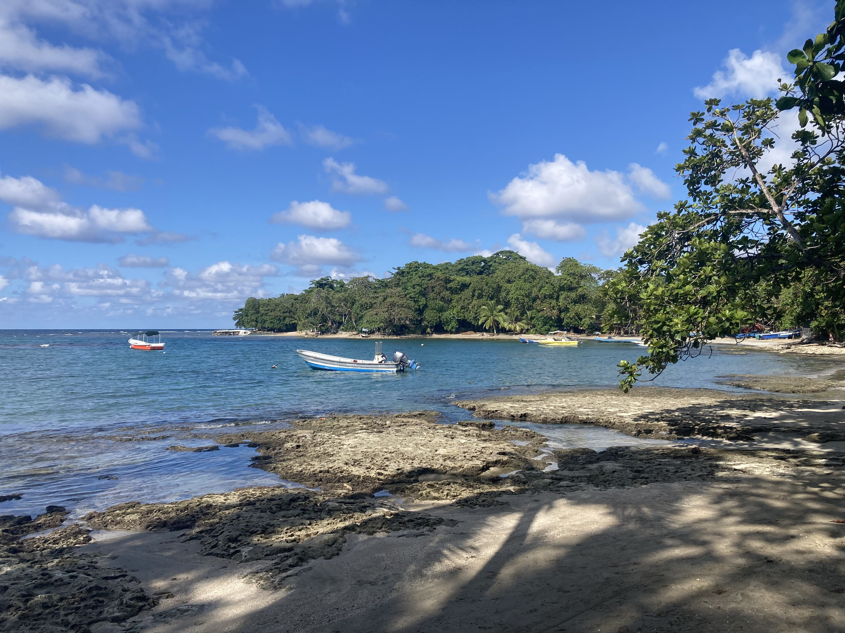
UPDATE
Our 2023 end of year data has been submitted early. Go team!☺
Please do not enter any new data into WebNEERS until we receive access to FFY2024 (Nov 15th).
Our next Zoom call will be Nov 13th at 9am. Calendar invite will be sent soon!

