Slide 1
GROW THIS!
OSU EXTENSION SERVICE
FOOD HERO RESEARCH TEAM
2024 OREGON GARDEN CHALLENGE

Slide 2
FLYER-GENERAL
Notes:
https://www.foodhero.org/growthis

Slide 3
Grow This! Background
Started in 2020, based on West Virginia Grow This!
Bi-Mart seed donations, 1st year seed 900 packets
Seed donations vary every year; other grant funding
3 ways to sign up: households, classrooms, groups
Tied to Food Hero Social Marketing messages
Notes:
General: remind them that first we will be directly emailing everyone a link (who is in the system) - direct link into feedback survey - launching that early Dec.- as soon as the survey go out, they will have early access to sign up form
ASK- sending out (next few weeks) sending out list of their partners in their community (especially teacher- teachers kits will go fast)- making sure teachers who had it last year sign up early this year- give them heads up to look for email (look in junk mail)
Halie starts talking here: Our surveys are like a self assessment - so hopefully it can help be a tool for them and give us information to find out how to continue to fund and improve

Slide 4
SOME SIGN-UP SURVEY THEMES
Growing Microgreens
Growing Potatoes
What type of seed you most want to grow for food
Confidence and skills in growing
Seed-Starting

Slide 5
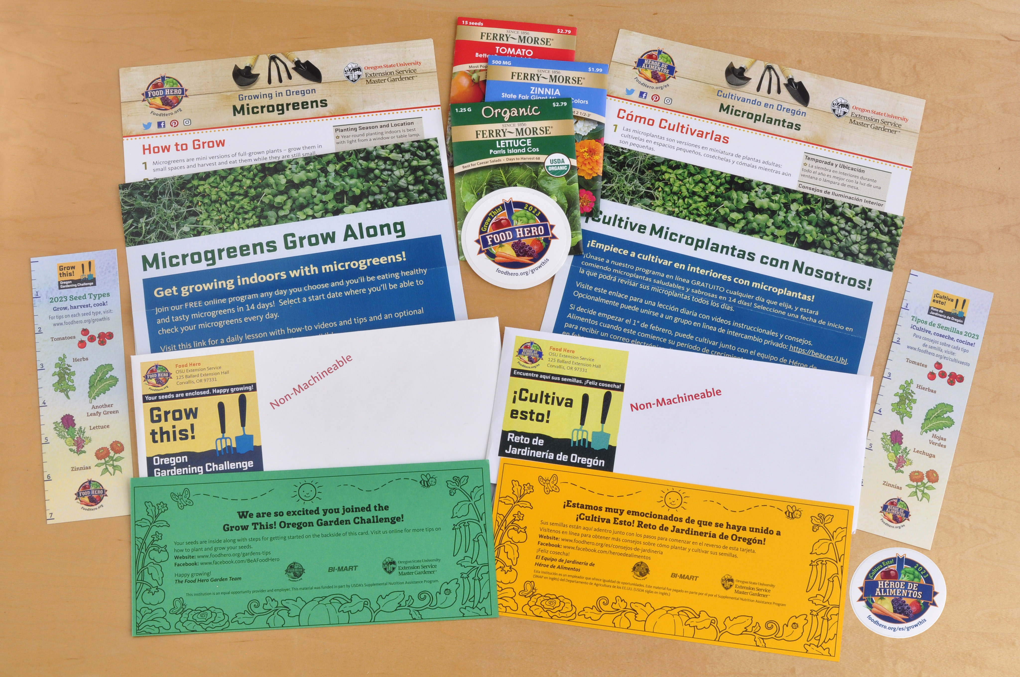
Household Kit
Notes:
Reminder that there are different ways for people to sign up!

Slide 6
2024 Seed Types – visit these links for how to grow them through to what to cook!
Herbs
I.E. Cilantro – www.foodhero.org/grow-cilantro
Leafy Greens
I.E. Kale – www.foodhero.org/grow-kale
Lettuce – https://foodhero.org/salad-greens-garden-tips
Zinnias – www.foodhero.org/grow-zinnias
Tomatoes; Grow This’ 2024 Challenge! – https://foodhero.org/tomatoes-garden-tips
Notes:
Halie
3,600 go out to households that sign up

Slide 7
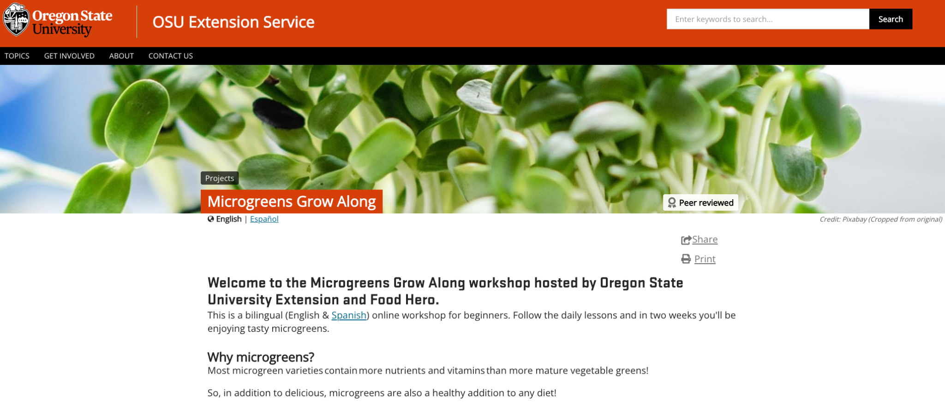
MICROGREENS
WORKSHOP
START ANYTIME: https://www.foodhero.org/microgreens
Notes:
Halie

Slide 8
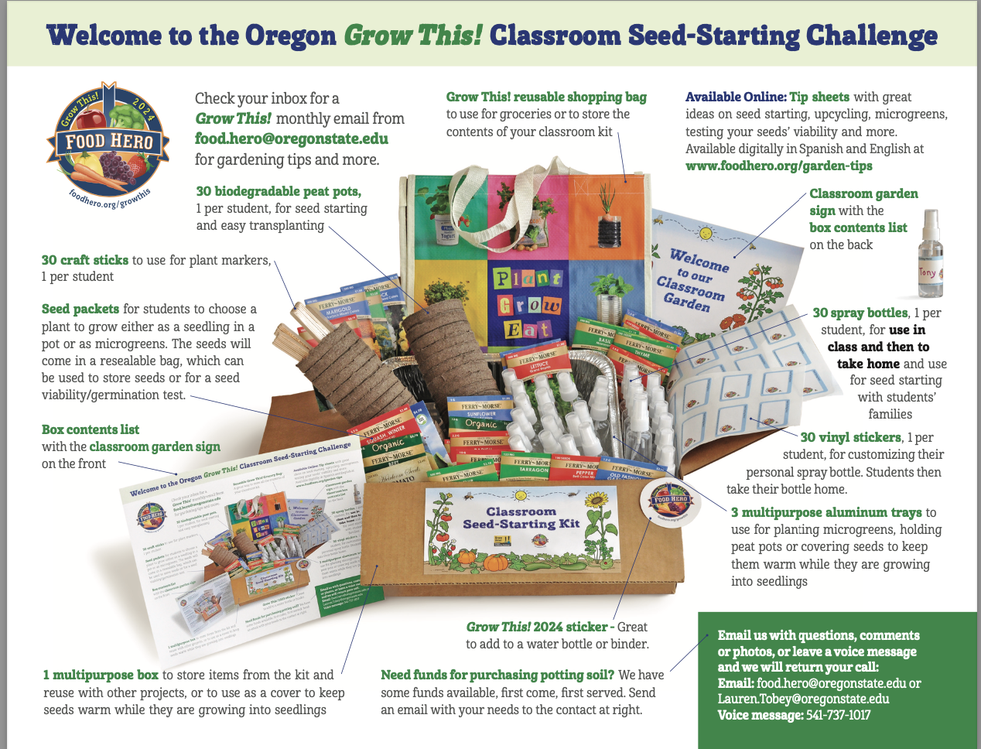
CLASSROOM SEED- STARTING KIT

Slide 9
Classroom Seed-starting Kits include:
1 multipurpose box to store items from the kit and reuse with other projects, or to use as a cover to keep seeds warm while they are growing into seedlings
3 multipurpose aluminum trays for planting microgreens and/or holding peat pots or
to use as a cover to keep seeds warm while they are growing into seedlings
30 biodegradable peat pots, 1 per student for seed-starting and easy transplanting
30 small spray bottles, 1 per student for use in class and then to take home and encourage seed-starting with their families
30 vinyl sticker sheets, 1 per student, used to label individual spray bottles
30 craft sticks to use for plant markers, 1 per student
10 seed varieties- multiple packets of each (about 40 packets) for students to choose a plant to grow either as seed starts in pots or as microgreens.
Tip sheets- great ideas on seed starting, upcycling, microgreens, testing your seeds' viability and more.
Notes:
Bee books –

Slide 10
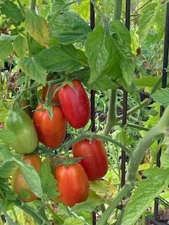
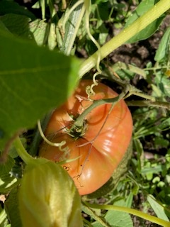
Seed Varieties for 2024
Classroom Seed Kit 1 packet each of:
Onions
Squash
Green Bean
Lettuce
Tomatoes
Peas
Radish
Beets
Leafy greens
Melon
Cucumber

Slide 11
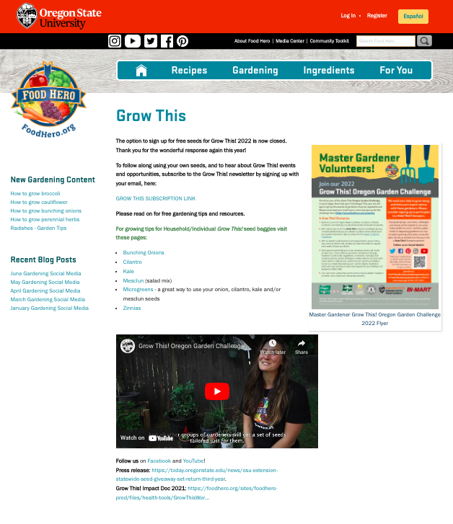
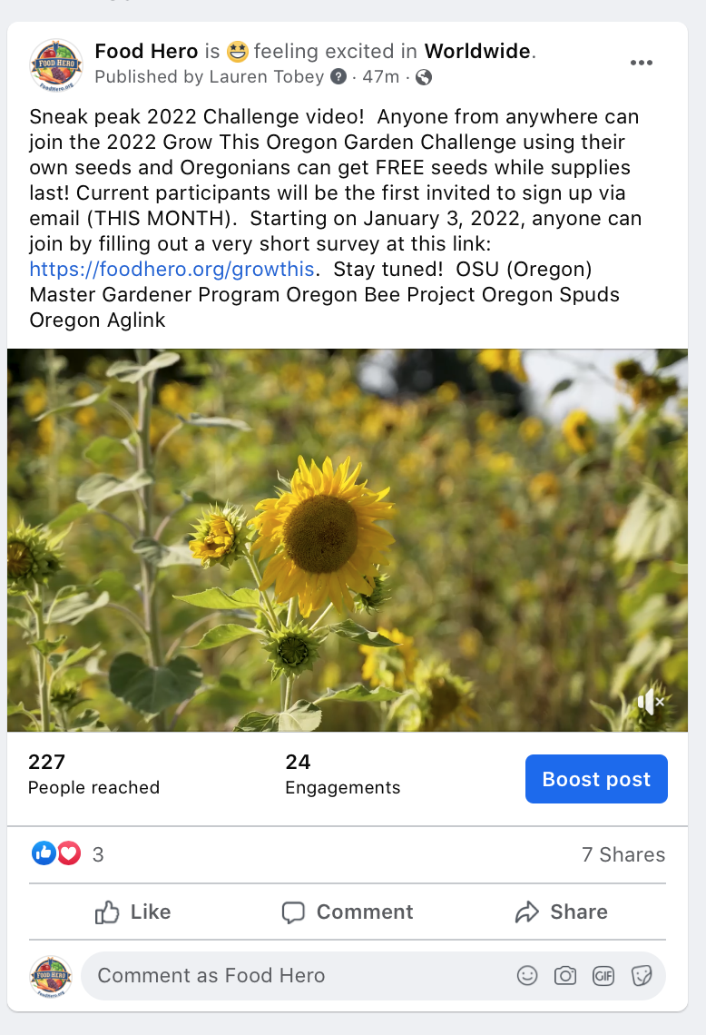
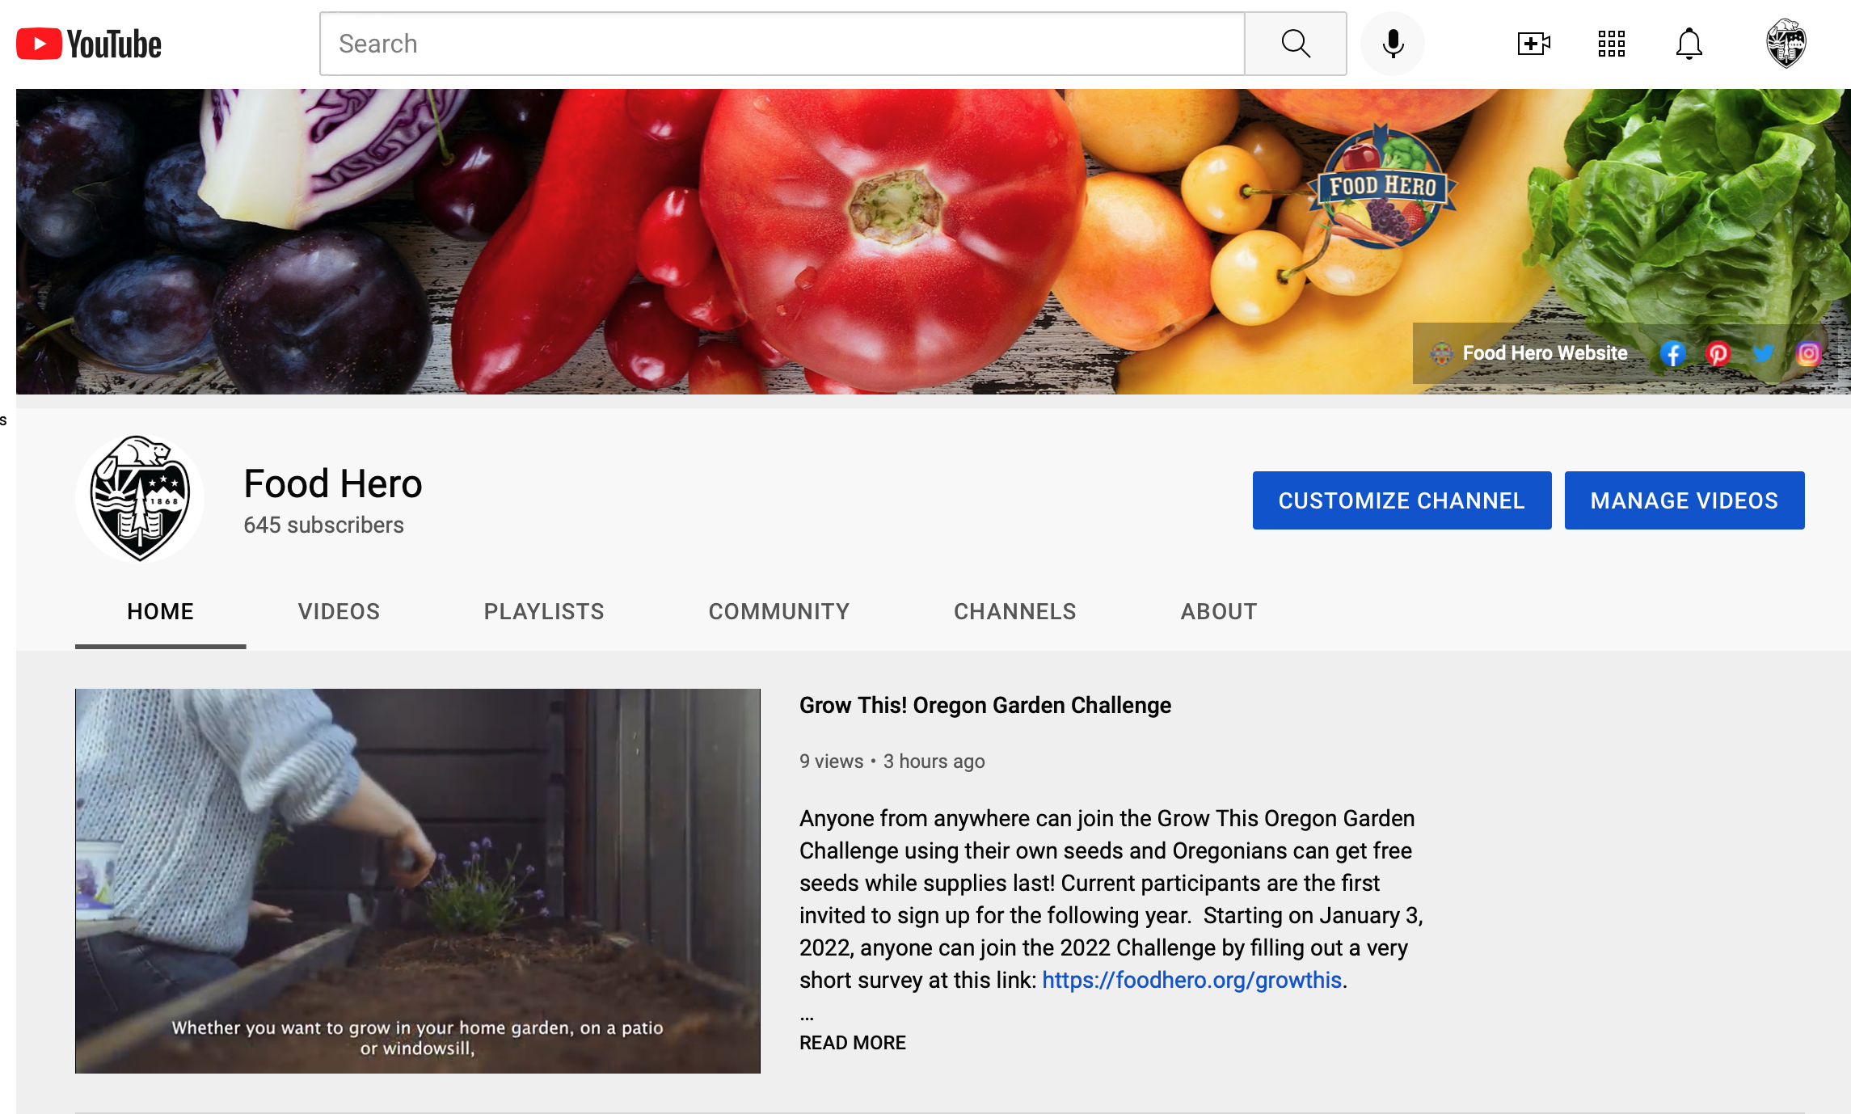
PLEASE SHARE THESE PAGES!
https://www.youtube.com/c/ FoodHeroVideos
www.foodhero.org/growthis
https://fb.watch/9arO-CdrvE/
Notes:
Tyler
Mention new website changes

Slide 12
What questions do you have?
Thank you!
Notes:
Mention that we’ll send out powerpoint at end of week OR send it now and have them check for updated links.

