Slide 1
Pinterest Project
By: Ainsley Beck, Meg Clements & Brooke Robinson

Slide 2
Pinterest Overview
A “visual discovery engine”

Slide 3
Background
Pinterest presence since 2012
Last consistent posting schedule was August 2023
Started the project in December of 2023
Second leader of website traffic behind Google
Our Pinterest audience
Around 1.6 million monthly views
Categories of interest
parenting & world cuisine
Age 18 - 24 (33.5%), 25-34 (30%)
80% of users are on mobile devices

Slide 4
Systematic Approach
Best practices
images, keywords (ex: meals/recipes), format, posting frequency
Evaluated competitors
Proposal of graphics and plan
Pinterest Guide
Defined process
SEO considerations
Built-in reevaluation monthly
Updated Pinterest Page
Research
a/b testing
Tracking impressions, clicks, conversions to the website

Slide 5
Current Pinterest
Process Results

Slide 6
Outcomes
(January 13-March 12)
Impressions 3.21M
+16%
Engagements
113.1k
+20%
Outbound Clicks
13.82k
+32%
Saves
5.71 K
+12%
Total Audience
1.27M
+5.1%
Engaged Audience
75.53K
+20%
Notes:
define each

Slide 7
Trends
(January 13-March 12)
Saturday vs Wednesday
Average difference of 19.29k impressions

Slide 8
Most Popular Pins
Overall (created 2013-2021)
Created in last 30 days

Slide 9
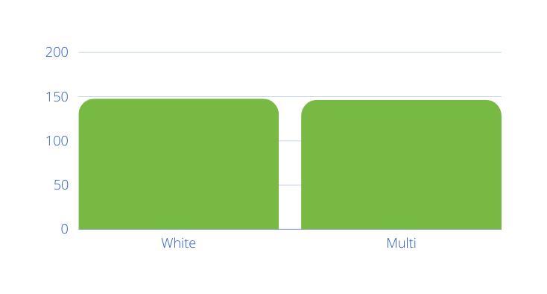
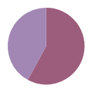
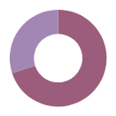
A/B Testing
Total Views*
Conversions*, Pin Clicks*
First test in process
First A/B test is white overlay vs colored overlay (color changes depending on the photo)
Same time, same day, same caption, etc
The Ratio:
Conversions 2:3
Pin Clicks: 3:7
*Only 4 data points were ready to be used for this presentation

Slide 10
Future A/B Testing
Example Descriptions:
“Zesty and flavorful, this fresh alternative to cranberry sauce is great year-round! The cranberry relish is lower in sugar and pairs well with a lot of different meals. Try it as a healthy topping for meat, fish or grain bowls. It also tastes great on toast, pancakes and in sandwiches!”
V.S.
“This cranberry relish is great year-round! It is lower in sugar and pairs well with a lot of different meals. Try it as a healthy topping for meat, fish or grain bowls. It also tastes great on toast, pancakes and in sandwiches!”
Descriptions:
Putting recipe name In descriptions vs not putting recipe name In description
Length of descriptions
Amount of keywords used
Where keywords are In the description

Slide 11
Moving Forward
Goals
Questions
Maintain growth rate by increasing monthly views by 100,000 in the next 3 months
Post all recipes and compilations
Establish an updated approach and guide based on our first trend analysis and a/b tests
Provide more illustrations and resources for kids
Categories and materials for you and the communities in which you work
Adding comments will increase engagement and reach
Questions or comments for us?

Slide 12
Thank You!
Questions or Comments:
robinbro@oregonstate.edu

