Slide 1
Growing Healthy Kids Virtual Toolkit
Notes:
Brief welcome and introduction to the presentation
Purpose: To share insights into the Growing Healthy Kids Virtual Toolkit use in the MYP Unit—Expand capacity

Slide 2
Outline
Background of GHK Virtual Toolkit/Use in MYP
Implementation Basics
Annual Timeline
Recruitment/Registration Process
Qualtrics Registration
GHK Physical Toolkits
Weekly Lesson Sample
Evaluation-Post-Survey for Teachers
Evaluation Data
Adaption/Updates
Spring 2024 Plans

Slide 3
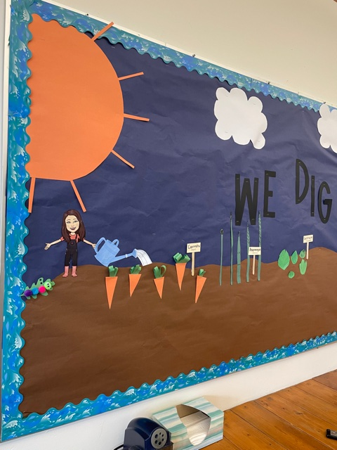
Background
Growing Healthy Kids is a garden-themed nutrition-education curriculum developed at Oregon State University. Audience: 2nd and 3rd grade
7 lessons
The Virtual Toolkit includes video lessons and other materials with great tips and tricks.
Developed in 2020/2021 by the Portland and Linn-Benton SNAP-Ed Units
Google site with lesson components
English and Spanish
Accessible on Food Hero
Notes:
Slide 3: Background
What is Growing Healthy Kids?
Target Audience
Program Objectives
Distance-learning: Adapted to a virtual toolkit in 2021?

Slide 4
Use in Marion, Polk, Yamhill
Used in 2021, 2022, 2023
Teacher-led lessons with students
We supply physical toolkits to teachers before the series begins
Weekly, we email teachers the lesson along with guidance on how to implement
New in 2023* ODE Farm to School funds for local produce tastings

Slide 5
Annual timeline
1st week of April
Mid-April
End of May
June
February
End of March
Teacher recruitment and registration via Qualtrics begins
Registration ends; Confirmation sent to registered teachers
Physical toolkits compiled and delivered to schools
GHK begins; Online lessons are sent via email to teachers weekly for 7 weeks
GHK ends & post-survey is sent to teachers
Post-survey closes/data reviewed
Notes:
Process for recruitment and implementation with timeline
Flyer QR code and email to principals and office managers at all qualifying schools (late-February)
Send Teacher letter and link to registration in these emails
Send to previous year’s list of participating teachers to register
Qualtrics registration survey which asks about interest, number of students, languages preferred, if they want a toolkit or funds for food, etc.
Registration confirmed with teachers before spring break
Team put together toolkits 1st week of April
Team delivers toolkits to teachers same week
One person sends an email to all teachers every Monday with the video lesson link, an overview of the lesson and suggested activities to complete with students that week.
End of series, we send a post-survey to teachers and give them a few weeks to respond. (end of May-1st two weeks of June)

Slide 6
Recruitment & Registration
Email invitations (office managers and principals) all SNAP-Ed qualifying elementary schools in MPY
Includes:
GHK Overview Letter
GHK Flyer
Qualtrics Registration Link
Notes:
Overview Letter:
What is GHK
Options for implementation
What’s expected of teachers
Timeline for lessons
What they will receive
Link to registration survey

Slide 7
Qualtrics Registration
Gathers information from teachers about:
Name, email, school, grade, # of students
Language(s) preferred for materials
Interest in receiving a physical GHK toolkit
New in 2023, we asked:
Whether they wanted to receive funds to purchase local food, for in-classroom tastings
About their perceived ability to purchase local foods and where they intended to purchase food
Notes:
The Qualtrics registration identifies who wants to participate, allows us to gather data needed to put together the toolkits and understand needs ahead of time from teachers.

Slide 8
GHK Physical Toolkits
Classroom Gardening Materials
16qts soil
Growing containers
Radish, herb and lettuce seeds
Spray Bottle
GHK Curriculum Materials
Student Mission Logs (one per student)
GHK recipes
GHK coloring sheets
New 2023* Local Produce tastings (Funded by ODE Farm to School Ed. Grant)
$100 gift card for local food
Local Produce Guide (in partnership with Marion/Polk Small Farms Faculty, Hayley White)
Additional Materials
Series Overview Letter
FH Cutting Board
FH Gardening Calendars
FH Gardening Basics Handouts
FH Monthlies
FH Reusable Grocery Bag
Writing Prompt for each lesson
Notes:
Our GHK Physical Toolkits have grown every year. Listed here is what was included in each 2023 toolkit for teachers. Most supplies were purchased with SNAP-Ed funds with the exception of the funding for food.
We provide one copy in English and Spanish of each handout, and ask that teacher make copies for the students in their classrooms.

Slide 9
Week 1 Lesson email-Sample
GHK lesson is directly linked.
Guidance on how to complete the lesson and where to find resources is included.
Materials provided in physical toolkit are also linked in weekly emails.
Notes:
This is an example of the email that is sent to participating teachers on a weekly basis. We send them on Mondays, and directly link the GHK lesson in the languages they requested. The weekly email provides guidance on how to implement the lesson, as well as what materials correspond to that lesson. They receive all of these materials in their physical toolkit, and we package them by lesson, so that they are easier for teachers to find/use.

Slide 10
Qualtrics Post-Survey
Self-reported data assessing:
*We incentivize completion via a raffle, 5 bags with Food Hero Cooking Tools.
Online lesson and virtual toolkit usage
Format of lessons
How well lessons met objectives
Student enjoyment
Interest in participation in future years
Ideas for improvement
Notes:
At the end of the 7 weeks, we send teachers a post-survey via Qualtrics. While our unit has adapted this survey, the original survey was developed by a team of SNAP-Ed faculty and staff in 2021. Every year, we incentive completion of the survey through a raffle. Last year, it was 5 bags of Food Hero Cooking Tools.
The survey asks teachers about their:

Slide 11
Online, GHK Registration Data
2021
28 teachers, 15 schools
2022
40 teachers, 21 schools
2023
46 teachers, 18 schools
Notes:
Reach
Timeline: 2021, 2022, 2023
Number of teachers/students reached/ schools reached each year
Registered
21: 28 teachers, 15 schools
22: 40 teachers, 21 schools
23: 46 teachers, 18 schools
Number of bilingual, English and Spanish only
21: English: 21, 75%; Bilingual: 5-18%; Spanish; 2- 7%
22: English: 26-65%; Bilingual;12=30%; Spanish; 1-2.5%
23: English: 24-52%, Bilingual 20-44%;Spanish 2-4%;
Locations of schools (cities) on a map

Slide 12
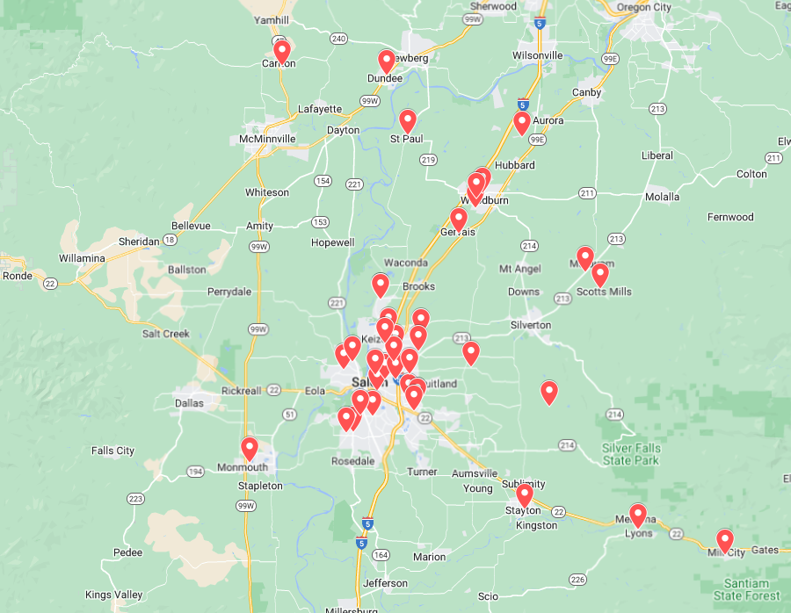
Participating elementary schools (2021-2023)
Notes:
Reach
Timeline: 2021, 2022, 2023
Number of teachers/students reached/ schools reached each year
Registered
21: 28 teachers, 15 schools
22: 40 teachers, 21 schools
23: 46 teachers, 18 schools
Number of bilingual, English and Spanish only
21: English: 21, 75%; Bilingual: 5-18%; Spanish; 2- 7%
22: English: 26-65%; Bilingual;12=30%; Spanish; 1-2.5%
23: English: 24-52%, Bilingual 20-44%;Spanish 2-4%;
Locations of schools (cities) on a map

Slide 13
Language (% of Classrooms) 2021-2023
Notes:
Reach
Timeline: 2021, 2022, 2023
Number of teachers/students reached/ schools reached each year
Registered
21: 28 teachers, 15 schools
22: 40 teachers, 21 schools
23: 46 teachers, 18 schools
Number of bilingual, English and Spanish only
21: English: 21, 75%; Bilingual: 5-18%; Spanish; 2- 7%
22: English: 26-65%; Bilingual;12=30%; Spanish; 1-2.5%
23: English: 24-52%, Bilingual 20-44%;Spanish 2-4%;
Locations of schools (cities) on a map

Slide 14
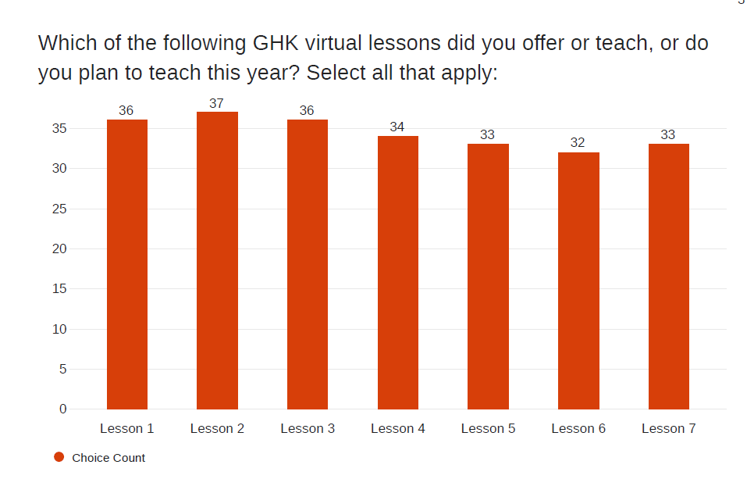
2023 Post- Survey Results
97%
100%
97%
92%
89%
89%
95% of teachers who responded reported using the GHK Virtual toolkit (N=40)
Only 37 teachers completed this question.
86%
Notes:
The important piece from this slide, is that while there is a slight decrease in the percentage of teachers completing all lessons, a large percentage teach all of the lessons with their students. While this is only 2023 data, this has been fairly consistent in 2021 and 2022 too.

Slide 15
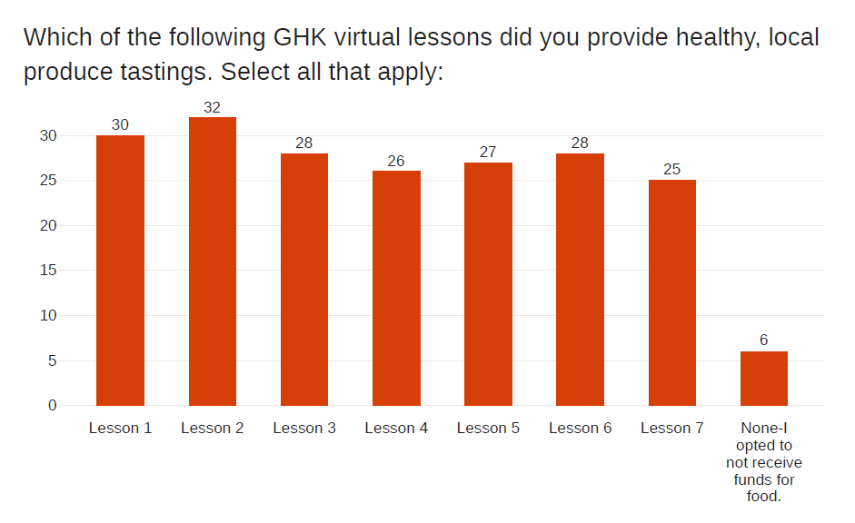

Slide 16
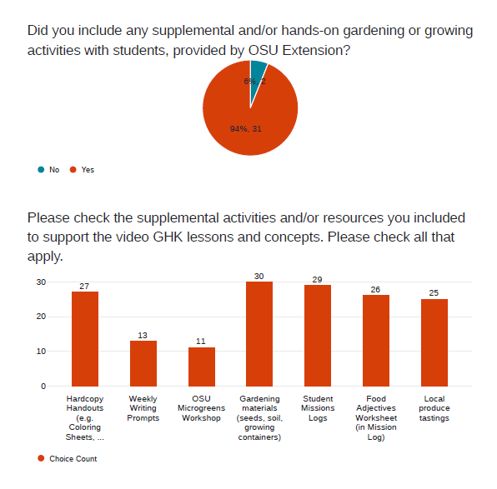
“My students were able to complete the coloring sheets, our lessons were interactive and linked to our new garden. Thanks, to the money provided students were able to do some produce and local produce testing. I played the video lessons in class, and we have conversations about what students learned, and then we worked on the activities.”
“The hardcopy handouts made it easy to make copies to send home for homework. Some students told me they tried out the recipes at home. We successfully grew radishes thanks to the supplies we got. I liked that the students kept track of stuff with the mission logs. They liked tasting foods they had never tried before.”
N=33
81%
90%
88%
77%
76%
39%
33%

Slide 17
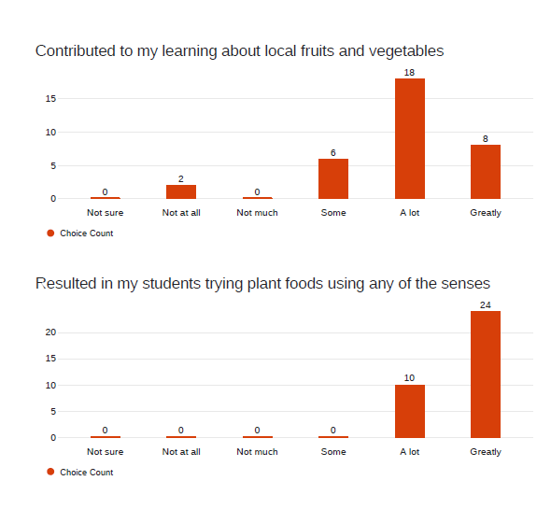
53%
24%
18%
6%
N=34
Notes:
Some questions are asked of teachers and some about students.

Slide 18
71%
29%
“My kids really got to experience trying new fruits/vegetables and being willing to try new foods. They loved that they didn't necessarily have to taste the items to experience them. They also adored planting seed because we have a new garden being installed in our school. The buy in was great!”
Notes:
Question for students.

Slide 19
47%
47%
6%

Slide 20
62%
38%

Slide 21
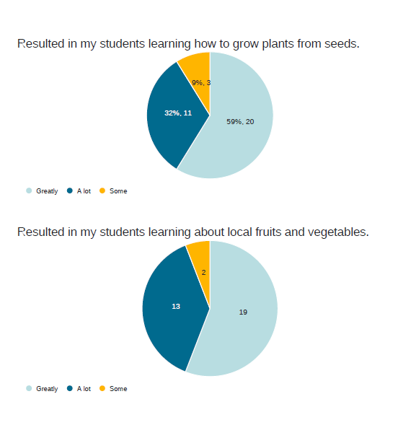
“Thanks to this program my classroom has developed a passion for gardening and is the most active group taking care of the school garden. Weekly writing prompts were used during writing time. The plant starters were transferred to our school garden additionally some students took starters home.”

Slide 22
6%
38%
56%
Notes:
Funds for produce tasting were for local produce. The local produce guide was developed to help teacher purchase local tastings for their students. In addition, Oregon Harvest for Schools videos developed by Food Hero and ODE are featured in each lesson.

Slide 23
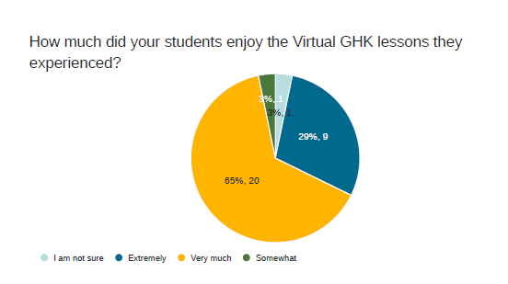

Slide 24
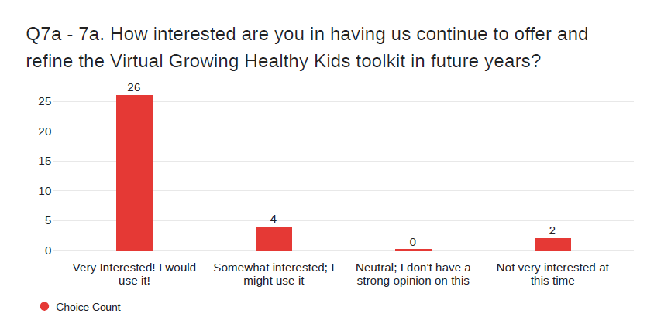
81%
13%
6%
Notes:
Interest in using again.

Slide 25
Adaptations/Updates over the Years
Soil measuring→ individual bags
Cups → containers
Focus on growing feasible items in the classroom
Radish, lettuces, herbs
Tasting as microgreens
Adding in the OSU Microgreens course as an educational option
Including a writing prompt for each lesson (teacher request)
Supplying the physical mission logs instead of the virtual option in GHK
Local Produce Guide
Funding for local produce tastings

Slide 26
Spring 2024
Local farmer grows produce tastings for lessons
Hire student worker to deliver to schools
**Depends on receiving supplemental funding
Why?
All funding for food stays local
Students try/learn about local foods
Easier for teachers
Some teachers reported that it was hard to find local produce in April-May
In 2023, 69% of funds for produce tastings were used and 31% were returned.
17 teachers purchased from local sources, but many went to grocery chains.
~20 different local sources of purchases

Slide 27
Thank you!
Questions?
Contact: Carly Kristofik; carly.Kristofik@oregonstate.edu

