Slide 1
The Grow This! Oregon Garden Challenge 2024
OSU EXTENSION SERVICE
January 22, 2024

Slide 2
https://foodhero.org/growthis 1. Link to sign up for households and group leaders. Ways to join the Challenge. 2. Sign-up process for Classroom Seed-Starting Kits is different.

Slide 3
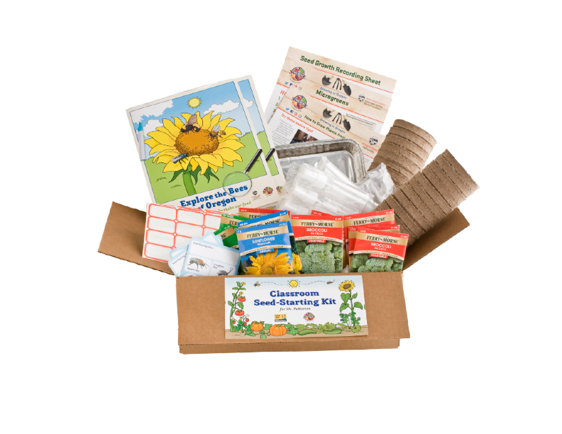
Grow This! Classroom Seed-Starting Kits
Increase by 10% (from 2022 baseline survey data) the number of classrooms/teachers from SNAP-Ed eligible schools participating in Food Hero activities.
 | 2022 | 2023
# of Classroom SS Kits Provided | 1,200 kits | 1,350 kits
# Teachers who signed up | 591 | 648
# Schools using CK | 337 schools/centers | 419
# of School Districts | 75 Oregon SDs | 123 Oregon SDs
% SNAP-eligible by FRM status | All schools eligible in 2022 | 62% eligible by FRM status
#Head Start/ELC classes | 22 | 64
Students reached with CK | 29,000 students | 40,500 students

Slide 4
Sign up Partner Teachers, Schools, Programs
Over 700 kits left; prioritize SNAP-eligible schools, Head Start & Early Learning Centers, other eligible programs like public libraries, youth treatment centers.
Encourage returning teachers and partners to take the feedback survey for early access to a classroom set of the new Explore the Bees of Oregon activity books. Feedback survey link here: https://beav.es/qAd
Invite new teachers, principals, eligible programs by email. Link to sign-up form here: https://beav.es/qW3
Include the Grow This! flyer, English and Spanish, for teachers to share with youth and families.

Slide 5
Group Leader Sign-Up: Garden Coordinators, Food Pantries, Libraries, Ag Fest, 4-H, and YOU
Sign up early to request specific types of seeds
Encourage returning group leaders to give us feedback, here:
Group leader and Individual sign-up link on the Grow This! webpages. One link goes to a main page with descriptions and ways to sign up for both options.
Sign up here for seeds to use with your classes and give out at events. Don’t forget to give feedback on your programs too!

Slide 6
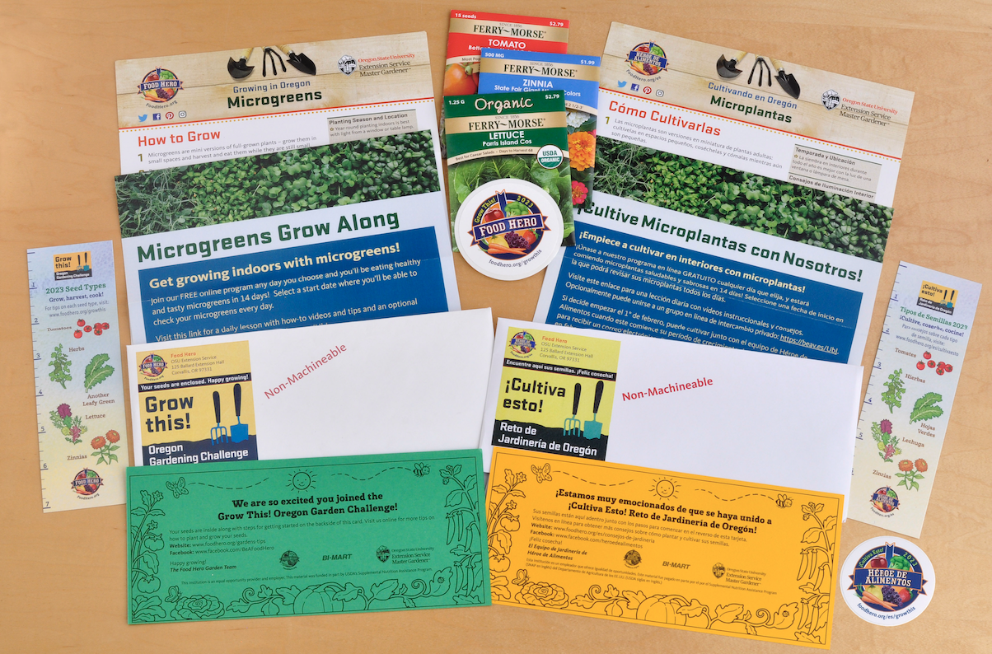
2024 Grow This! Home Envelope Kits

Slide 7
Questions?

