Slide 1
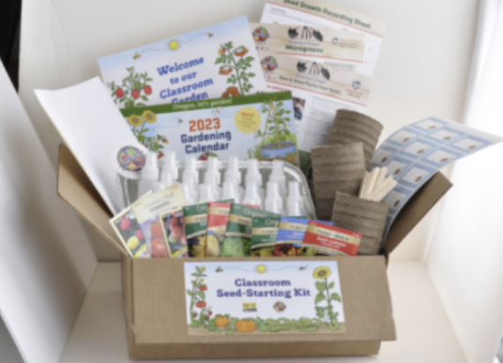
Teachers and educators: have you ever used a Grow This! Oregon Garden Challenge kit?
Start here:
https://beav.es/qAd
Take ten minutes to share your thoughts
Get early Access to Sign up for the 2024 kits!
Kits will Be Shipped in late February
As a Bonus, Request a Classroom Set of:
the new-edition Explore the Bees of Oregon activity books
2023 Gardening Calendars (or both)

