Slide 1
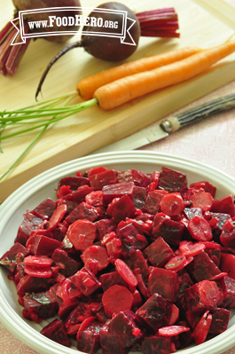
HARNESS THE POWER OF
SEARCH ENGINE OPTIMIZATION
WITH FOOD HERO
RECIPE COMMENTS

Slide 2
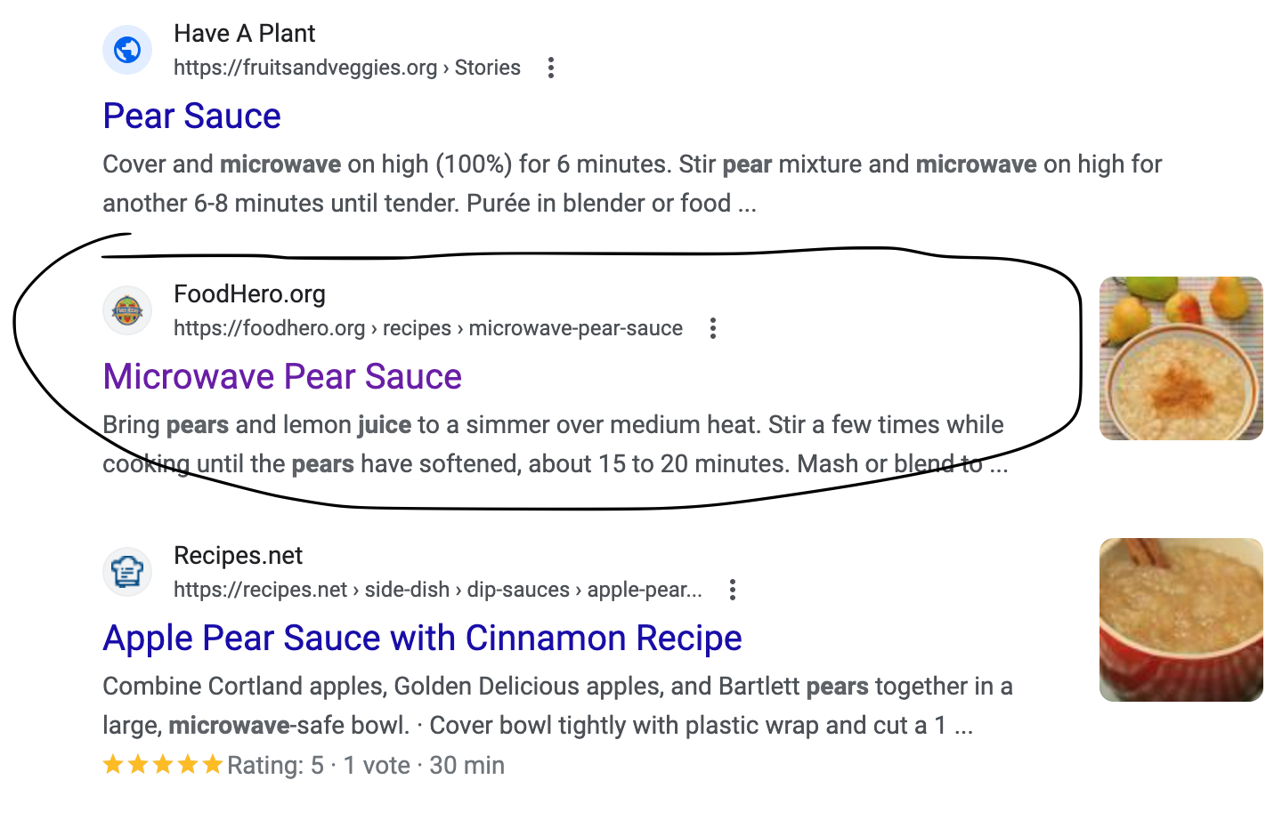
Search Engine Optimization
Search Engine Optimization is a process that aims to increase a website’s traffic by increasing its visibility in search engine results.
For example, it allows a recipe to show up in the search engine results when a person is Googling for things like “easy weeknight dinners” or “microwave pear sauce.”
Oregon State University Extension

Slide 3
How can you help?
Improve Food Hero’s SEO and bring more people to Food Hero
PLEASE add recipe comments that describe your experience and results with recipes in ways that include “key words”
Key words are those words and phrases that cooks might use in searching for a recipe or types of recipes…
Examples include “best skillet meal,” “favorite blueberry muffins,” “easy weeknight meal,” “delicious peanut sauce,” “tasty vegetables my kids loved,” “healthy snack that tastes great”
The more recipe comments we add, the more key words that can be found, the more likely online searches will include our recipes…and this helps our efforts to reach more Oregonians!
Oregon State University Extension

Slide 4
How to add recipe comments
1. Register to create a new Food Hero account
OR
log in to your existing account.

Slide 5
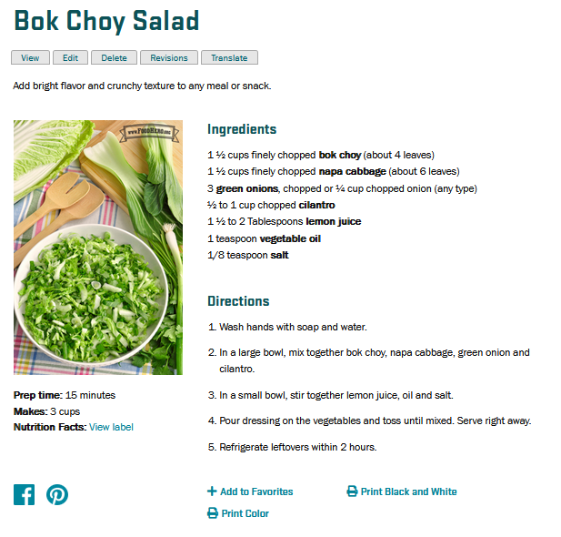
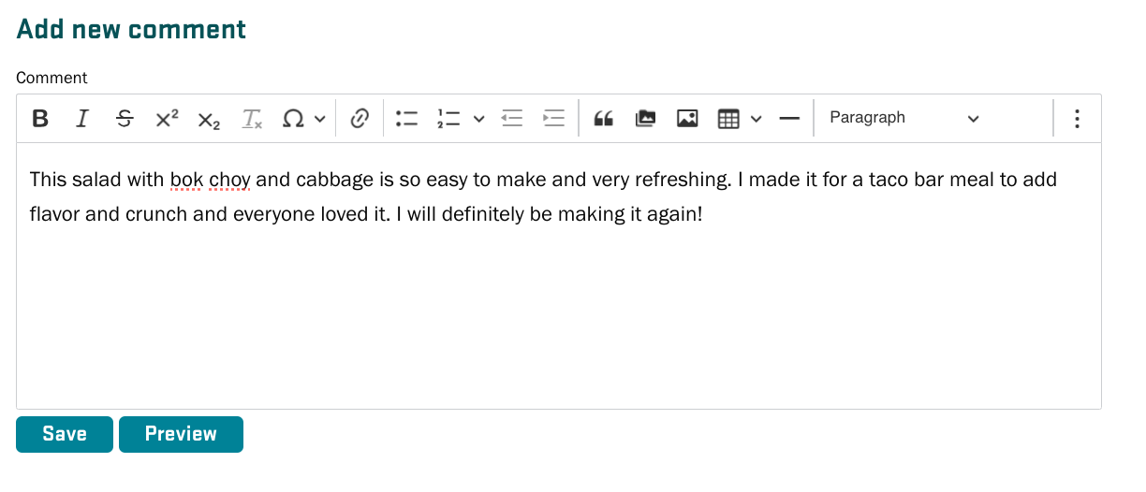
How to add recipe comments
2. Find the recipe you want to comment on. Scroll to the bottom of the recipe page.
Type in your comments. Save when finished.

Slide 6
Please, add recipe comments!
Some tips:
Keep your use of key words sounding natural (don’t “stuff” them).
Think back to recipes you’ve made in the past for home, schools, farmers markets, food banks and other places. Leave comments that help your colleagues, partners and SNAP-Ed clients to know what’s valuable about the recipes.
Try recipes new to the website/new to you and provide your comments.
Our goal is for each recipe to have at least 5 comments. More is even better!
THANK YOU!

