Slide 1
Family & Community Health Updates from Allison Statewide FCH/SNAP-Ed Meeting September 26, 2022
College of Public Health and Human Sciences

Slide 2
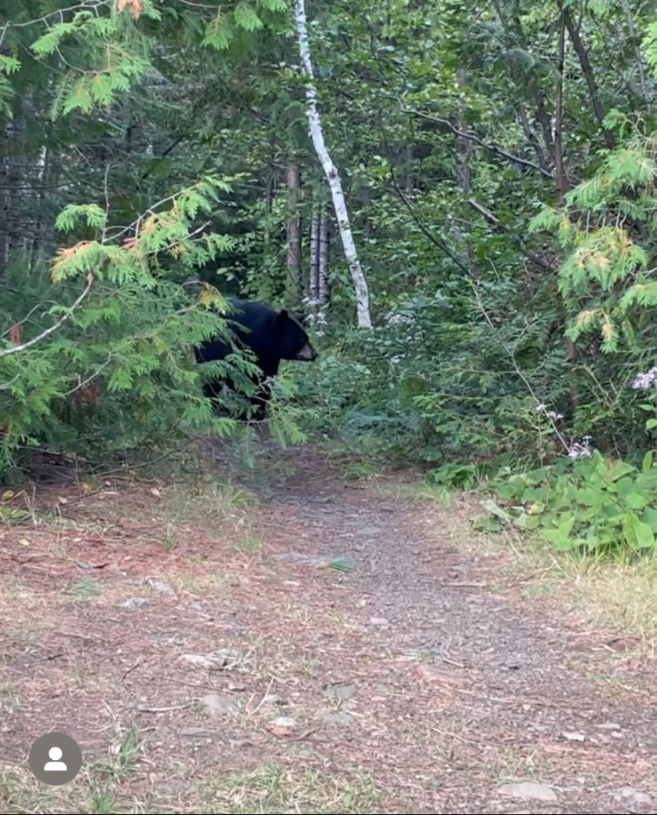

Slide 3


NEAFCS Updates
Notes:
Special thanks to Lauren Kraemer who serves as the VP of Awards and Recognition for our Oregon affiliate of NEAFCS. We received 5 national and 9 regional awards earlier this month. NEAFCS received 522 awards applications from 38 states! We are so pleased that our team members were chosen to receive national recognition for our work.

Slide 4
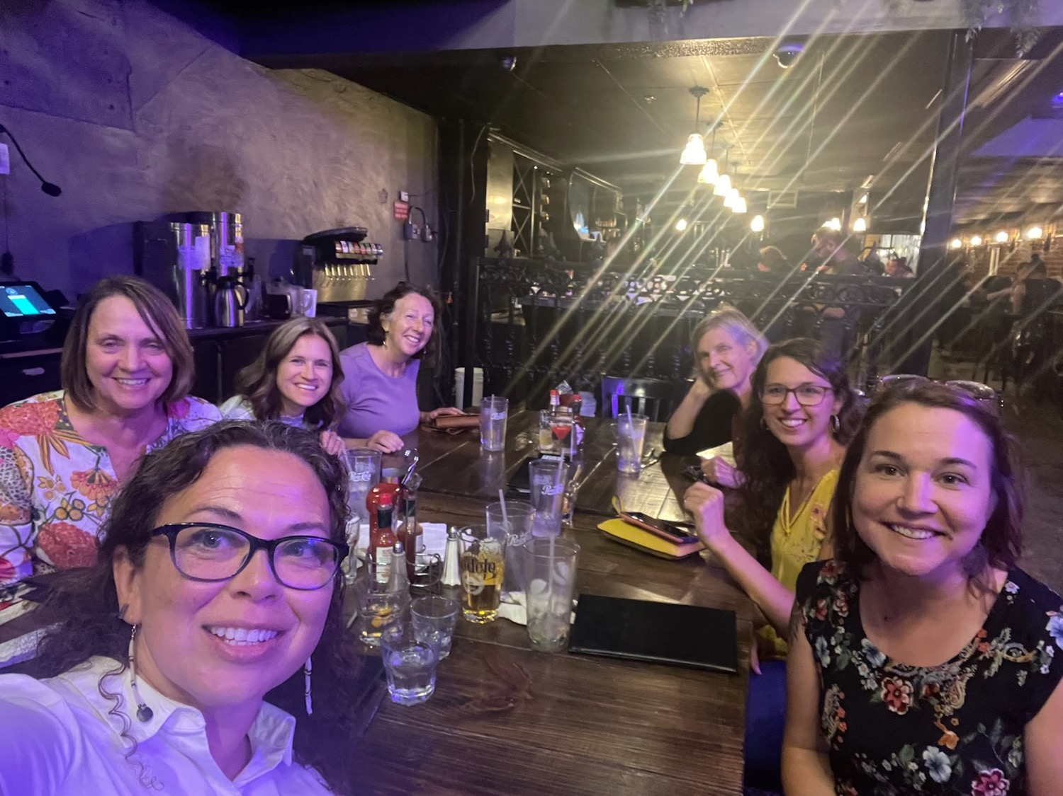

Slide 5
Mary W. Wells Memorial Diversity Award
1st Place National Winner
1st Place Western Region Winner
Indigenous Peoples’ Workgroup
Olivia Davis and Danita Macy

Slide 6
Extension Disaster Education Award
1st Place National Winner
1st Place Western Region Winner
Creating a Culture of Preparedness Publications Support Oregonians in Preparing for the Cascadia Subduction Zone Event and Other Disasters
Lauren Kraemer, Glenda Hyde, Lynette Black, Catalina Frank, Ann Murphy, Janet Donnelly, Greg Aronoff, Stephanie Russell, Brenda Marty-Jimenez, Jim Sloan, Patrick Corcoran

Slide 7
Communications Newsletter Award
2nd Place National Winner
1st Place Western Region Winner
Food Hero for Older Adults: A focus on key nutrients, food and physical activity.
Cheryl Kirk, Sally Bowman, Rose Jepson-Sullivan, Dusti Linnell, Christine Mouzong, Thomas Packebush, Ellen Radcliffe, Carol Walsh, Lucy Huffman, Anne Goetze, Laura LaMotte

Slide 8
School Wellness Award
3rd Place National Winner
1st Place Western Region Winner
Growing This! Oregon Garden Challenge Supports Schools and Teachers
Mandy Hatfield, Sally Bowman, Lauren Kraemer, Katie Ahern, Cheryl Kirk, Maureen Quinn, Kathy Bates, Jenny Boyle, Kristina Parry, Lauren Tobey, Christine Mouzong, Gail Langellotto, Brooke Edmunds, Hallie Cousineau, Carol Walsh, Lupita Zamora Estrada, Stephanie Russell, Joyce Senior Angulo, The Oregon Bee Project, Potato Commission, and Bi-Mart

Slide 9
SNAP-Ed/EFNEP Educational Program Award
3rd Place National Winner
3rd Place Western Region Winner
Growing This! Oregon Garden Challenge Supports Schools and Teachers
Mandy Hatfield, Sally Bowman, Lauren Kraemer, Katie Ahern, Cheryl Kirk, Maureen Quinn, Kathy Bates, Jenny Boyle, Kristina Parry, Lauren Tobey, Christine Mouzong, Gail Langellotto, Brooke Edmunds, Hallie Cousineau, Carol Walsh, Lupita Zamora Estrada, Stephanie Russell, Joyce Senior Angulo, The Oregon Bee Project, Potato Commission, and Bi-Mart

Slide 10
Communications Educational Publications Award
1st Place Western Region Winner
BE Physically Active Today 2Day Electronic Flyers
Katie Ahern, Mandy Hatfield, Kathy Gunter, Kaitlin Greene

Slide 11
Family Health & Wellness Award
2nd Place Western Region Winner
Tailoring an Adult Physical Activity Program to Meet Needs During and After the COVID-19 Pandemic
Allison Harris, Sally Bowman, Erin Taylor, Laura Ridler, Nikki Prosch, Hope Kleine, Nancy Mears, Brooke Walker, Nick Turkas, Lucy Lores, Yolanda Marquez, Rena Titus, Beatriz Botello—Salgado, Rebecca Fallihee, Ellen Radcliffe, Shannon La Fon, Matilde Rodriguez, Maureen Quinn, Deb Warnock, Shana Withee, Stephanie Stuart, Elena Illescas

Slide 12
Innovative Youth Development Programming Award
3rd Place Western Region Winner
Find a Need and Fill It: Offering Afterschool Programs When the School Can’t
Cindy Brown

Slide 13
Community Partnership Award
3rd Place Western Region Winner
Indigenous Peoples’ Workgroup
Danita Macy, Olivia Davis, Sara Olson, Rosanna Sanders, Patty Case, Amanda Hatfield, Carly Kristofik, Christopher Scadden, Renee Johnson

Slide 14

CPHHS All College Meeting
Watch it here!
https://live.oregonstate.edu/
Dean’s Remarks @ ~ 11 minutes
Zoom meeting 10/6 to discuss reorganization of the college: update and launch streamlined process
Going to be leading college of our type (R1, LGU, CEPH accredited) to truly integrate research, teaching, and outreach/community engagement
“Soon going to have an Associate Dean for Outreach and Engagement leading a unit with improved infrastructure”
New Roles @~ 30 minutes
Promotions/Tenure @ ~ 1 hr 6 minutes
Awards @ ~ 1 hr 9 minutes
Notes:
ADOE job description/announcement in an email from Kaycee Headley on September 8, 2022 with “Internal Opportunity” in the subject line.

Slide 15
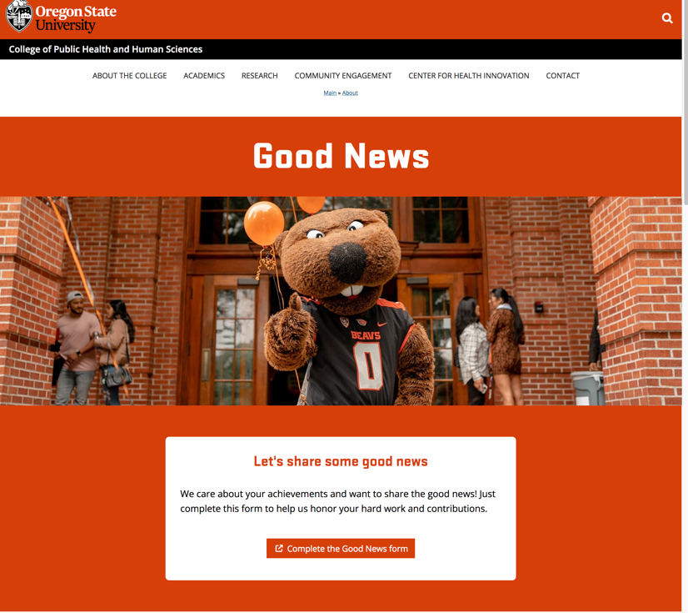
Sharing Good News!
https://health.oregonstate.edu/good-news

Slide 16
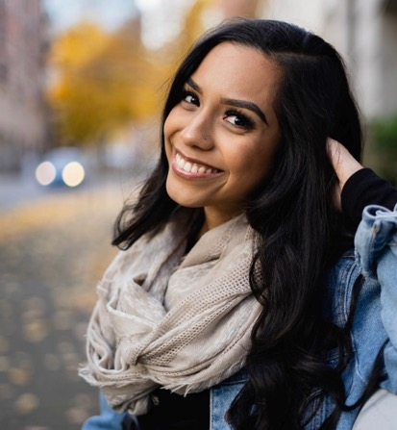
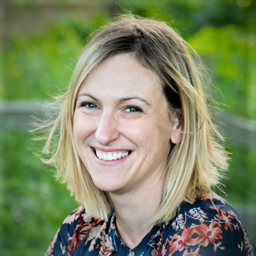
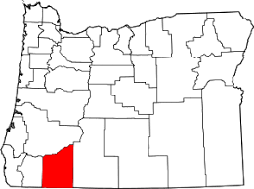
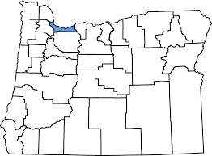
New faculty, staff & roles | Extension FCH
Guadalupe Estrada
Education Program Assistant 2
Portland/ Metro
Courtney Olcott
Assistant Professor of Practice
Central Point/ Jackson County
OREGON STATE UNIVERSITY | COLLEGE OF PUBLIC HEALTH AND HUMAN SCIENCES
Notes:
Lupita received her Bachelor of Science degree in public health from Oregon State University
Courtney Olcott received her PhD from Indiana University in Public Health and enjoys hiking, spending time with family and friends, and reading mystery novels.

Slide 17
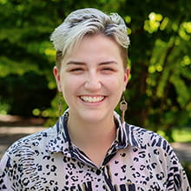
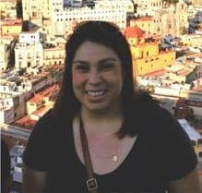
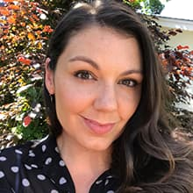
New faculty, staff & roles | Extension FCH
Oregon Parenting Education Collaborative​
Linse Sullivan
Administrative Program Assistant
Brenda Ulloa
Outreach Coordinator
Patricia Foster
Outreach Coordinator
OREGON STATE UNIVERSITY | COLLEGE OF PUBLIC HEALTH AND HUMAN SCIENCES
Notes:
Prior to coming to Oregon State University and OPEC, Linse was a general music teacher and still loves to teach early childhood music classes.
Brenda enjoys hiking and completing Disney puzzles with her fiancé
Patricia has worked with the Oregon Parenting Education Collaborative, a program that receives technical assistance from Oregon State University since 2016. When she is not working, she is spending most of her time coaching her 8-year-old daughter in volleyball and chauffeuring her 13-year-old son from one soccer game to the next

Slide 18
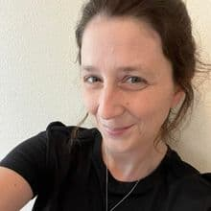
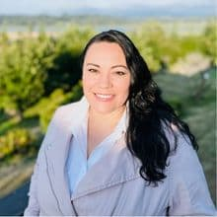
New faculty, staff & roles | Extension FCH
Oregon Parenting Education Collaborative​
Chelsea Hamilton
Outreach Coordinator
Amanda Casian
Outreach Coordinator
OREGON STATE UNIVERSITY | COLLEGE OF PUBLIC HEALTH AND HUMAN SCIENCES
Notes:
Chelsea Hamilton joins the OSU/OPEC team after 10 years of working in partnership with the initiative through other organizations. Being a part of the leadership has been her dream for many years, and she is excited to join here at OSU.
Amanda enjoys spending time cheering on her daughters during their sports activities. Her dog loves joining in on the fun, and together they are creating priceless memories.

Slide 19
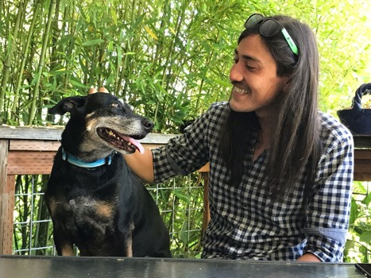
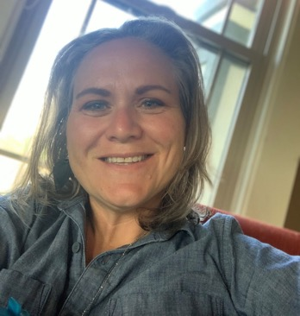
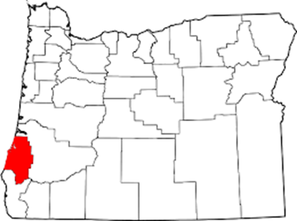
New faculty, staff & roles | Extension FCH
Tyler Spofford
SNAP-Ed/Horticulture Gardening Program Coordinator
Corvallis/Benton County
Samantha Clayburn
Master Food Preserver/ Master Gardener Program Coordinator
Myrtle Point/Coos County
OREGON STATE UNIVERSITY | COLLEGE OF PUBLIC HEALTH AND HUMAN SCIENCES
Notes:
Tyler is a recent graduate from OSU where he researched the costs and benefits of container gardening with Dr. Gail Langellotto
While new to this position, Samantha has actually worked for OSU for 8 years now starting as an office specialist in the Coos County Extension Office. In her spare time, she is also the mayor of Myrtle Point where she was born and raised.

Slide 20
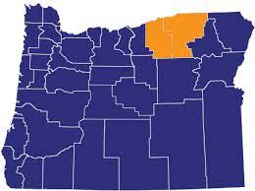
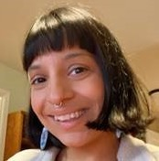
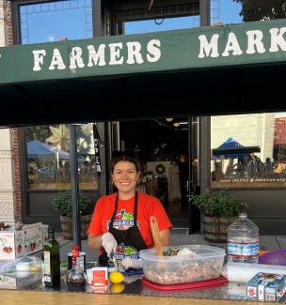
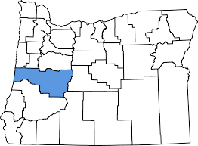
New faculty, staff & roles | Extension FCH
Dalia McMullin
Education Program Assistant/ SNAP-Ed
Eugene/Lane County
Carolina Muniz
Education Program Assistant 2
SNAP-Ed Umatilla/ Morrow
OREGON STATE UNIVERSITY | COLLEGE OF PUBLIC HEALTH AND HUMAN SCIENCES
Notes:
Carolina, SNAP-Ed EPA2 in Umatilla/Morrow counties, her background is from La Universidad de Guadalajara in Mexico. She really enjoys outdoor activities like kayaking and biking and cooking healthy recipes to share with family and friends.
Dalia loves cooking, crafting, and tending to her plants.

Slide 21
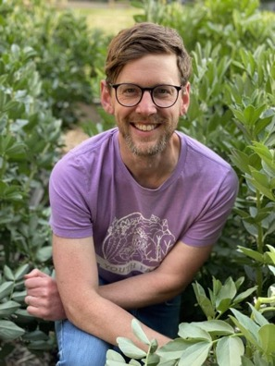
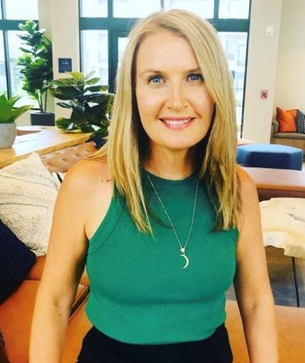
New faculty, staff & roles | Extension FCH
Jared Hibbard-Swanson
Program Manager
Food Security Food Safety
Campus
Danielle Wood
Administrative Assistant to the
Extension FCH Program Leader
OREGON STATE UNIVERSITY | COLLEGE OF PUBLIC HEALTH AND HUMAN SCIENCES
Notes:
Jared is a food systems advocate and organic farmer with a PhD in philosophy.
Danielle moved here 6 months ago from Philadelphia, Pennsylvania. She loves spending time with her husband in the outdoors, reading, cooking or doing some sort of physical activity like running.

Slide 22
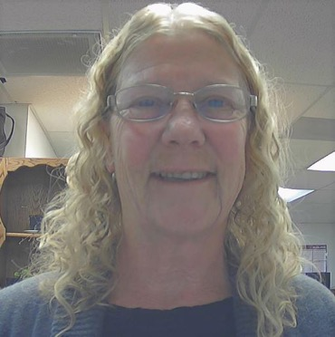
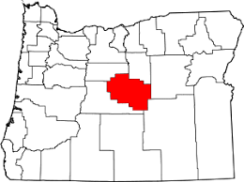
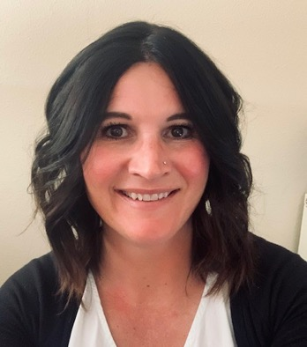
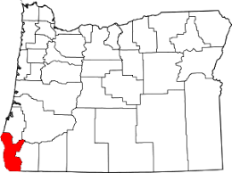
New faculty, staff & roles | Extension FCH
Linda Pinkham
SNAP-Ed Program Assistant
Gold Beach/ Curry County
Shawna Holland
Educational Program Assistant
Prineville/ Crook County
OREGON STATE UNIVERSITY | COLLEGE OF PUBLIC HEALTH AND HUMAN SCIENCES
Notes:
Linda is a Foodie who likes to play Food Hero recipe roulette with captive audiences. She is the new SNAP-Ed Program Assistant at the Curry County Extension.
Shawna fondly remembers her 5 seconds of fame on ESPN holding her homemade sign in 2007 when the BEAVS beat UO in double overtime at Autzen! Shawna expects to be on campus as much as possible to watch athletics and visit her daughter who is starting her freshman year at OSU this fall! Go Beavs

Slide 23
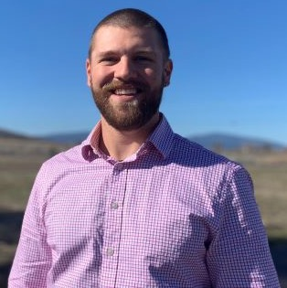
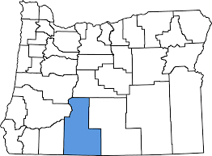
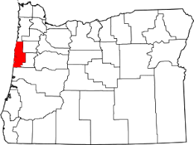
New faculty, staff & roles | Extension FCH
Nicholas Diewald
SNAP-Ed Program Assistant
Klamath Falls/ Klamath County
Jazmin Flores
SNAP-Ed Program Assistant
Newport/ Lincoln County
OREGON STATE UNIVERSITY | COLLEGE OF PUBLIC HEALTH AND HUMAN SCIENCES
Notes:
Nick is excited to gain classroom experience and confidence in organizing community support around health and wellness.
Jazmin Flores is our new SNAP-Ed Program Assistant in Lincoln County.

Slide 24
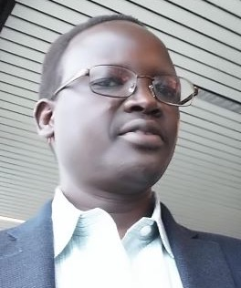
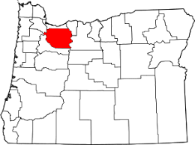
New faculty, staff & roles | Extension FCH
Abraham Piok
SNAP-Ed Program Coordinator
Clackamas County
Beatriz Salgado
SNAP-Ed/ FCH Program Coordinator
Newport/ Lincoln County
OREGON STATE UNIVERSITY | COLLEGE OF PUBLIC HEALTH AND HUMAN SCIENCES
Notes:
Abraham is our new SNAP-Ed program assistant in Clackamas County.
Beatriz Salgado is the new SNAP-Ed/ FCH Program Coordinator in Newport

Slide 25
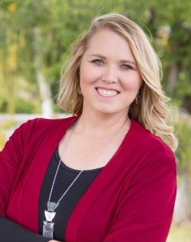
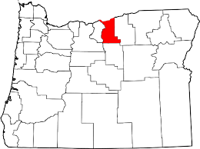
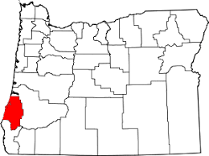
New faculty, staff & roles | Extension FCH
Nicole Wells
Educational Program Assistant
Myrtle Point/ Coos County
Jessica Barnett
Educational Program Assistant
Condon/ Gilliam
OREGON STATE UNIVERSITY | COLLEGE OF PUBLIC HEALTH AND HUMAN SCIENCES
Notes:
Jessica Barnett has joined the FCH team in Gilliam County.
And last but not least, we welcome Nicole Wells to the CPHHS community. Nicole is an EPA in Coos County.
BPHS has been growing, too. Megan MacDonald will now tell us about our new colleagues in her school, including PAC and Faculty Staff Fitness.

Slide 26

White House Conference on Hunger, Nutrition, and Health
https://health.gov/our-work/nutrition-physical-activity/white-house-conference-hunger-nutrition-and-health
Notes:
Sara Wilson Wolfe will attend the White House conference and report back to us

Slide 27
Extension Annual Conference
https://employee.extension.oregonstate.edu/resources/extension-annual-conference
Plan to join us at this year's IN-PERSON annual conference December 5 – 8, 2022!
OSU Extension Association (OSUEA) and the OSU Extension and Engagement Director’s Office are partners in bringing together this important professional development, recognition, and networking opportunity for all statewide Extension faculty and staff.
All OSU Extension and Engagement faculty and staff, if able, should plan to attend this year, especially after the last few years of virtual professional development.
This year’s conference theme will be GETTING BACK TO ENGAGEMENT.
FCH portion is Tuesday December 6, 8 am to 12 noon
No FCH content is being planned for Monday December 5th – Remember we took the “middle path” option

Slide 28
Family & Community Health Updates from Allison Statewide FCH/SNAP-Ed Meeting September 26, 2022
College of Public Health and Human Sciences

