Slide 1
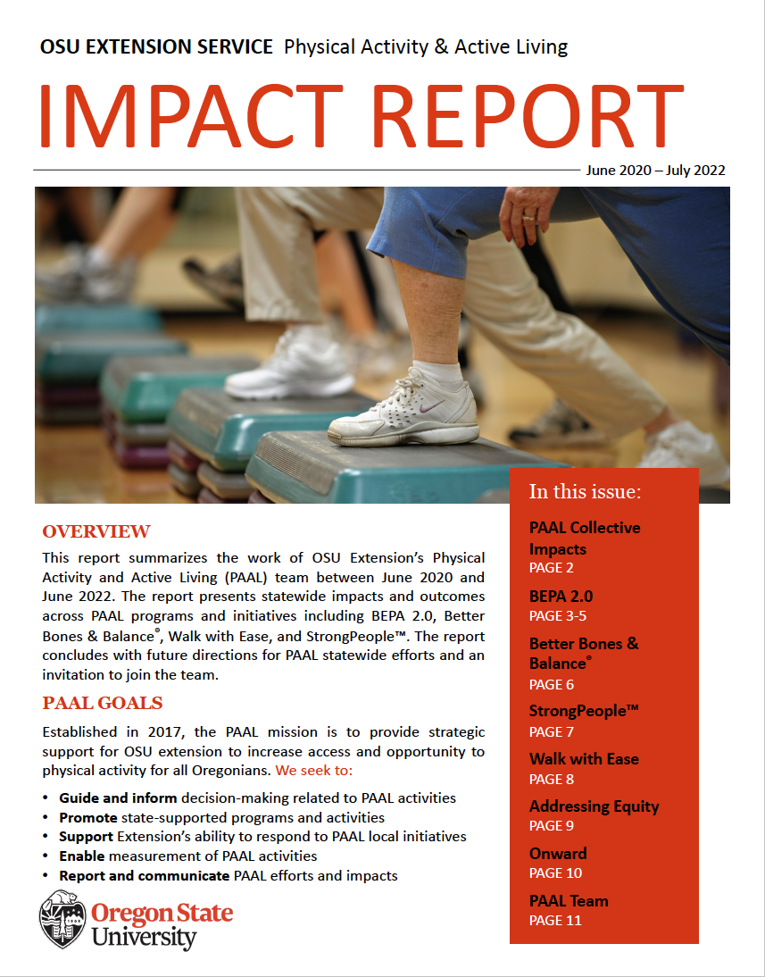

Physical Activity & Active Living (PAAL) Team
Announcements
PAAL Impact Report in or coming to your inboxes!
BEPA 2.0 Online Training is available for onboarding or outreach activities.
Do you need support for walkability initiatives in your county?

