Slide 1

College of Health
OSU Extension – Family & Community Health
Oregon’s
WALK WITH EASE
Program Introduction
Notes:
Add brief introduction to the WWE program
- evidence-based walking program designed to meet people where they are at and help them get up and moving
- Targeted for people living with chronic disease, such as arthritis, and chronic disease prevention. Open to all people of all abilities.
Today I will provide a brief program overview of WWE in Oregon, share some program updates, and also provide information on how you can become an instructor (or refresher for those already trained!)

Slide 2

Walk With Ease (WWE) Program
Evidence-based physical activity walking program developed by the Arthritis Foundation
Proven to:
  Improve physical and mental health
  Teach proper stretching and pain management techniques
  Build stamina, strength, confidence and walking pace
Helps make lifestyle changes
Notes:
Walk With Ease is an evidence-based walking program, developed by the AF for people with arthritis and other chronic pain conditions.
The program is available to everyone and can be beneficial to everyone! Anyone who is hoping to be more physically active can benefit from this program. (Don’t require arthritis diagnosis to participate)
The program is proven to:
Increase physical activity
Decrease pain and fatigue
Increase physical abilities and walking endurance
Help make lifestyle changes

Slide 3

WWE in Oregon
Three versions of the program:
  Instructor led in-person classes
  Self-directed program
  Online virtual classes
OSU Extension serves as the “hub” for WWE in Oregon!
Notes:
I’d like to start by discussing the different formats that Walk With Ease is taught in. In Oregon, there are three versions of the program. [List formats]. I’m going to go through each of these formats in the following slides but we will focus primarily on the virtual program during this session.
OSU Extension serves as the “hub” for WWE in Oregon. We partner with the Oregon Health Authority and have CDC Arthritis Funds to support implementation of the program. We just received news we received funding from the CDC for the next 5 years! We are also a recent sub-awardee of an Administration for Community Living grant. We deliver in-person classes throughout the state through local Extension offices and faculty/staff and we also support community organizations that lead the program. (Such as churches, community centers, senior centers, healthcare clinics, hospitals and more).
WWE is bilingual (English & Spanish) Camine Con Gusto

Slide 4
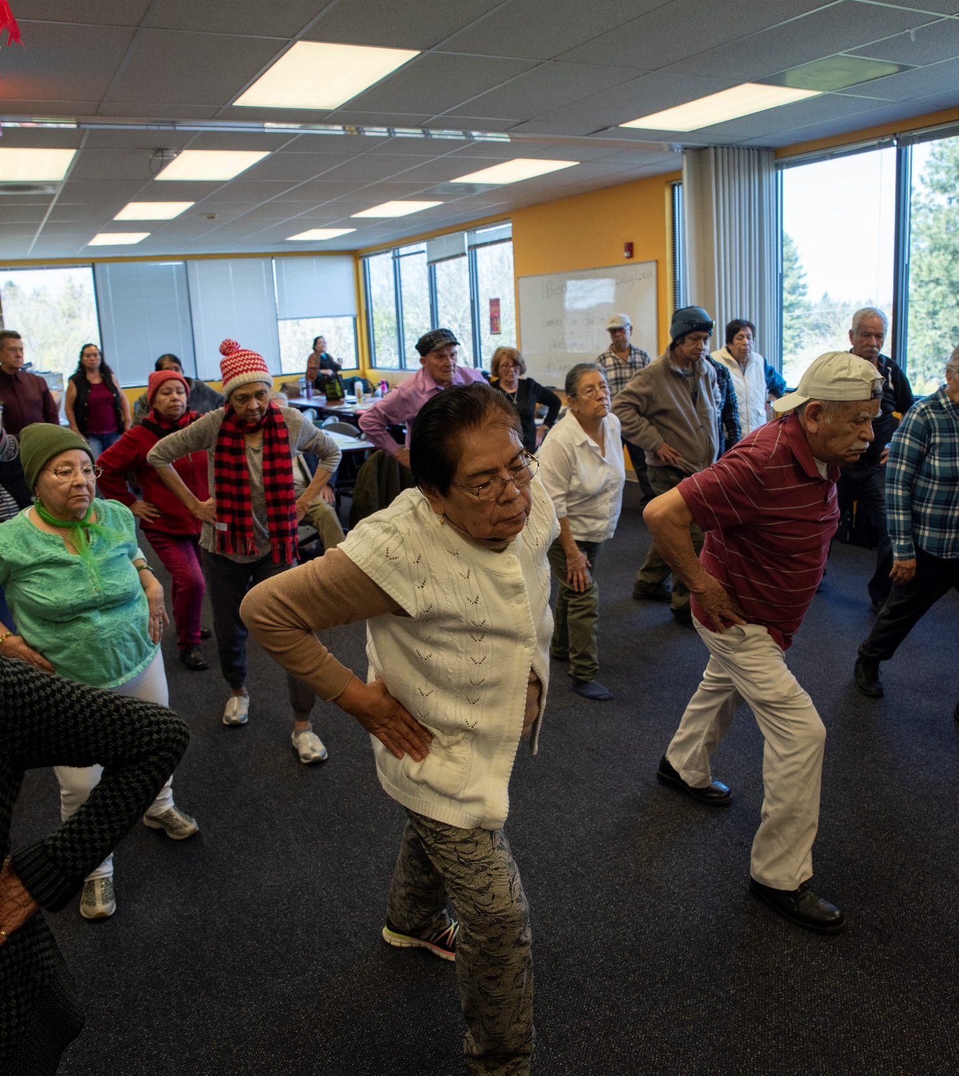
Instructor-Led
In-Person Classes
18 sessions, held over six or nine weeks
Health education and group walking
Led by a trained leader
All participants receive WWE books and water bottles
Notes:
Original format of the program
Taught by OSU Extension AND community organizations
Sessions are broken into lecturettes and group walking
Starts with a lecturette that covers topics like goal setting, creating a walking plan and walking contract, overcoming barriers, and health education for symptom management.
Each session includes:
Informational mini-lectures & health-related discussion topics
Managing chronic pain, goal setting, motivation, etc.
Group problem-solving and sharing
Warm up and cool downs including stretches and strengthening exercises
10-35 minute walking period & self-paced group walks
Each session length varies – typically 60 minutes

Slide 5
Virtual Classes
Live, webinar-based classes with a trained instructor
Six-week program with sessions held once weekly through Zoom
Includes:
  health education on symptom management, overcoming barriers, and stretching and exercising safely
  facilitated discussion
Participants walk independently throughout the week
Everyone receives a workbook by mail
Notes:
Most groups meet once per week for six weeks. These sessions include health education on symptom management, establishing a walking program, stretching and strengthening exercises, and more. There is also time allotted for social connection.
Because the program is meeting virtually, participants walk independently throughout the week.
A WWE guidebook is mailed to all registered participants.
Benefits… social connection, trained leader, structure and accountability.

Slide 6
Self-Directed Program
Participants register online and create an account
Everyone receives a free workbook (paperback or eBook)
Portal includes walking diary, weekly videos, and resources
Weekly support emails
Rolling registration
Completely independent study!
Available FREE to all Oregonians
Notes:
This is an entirely online and self-paced program.
Hosted online through the Osteoarthritis Action Alliance portal. Register online and create an account in the portal – they can choose to receive their workbook digitally or by mail.
Once participants register, they are encouraged to visit their portal account regularly to track their goals and walking minutes/time. The portal serves as a one-stop-shop for the WWE self-directed program. It has links to audio lecturettes, weekly videos, and other resources like self-tests, the walking contract, and class handouts.
Participants will also receive weekly support emails that remind them to track their minutes and provide additional links and resources, as well as homework and weekly challenges.
Some benefits of the program…
Rolling registration – you can sign up at any time and you will be automatically enrolled in the program! Once they receive their book the program starts.
Completely independent study! It’s structured as a six week course but can be done at your own pace and on your own time. There’s no in-person meet up – the physical activity portion is also entirely independent.

Slide 7
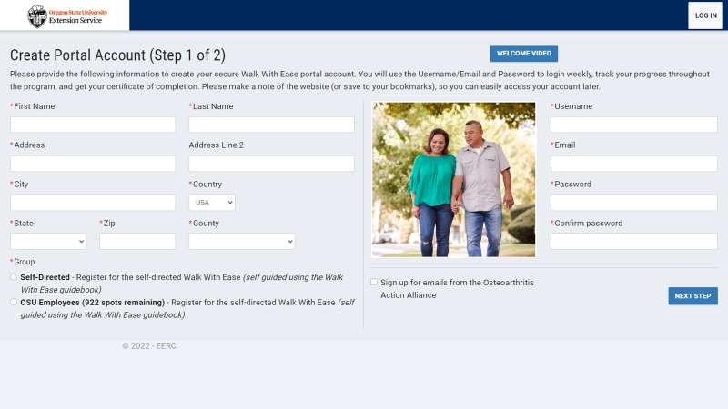
Notes:
Portal completely bilingual in English and Spanish
Since there are multiple ways to engage and connect participants to the WWE program, it is EASY to implement WWE in your communities (virtual/online options for rural communities)

Slide 8



WWE + Older Adult Behavioral Heath Initiative
OABHI statewide program through OHA
OA Behavioral Health Specialists represent each county
Partnership in Jackson County to deliver WWE
  Scaling partnership with WWE + OABHI
Notes:
frame it as an update - that you partnered with your older adult specialist in your county to deliver WWE and had an opportunity to share with the statewide group about the program and how Extension can support them. Maybe let county folks know there's a chance someone from the health dept will reach out to them and that the county health dept can be a valuable partner if they are interested in WWE. They aren't obligated to co-teach a class if someone reaches out but more as a heads up so that they aren't surprised and can share about the program/consider how they can support classes. At the very least they will know from this presentation how statewide Ext. supports WWE and can refer them to us

Slide 9
I Want to Lead a Class! – What Next?
Contact us! Email walk@oregonstate.edu
Support for leaders and classes:
Scholarships for leader training
Access to online CPR certification
Leader materials: class scripts, posters for classes, program forms, and virtual class toolkit
Marketing materials
Books and water bottles for all class participants
  Coming soon: T-shirts for leaders!
Leader support and engagement
Technical assistance through email, phone, and online
Visit walk.oregonstate.edu to learn more
Notes:
If you think this is a good fit for your county, how do you get started?
Local OSU Extension offices may be able to help support.
Specialists can lead the class!

Slide 10


Leader Training
Leader training is online & self-paced
OSU offers scholarships for leader training
OSU covers CPR certification, if needed
Notes:
Athletics & Fitness Association of America (AFAA)

Slide 11
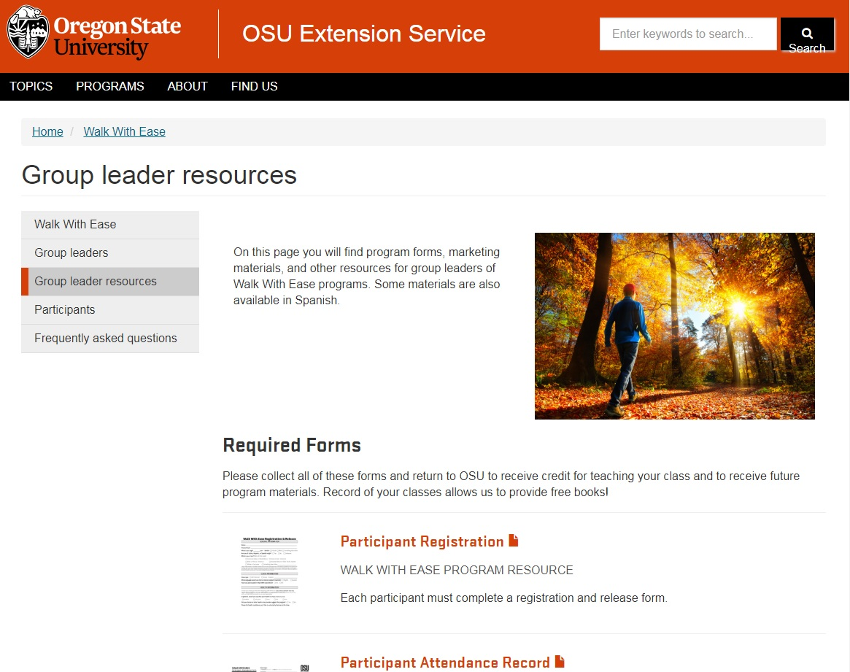
Data Reporting
Required forms:
  Participant Registration
  Attendance Record
  Program Evaluation
All program forms, marketing materials, and other resources can be located under the Group Leader Resources page at walk.oregonstate.edu
Notes:
Outside organization – enter directly in Compass
Reach out to me if you are not connected with Compass! (Outside org only)
Materials are available in English and Spanish

Slide 12
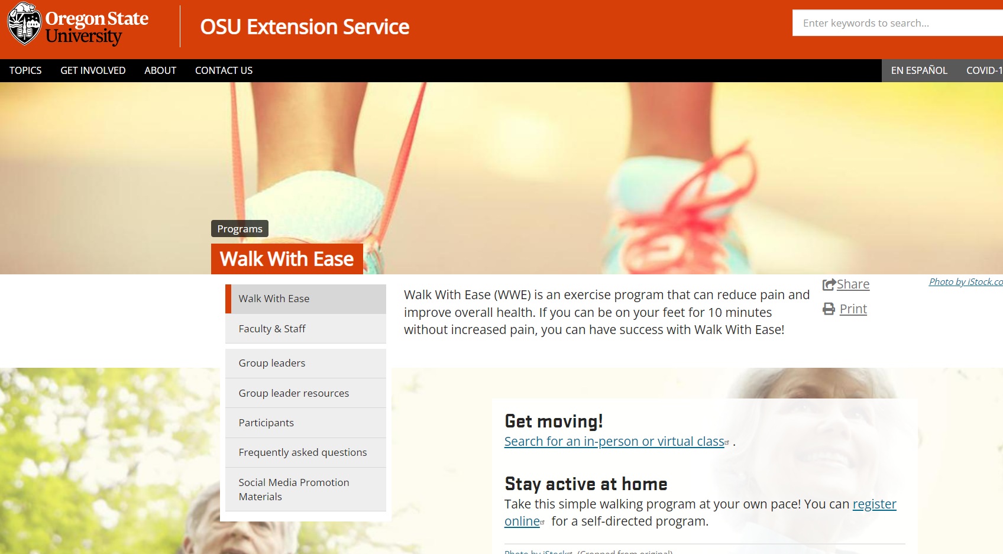
walk.oregonstate.edu
Notes:
WWE website/landing page… where you can find WWE forms, FAQs, etc.

Slide 13
THANK YOU!
Allison Harris & Ellen Radcliffe
Walk With Ease Team
Oregon State University Extension Service
walk@oregonstate.edu
Visit our website to learn more about WWE in Oregon!
walk.oregonstate.edu
Notes:
Questions?

