Slide 1
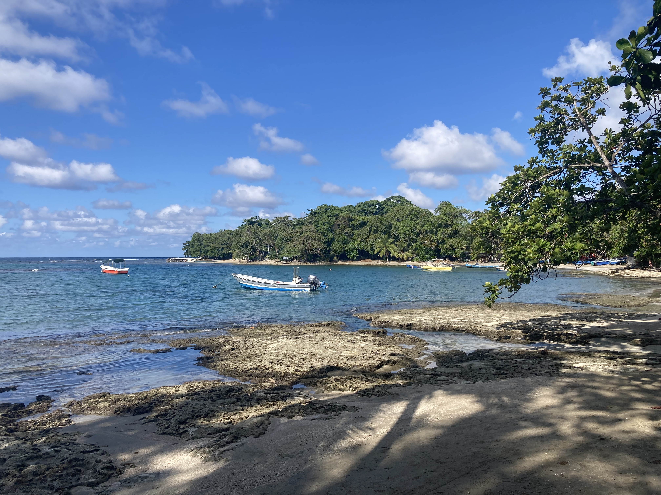

UPDATE
Our final budget for FFY2023 has been approved by the national office! 🎉
Our 2023 annual update and preliminary budget for FFY2024 are due July 1st. We did an early submission of both last week. ✅✅
Our next Zoom call will be July 10th at 9am. New calendar invite has been sent out! 😊

