Slide 1
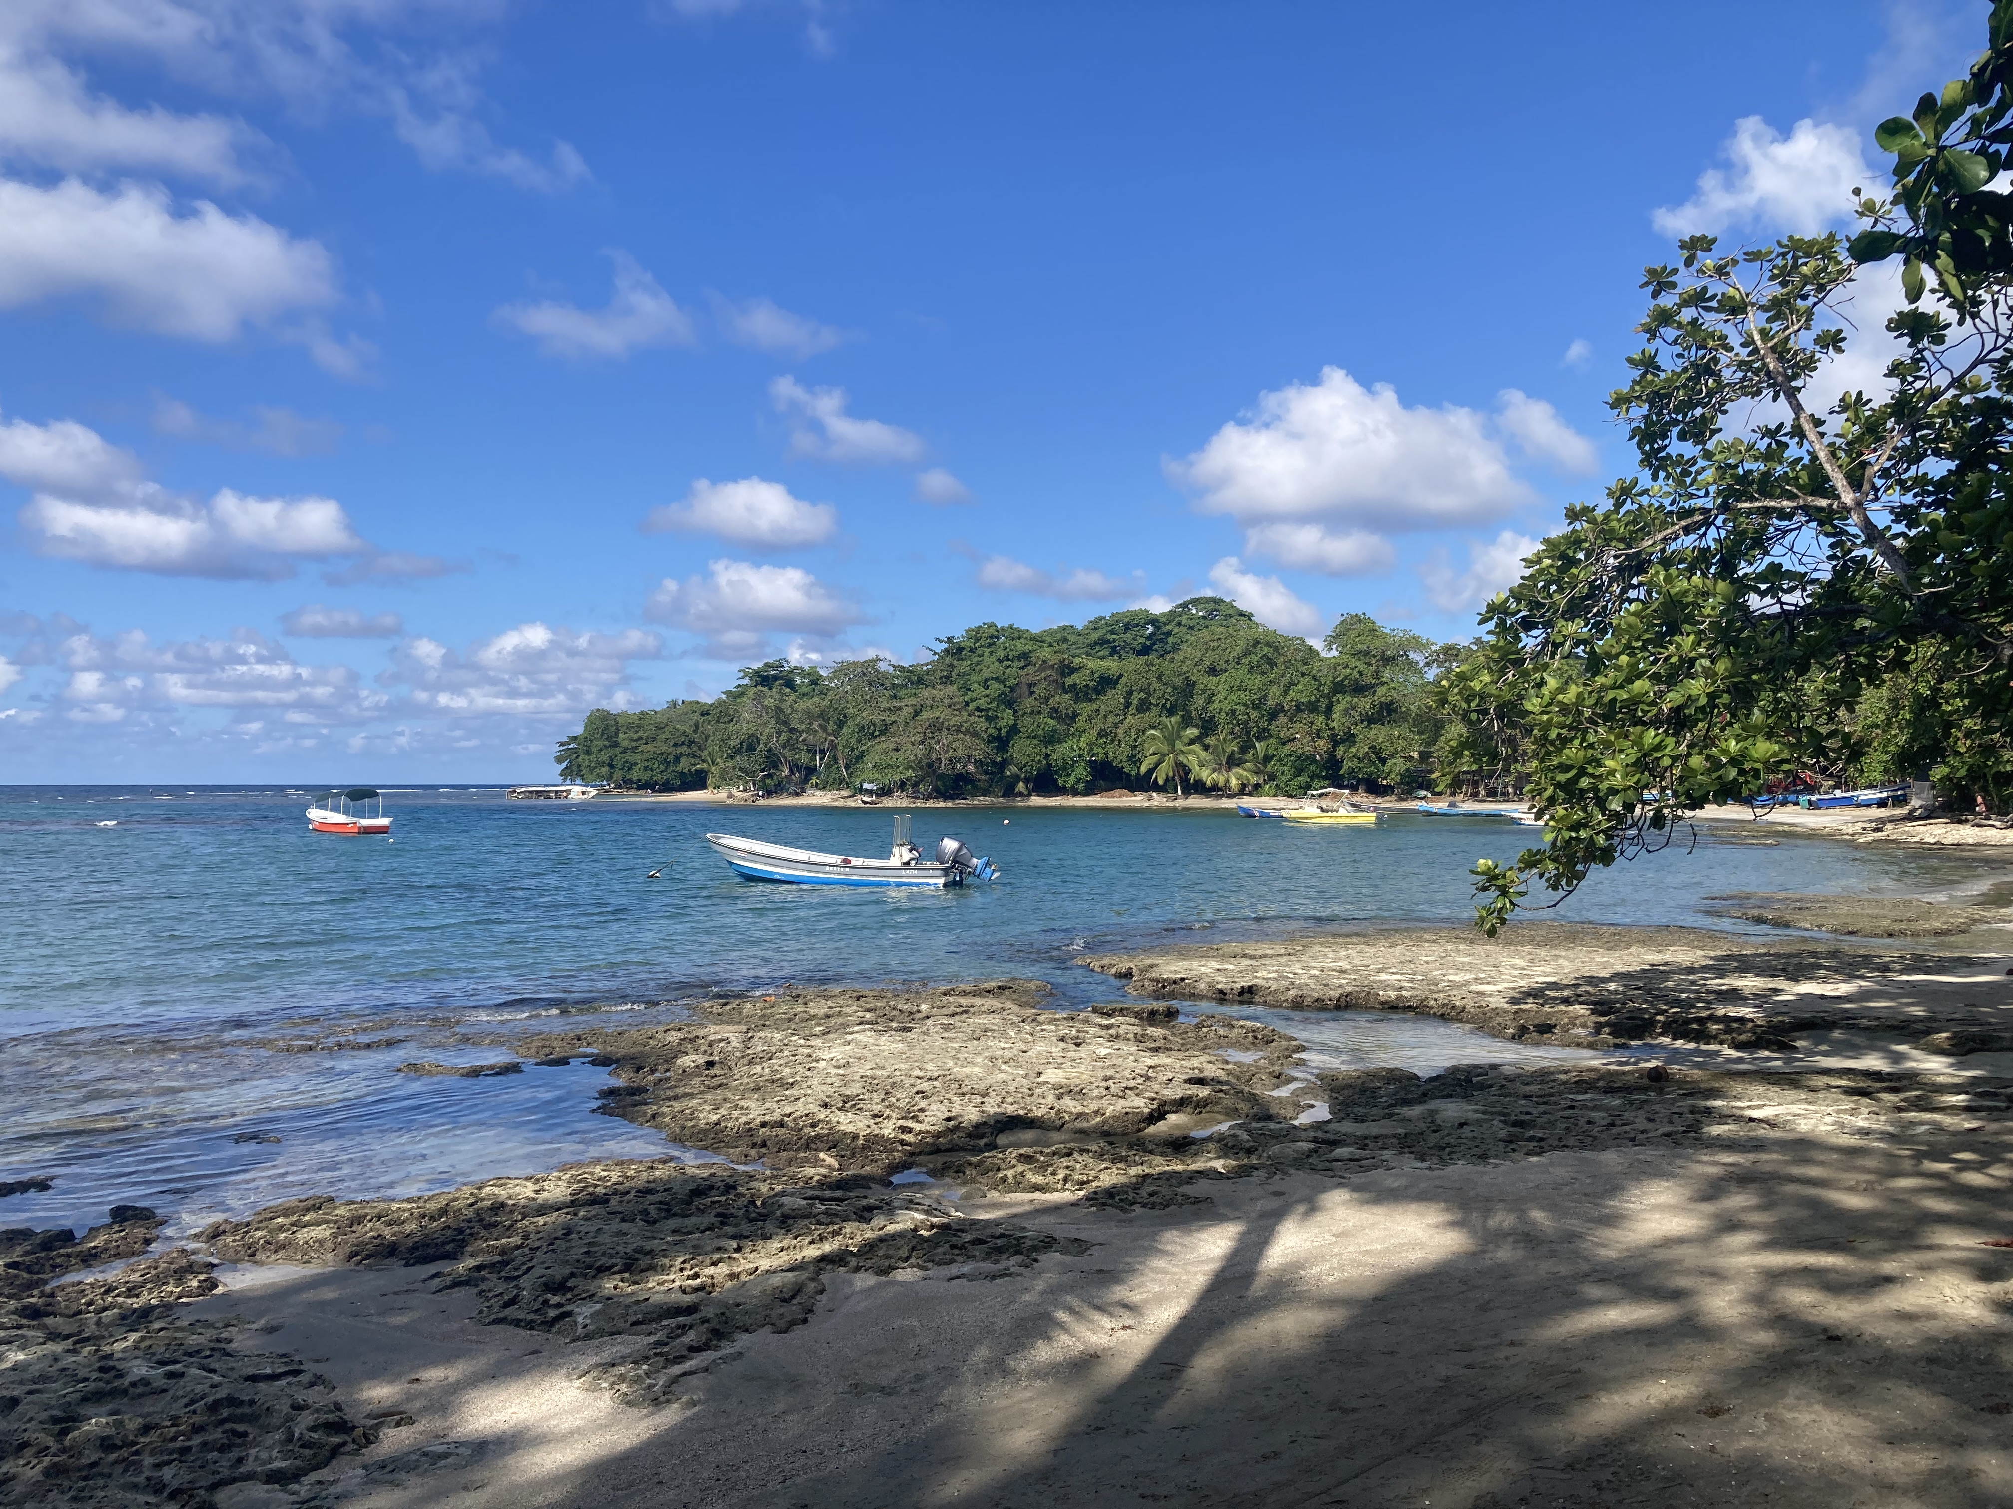

UPDATE
Our 2023 annual update and preliminary budget for FFY2024 are still in federal review.
The new 6-12 grade survey will be rolled out October 1st . Training recording and materials were sent via email on July 10th
Participant recruitment guidelines update
Our next Zoom call will be August 14th at 9am. New calendar invite has been sent out! 😊

