Slide 1
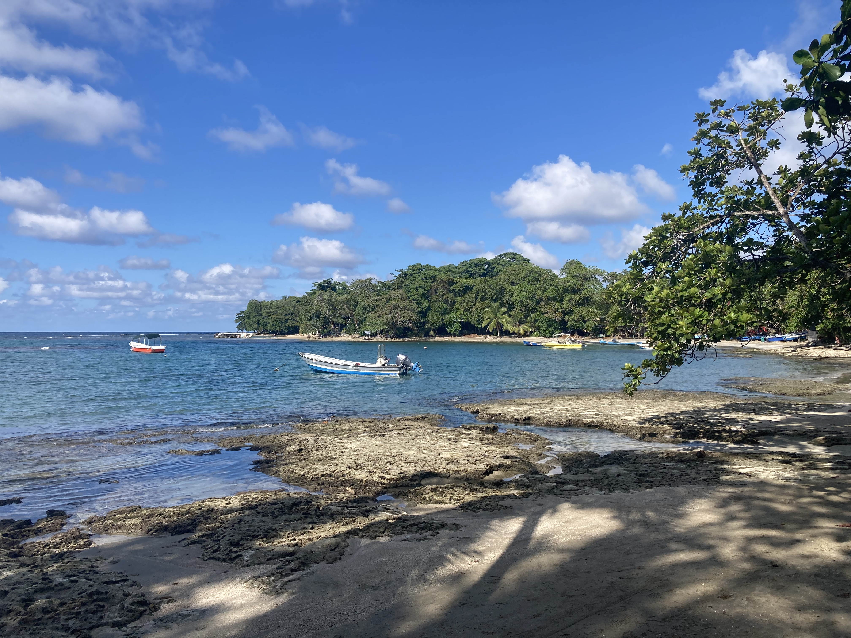

UPDATE
Our preliminary budget for FFY2024 has been approved. The 2023 annual update is still in federal review.
The new 6-12 grade survey will be rolled out October 1st . Training recording and materials were sent via email on July 10th
Participant recruitment guidelines update
The latest revision of Eating Smart ● Being Active (based on 2020-2025 DGAs) will be unveiled in the fall
Our next Zoom call will be Sept 11th at 9am. New calendar invite will be sent soon! 😊

