Slide 1
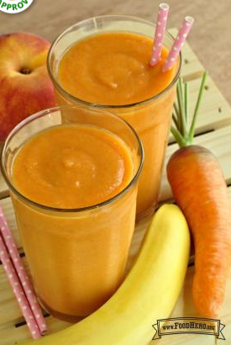
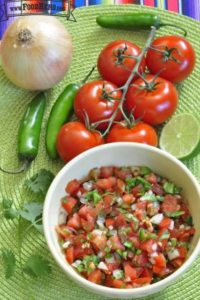
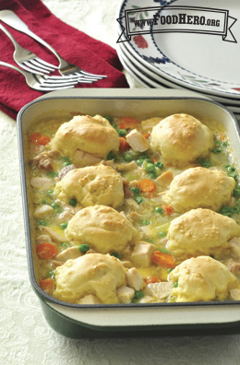
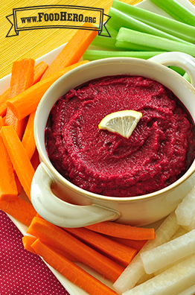

Food Hero: Recipe Selection, Nutrition Criteria and Style
OSU EXTENSION SERVICE

Slide 2

Documents
Food Hero Recipe Selection and Development Guidelines
Food Hero Recipe Nutrition Criteria
Food Hero Recipe Style Guide
NEW!
UPDATED!
UPDATED!

Slide 3
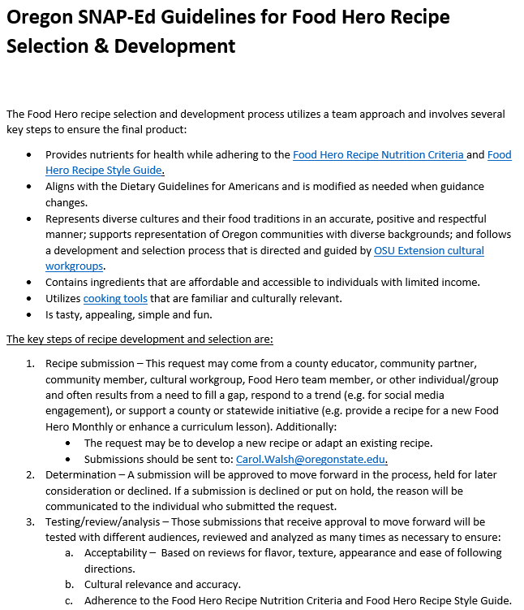

Overview
Key Steps
Submission
Determination
Testing/review/ analysis
https://nutrition.extension.oregonstate.edu/collection/food-hero-recipe-selection-criteria?check_logged_in=1

Slide 4
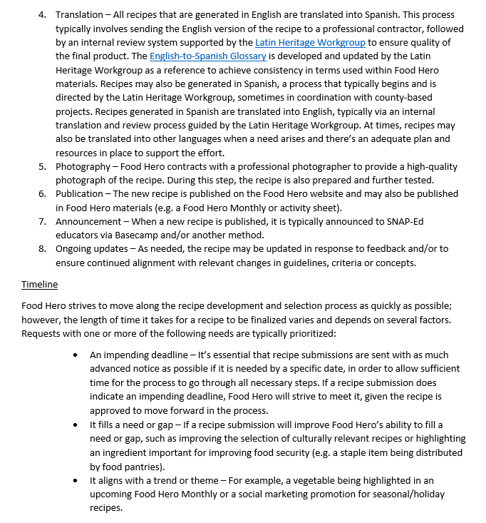
Overview
Key Steps (continued)
Translation
Photography
Publication
Announcement
Ongoing updates
Timeline

Slide 5
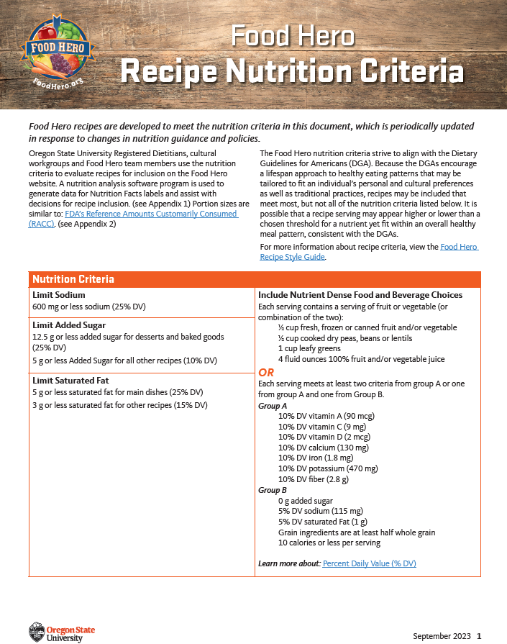
Overview
Who evaluates
Tools used
DGA alignment
Nutrition Criteria table
Recipe appendices
https://foodhero.org/recipe-criteria

Slide 6
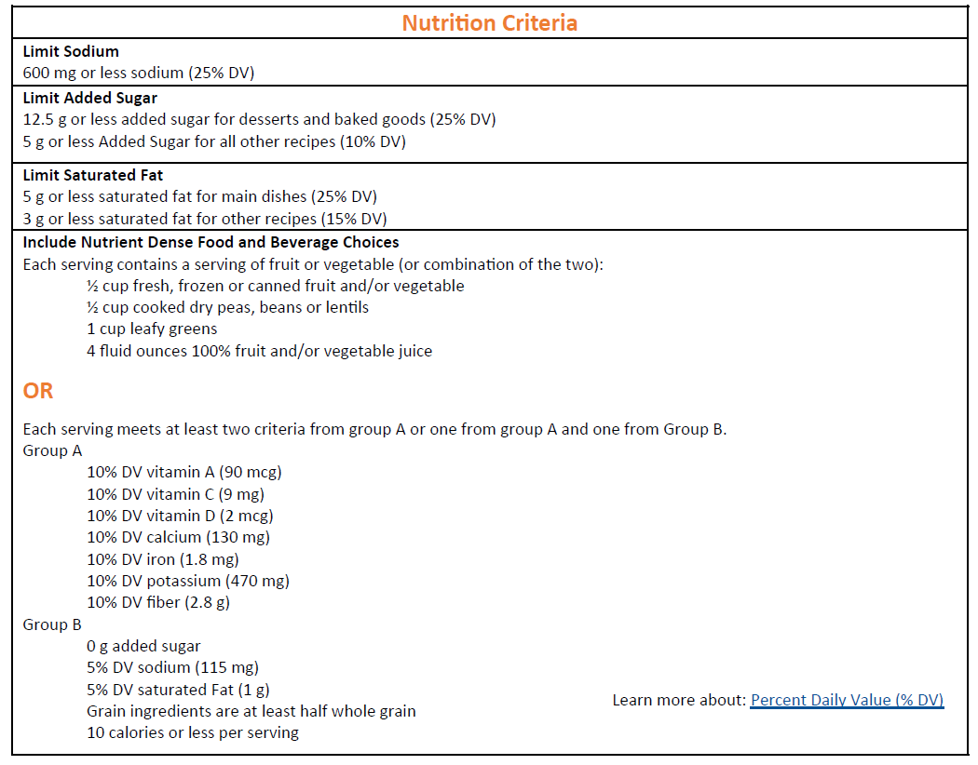

Slide 7
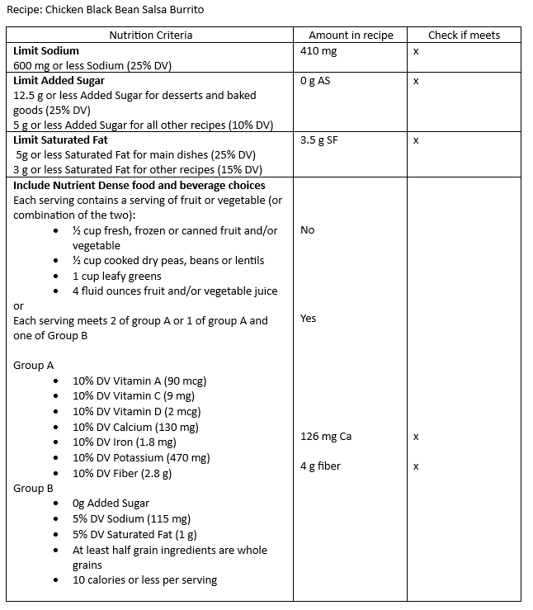
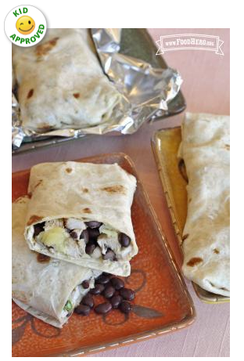

Slide 8
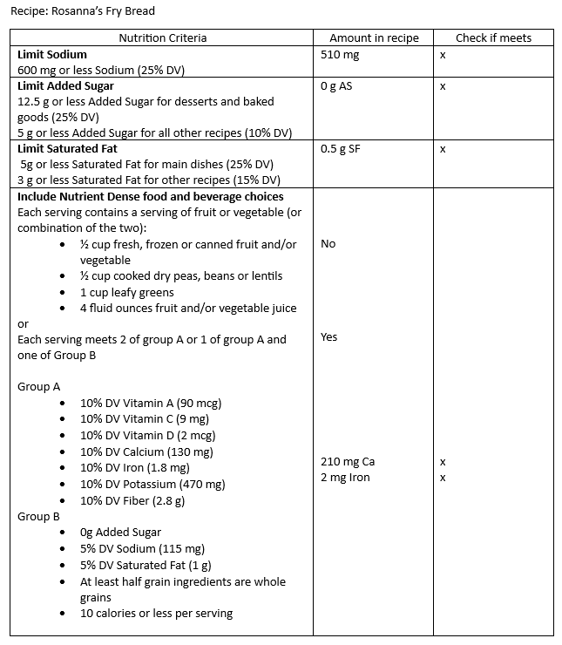
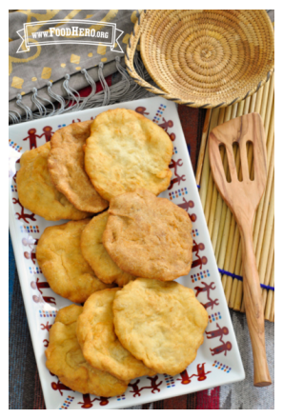

Slide 9
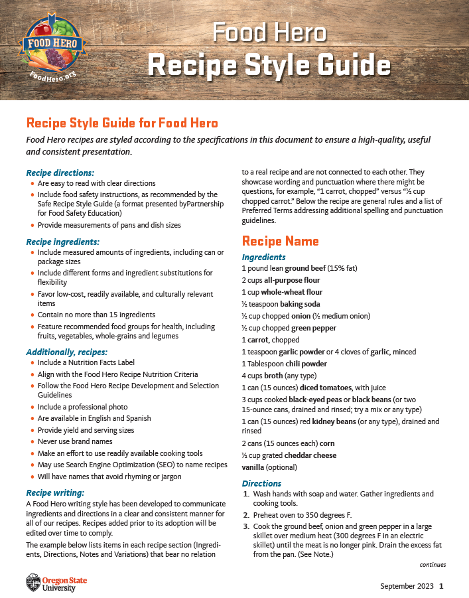
Recipe directions
Recipe ingredients
Additional recipe criteria
Recipe writing style
With examples
https://foodhero.org/recipe-criteria

Slide 10

Carol Walsh
carol.walsh@oregonstate.edu
Stephanie Russell
stephanie.russell@oregonstate.edu

