Slide 1

Food Safety Recipe Update
Frozen Vegetable Ingredients

Slide 2
National Center for Home Food Preservation annual update guidance
Commercially frozen, packaged, uncooked vegetables are not “ready to eat,” despite what you might see online.
Instructions on the packaging for reheating these vegetables should be followed.
Listeria outbreaks have been linked to commercially frozen uncooked vegetables.
Follow instructions on packaging for cooking frozen vegetables.

Slide 3
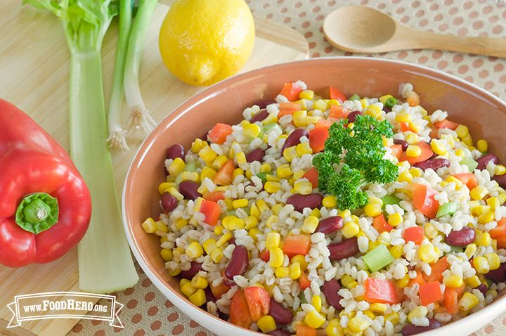
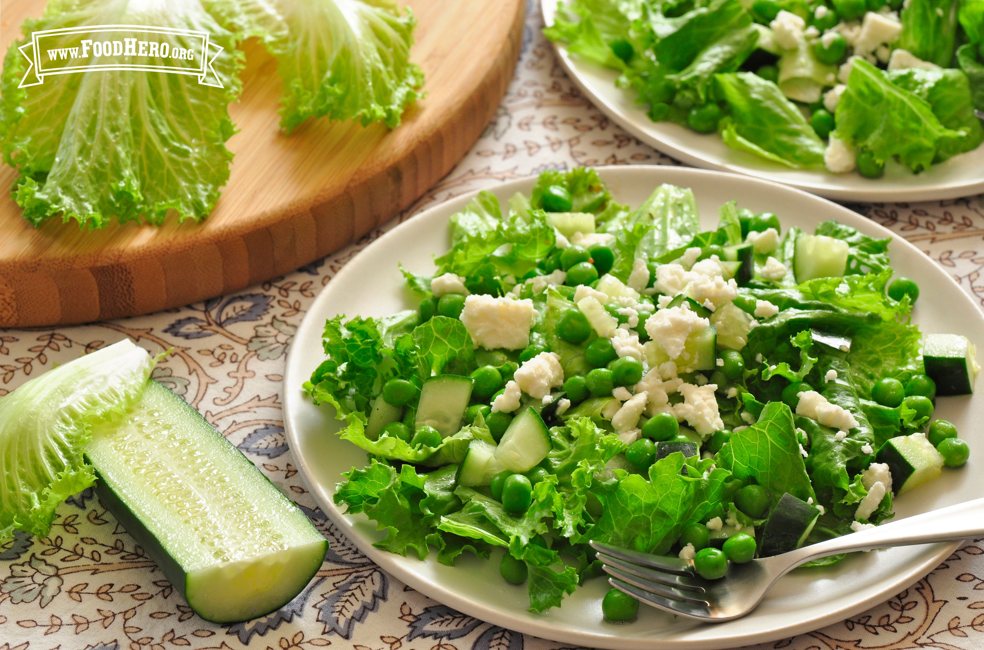
Food Hero Recipes encourage flexibility: fresh, canned and frozen
  For some recipes, cooking of frozen vegetables is not recommended when the vegetable is added to a cold salad.
For some recipes, thawed and uncooked vegetables are specified as an ingredient.

Slide 4
FH Recipes affected
Barley, Bean, and Corn Salad Green Salad with Peas
Cauliflower Salad Mushroom Bulgur Pilaf
Corn and Tomato Salad Pasta Salad
Corn Critter Salad Peach and Carrot Smoothie
Couscous Salad Summer Vegetable and Pasta Salad
Cowboy Salad Tuna Salad with Cucumber
Farmers Market Salsa Tuna Quesadillas
Fiesta Barley Salad

Slide 5
Recipe update solution
Add “See Notes” after frozen ingredient: “Cook frozen (vegetable name) according to package directions or to 165 degrees F.”
Change ingredient description Green Salad with Peas: “1 cup peas (cooked from fresh or frozen, or canned, drained and rinsed) (See Notes)”
Change ingredient description Peach and Carrot Smoothie: “1 cup carrots (cooked and cooled from fresh or frozen, or canned, drained and rinsed) (see Notes)”
Change direction in Cauliflower Salad “If using fresh vegetables, cook until barely tender. If using frozen vegetables, cook according to package directions or to 165 degrees F.”

Slide 6
Thanks for your assistance!
Keep your eyes out for more recipes!
Please contact me if you see any.
Please share this guidance for cooking frozen vegetables at any opportunity…especially with audiences that are at higher risk for foodborne illness (very young children, older adults and those with reduced immune function).

