Slide 1

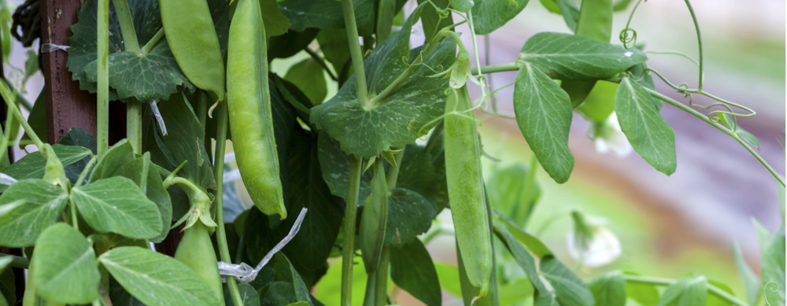

Grow This!
OSU EXTENSION SERVICE
2025 Oregon Garden Challenge

Slide 2

Year 6 Flyer – Send people here: https://www.foodhero.org/growthis
Notes:
https://www.foodhero.org/growthis -> MULTIPLE FUNDED
This is going into year 6 of Grow This! and we are grateful to our funders and partners to be able to offer it for another year.
Grow this will look a little different this year, more on that a little later, and we are still offering free seeds for households, teachers, and community groups & programs
This is the general informational flyer partners and schools can share with families and program participants. We provide free seeds for Oregonians, but Anyone can join using their own seeds.

Slide 3
Grow This! Background
Started in 2020, based on West Virginia Grow This!
Bi-Mart seed donations (2020 to 2024), 1st year 900 seed packets
Starting in 2025, using farmer-grown Oregon seeds from the Territorial Seed Company and seed potatoes
3 ways to sign up: households, classrooms, groups/programs
Tied to Food Hero Social Marketing messages
Notes:
How Grow This got started. It became a focus for Food Hero during the pandemic, when families were working and schooling from home and becoming interested in growing their own food at home. One of our educators, an Americorps volunteer, requested a donation of seeds from Bi-Mart and received over 900 seed packets. What started in a garden in Roseburg turned into a statewide Challenge, when we learned about the West Virginia Extension program’s Grow This! model. So Oregon Grow This! is adapted from that model to serve Oregonians and focus on foods that grow well in all regions of Oregon.
Bi-Mart continued to donate seeds every year for the last five years. They were not able to continue with seed donations this year, so this year, we are working with Territorial Seed Company, an Oregon-based seed company, and offering farmer-grown seeds developed in Oregon. One type we are offering in household kits this year, the Sugar Pod II, was developed at OSU!

Slide 4
Grow This! Background
3 ways to sign up: households, classrooms, groups/programs

Slide 5
What’s New for Grow This! 2025?
Seeds from Territorial Seed Company
Households: everyone is growing the type of plants
Schools: increased focus on pollinators, same plants
Community programs: mini kits for working with school-age children and teens
Everyone: grow along with your own seeds; monthly growing tips and recipes

Slide 6
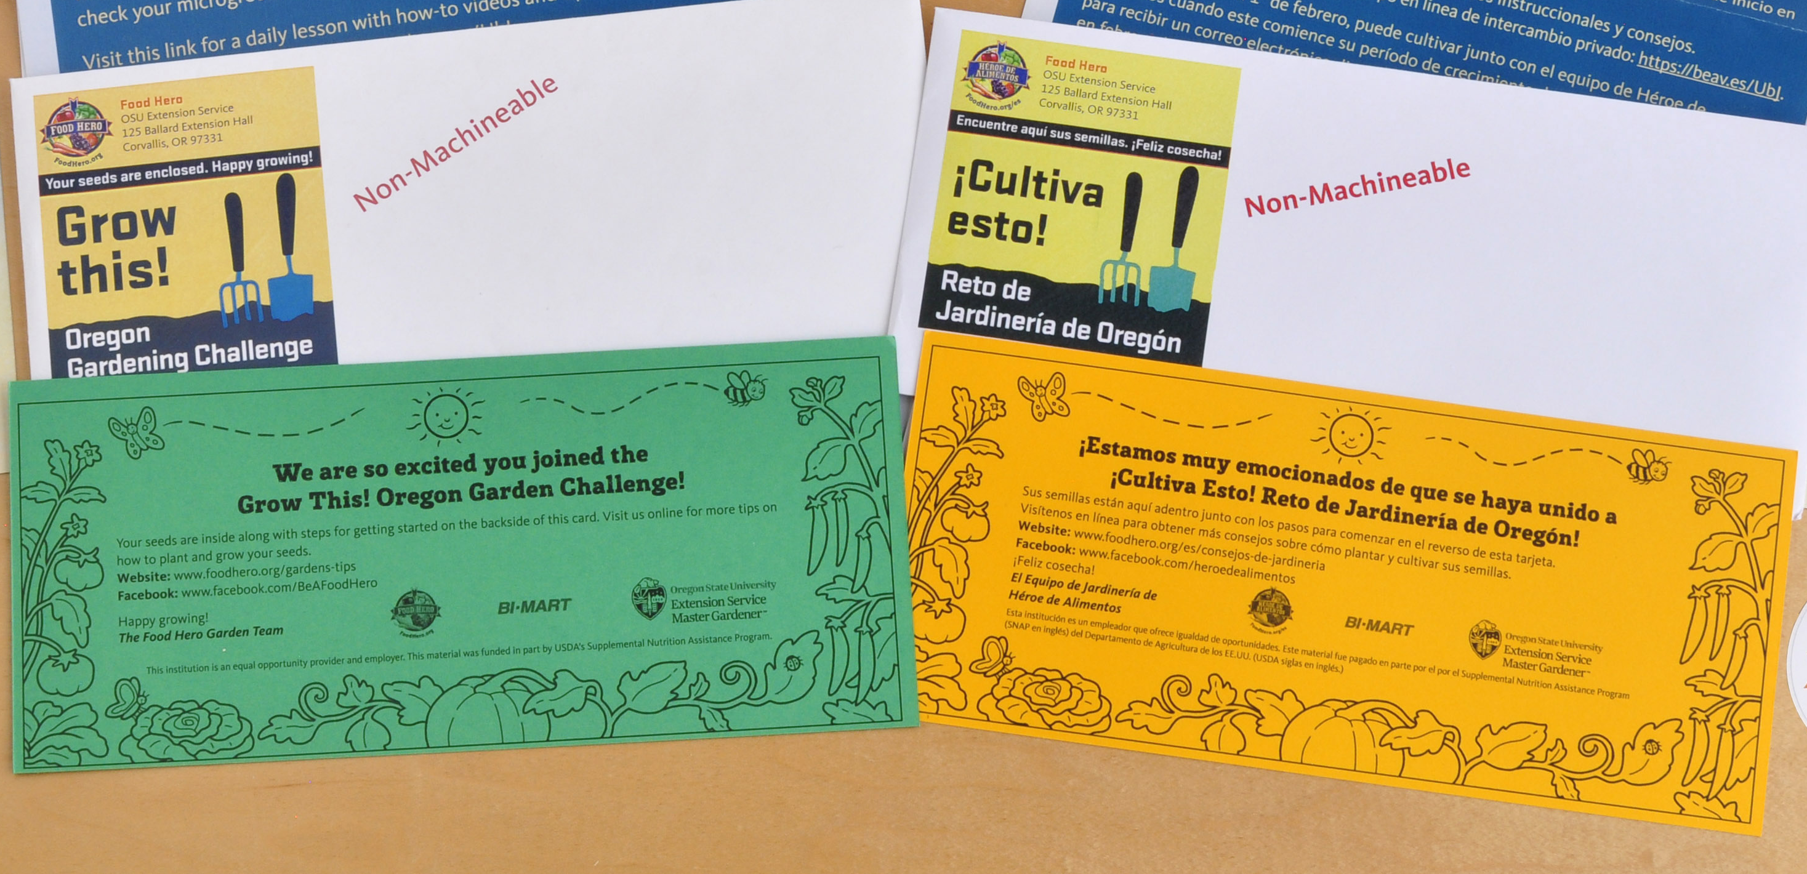
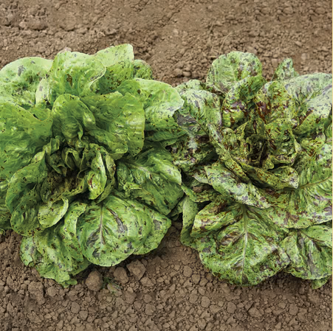
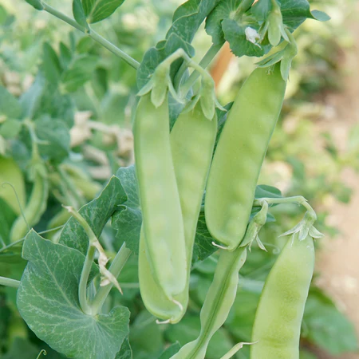

Household Kit
Notes:
Reminder that there are different ways for people to sign up!
An Oregon State University development, Oregon Sugar Pod II is highly disease resistant.
Flashy Trout Back – Dark Leaf Romaine Rich Buttery Flavor (55 days), Oregon Sugar Pod II (70 days easy to grow), Snack Mix Sunflower (ask Terr about germination/days till harvest)

Slide 7
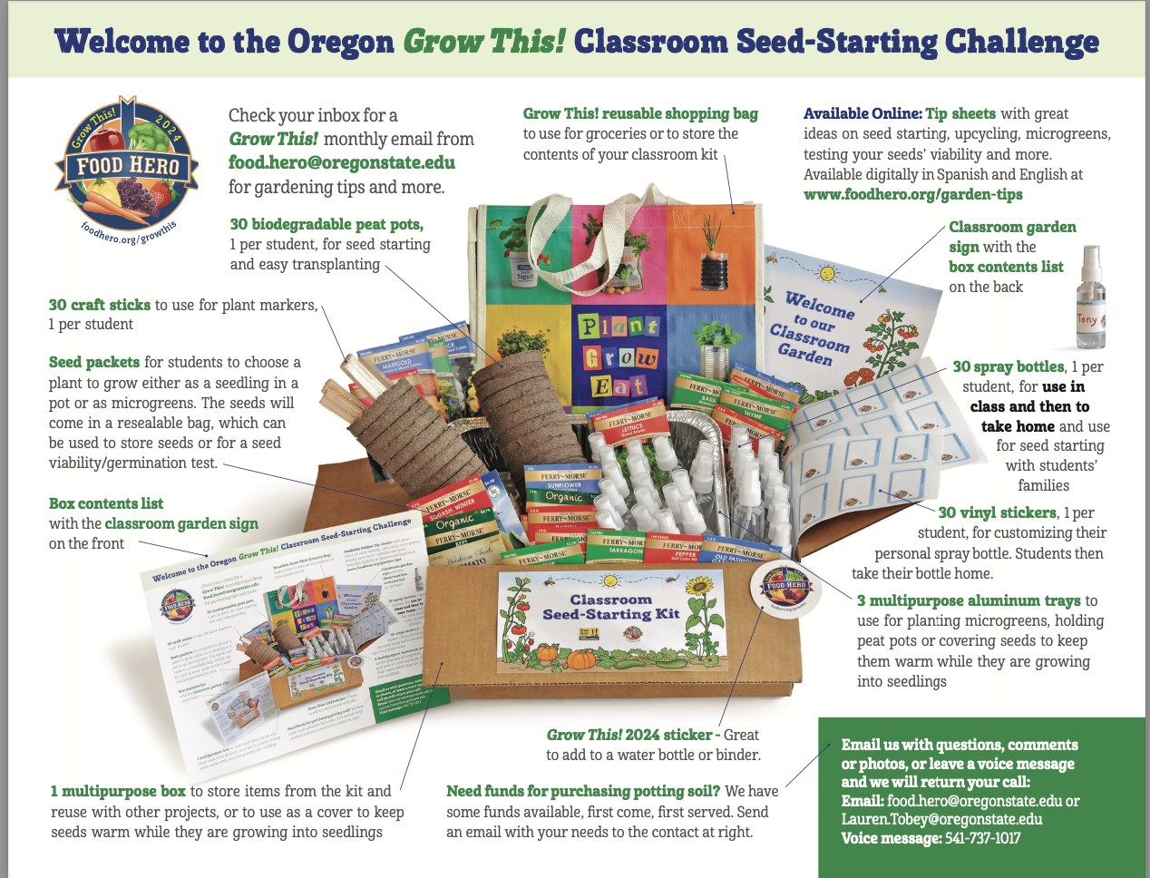

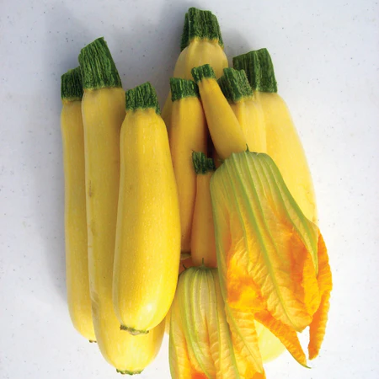
Classroom Seed-Starting Kit
Notes:
What different –
1. Water bottles change saves money and bigger spray bottle
2. Less seeds but all the same type and a focus on how far a seed packet can go! Sunflower starburst panache,
3. Bee books for all and bee messaging in monthlies
Flashy Trout Back – Dark Leaf Romaine Rich Buttery Flavor (55 days), SQUASH SUMMER CUBE OF BUTTER (50 days), SUNFLOWER STARBURST PANACHE

Slide 8
Classroom Seed-Starting Kits include:
1 multipurpose box to store items from the kit and reuse with other projects, or to use as a cover to keep seeds warm while they are growing into seedlings
3 multipurpose aluminum trays for planting microgreens and/or holding peat pots or
to use as a cover to keep seeds warm while they are growing into seedlings
30 biodegradable peat pots, 1 per student for seed-starting and easy transplanting
2 classroom spray bottles
Food Hero/Grow This 2025 Challenge sticker, 1 per kit
30 craft sticks to use for plant markers, 1 per student
3 seed varieties Oregon seeds- for students to choose a plant to grow either as seed starts in pots or as microgreens.
Link to Tip sheets
Food Hero Garden Grocery Bag for easy storage
Bee Book sample and way to order class set

Slide 9
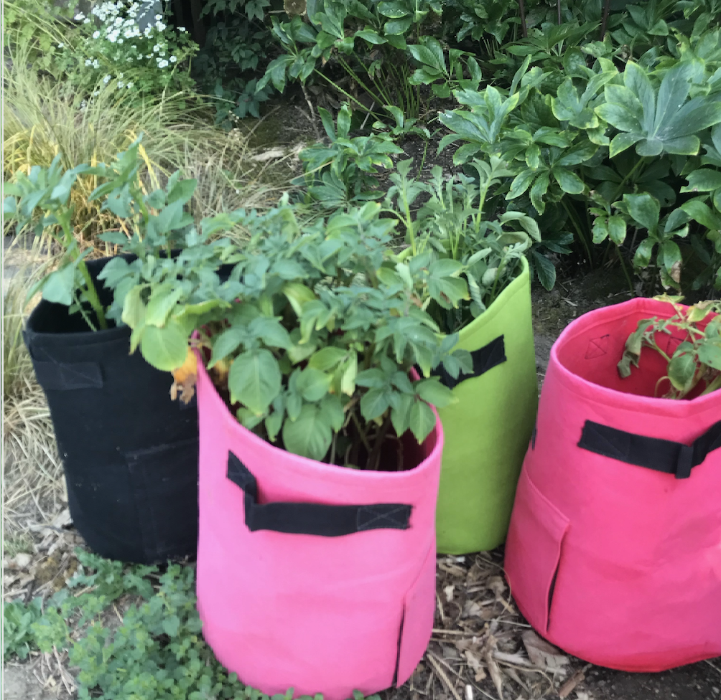
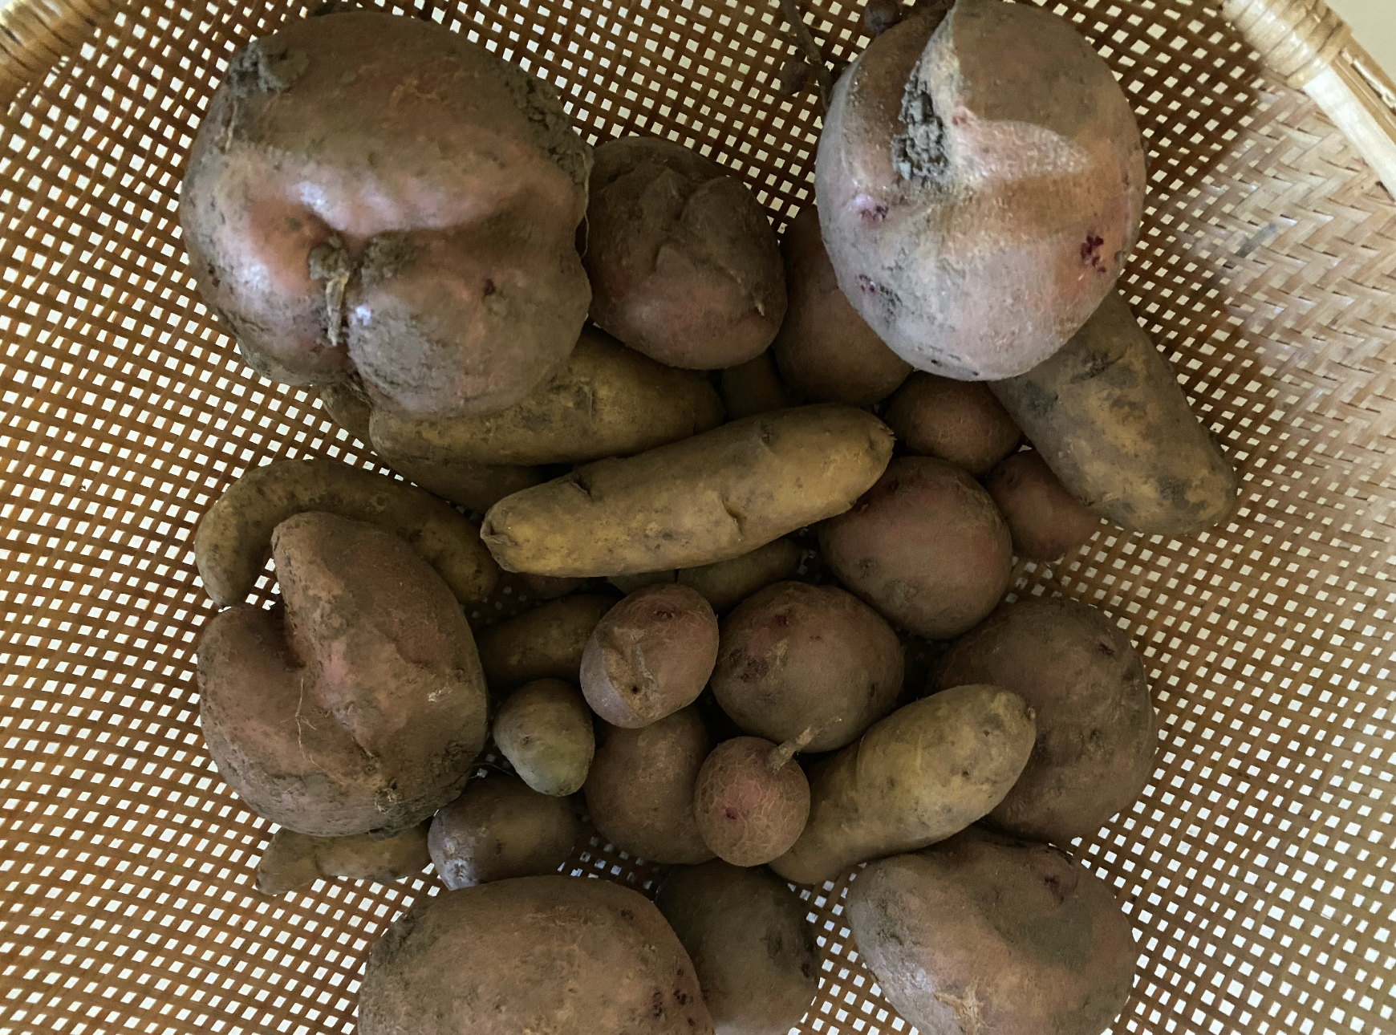
Seed Potato - Starting Kit
Notes:
What different –
1. Water bottles change saves money and bigger spray bottle
2. Less seeds but all the same type and a focus on how far a seed packet can go!
3. Bee books for all and bee messaging in monthlies

Slide 10
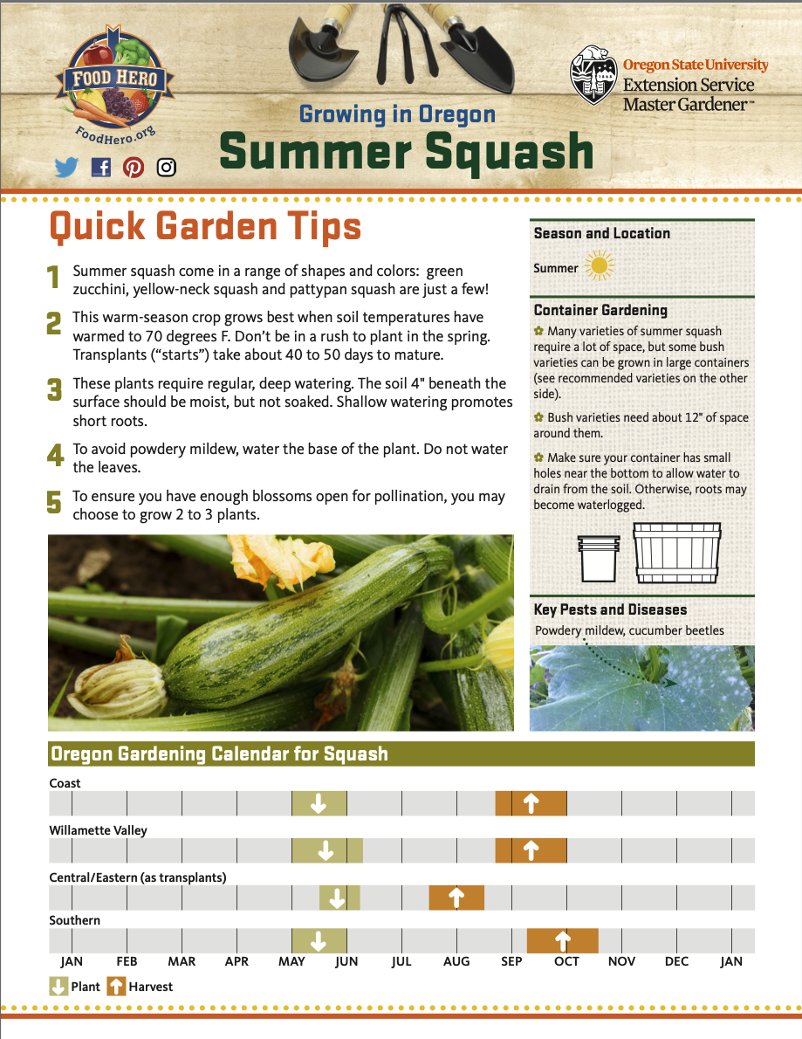
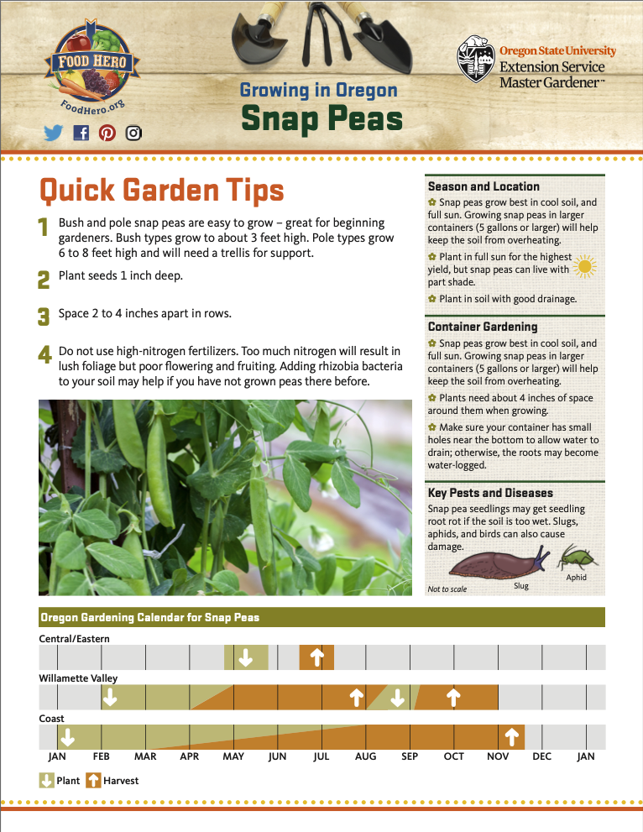
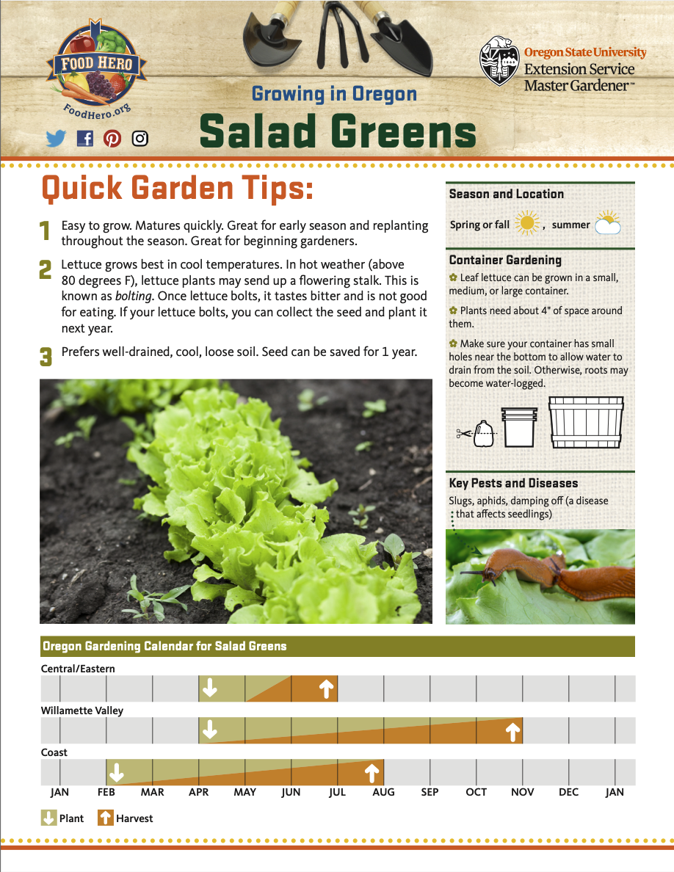
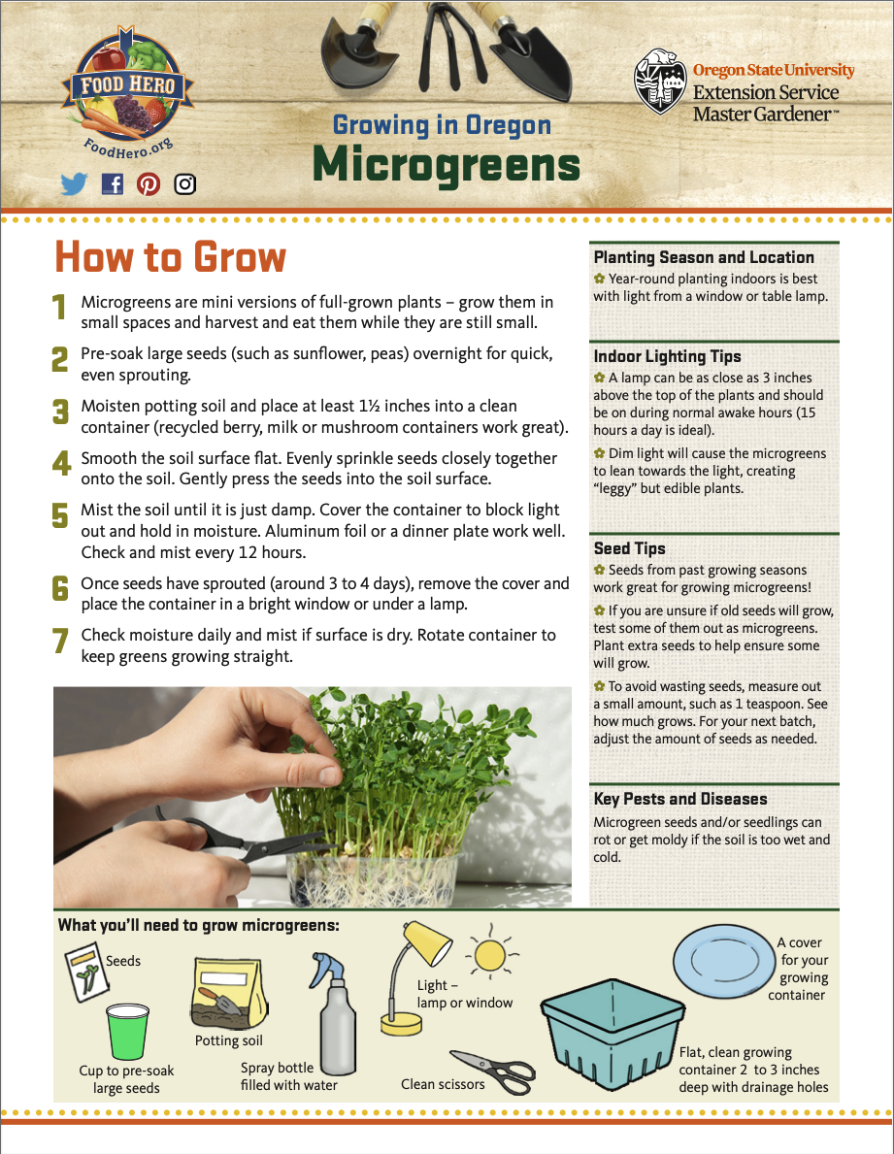




Follow Along!
Visit www.foodhero.org/growthis to follow along!
Notes:
What different –
1. Water bottles change saves money and bigger spray bottle
2. Less seeds but all the same type and a focus on how far a seed packet can go!
3. Bee books for all and bee messaging in monthlies

Slide 11
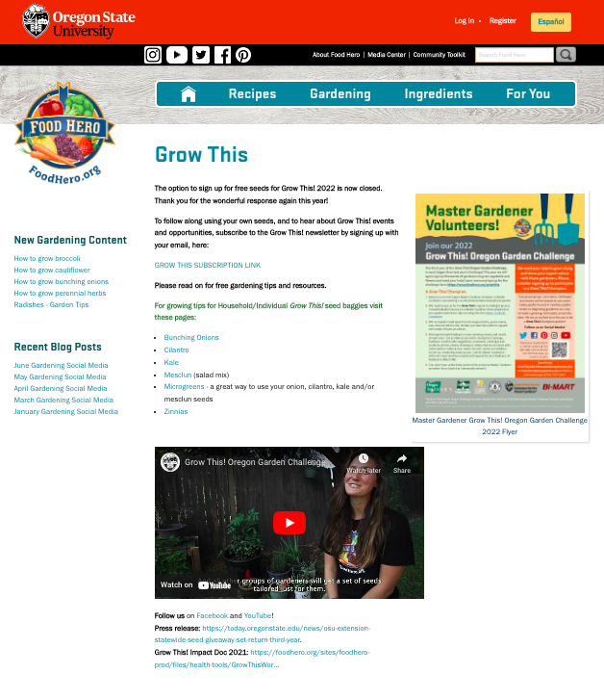
Please share flyer on Grow This! webpage:
www.foodhero.org/growthis

Slide 12

What questions do you have?
Thank you!

