Slide 1
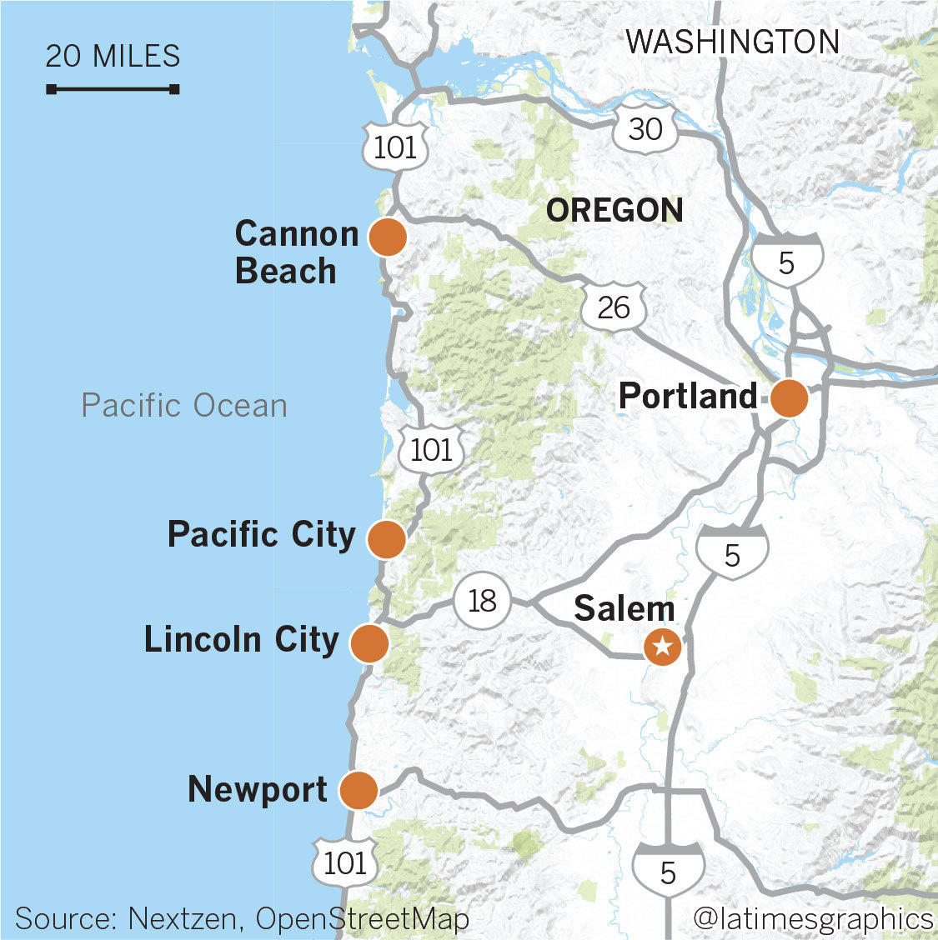
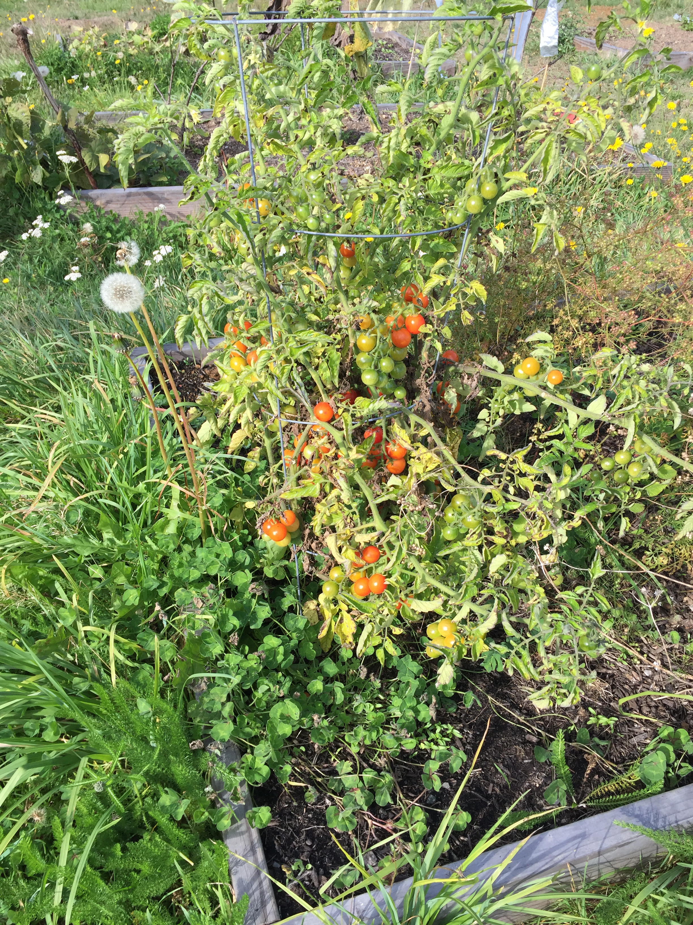
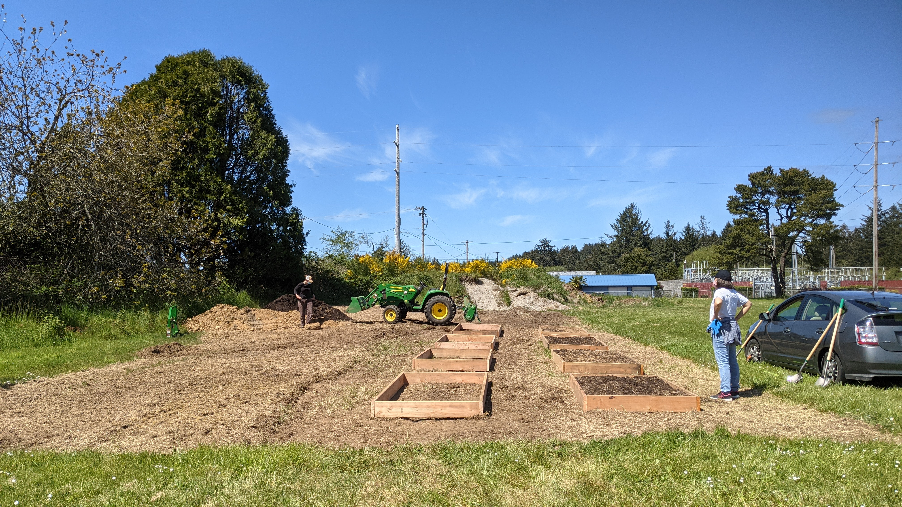
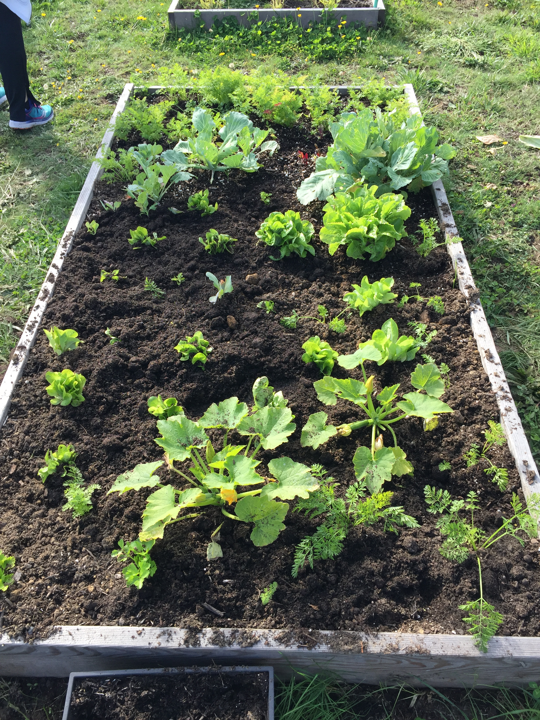
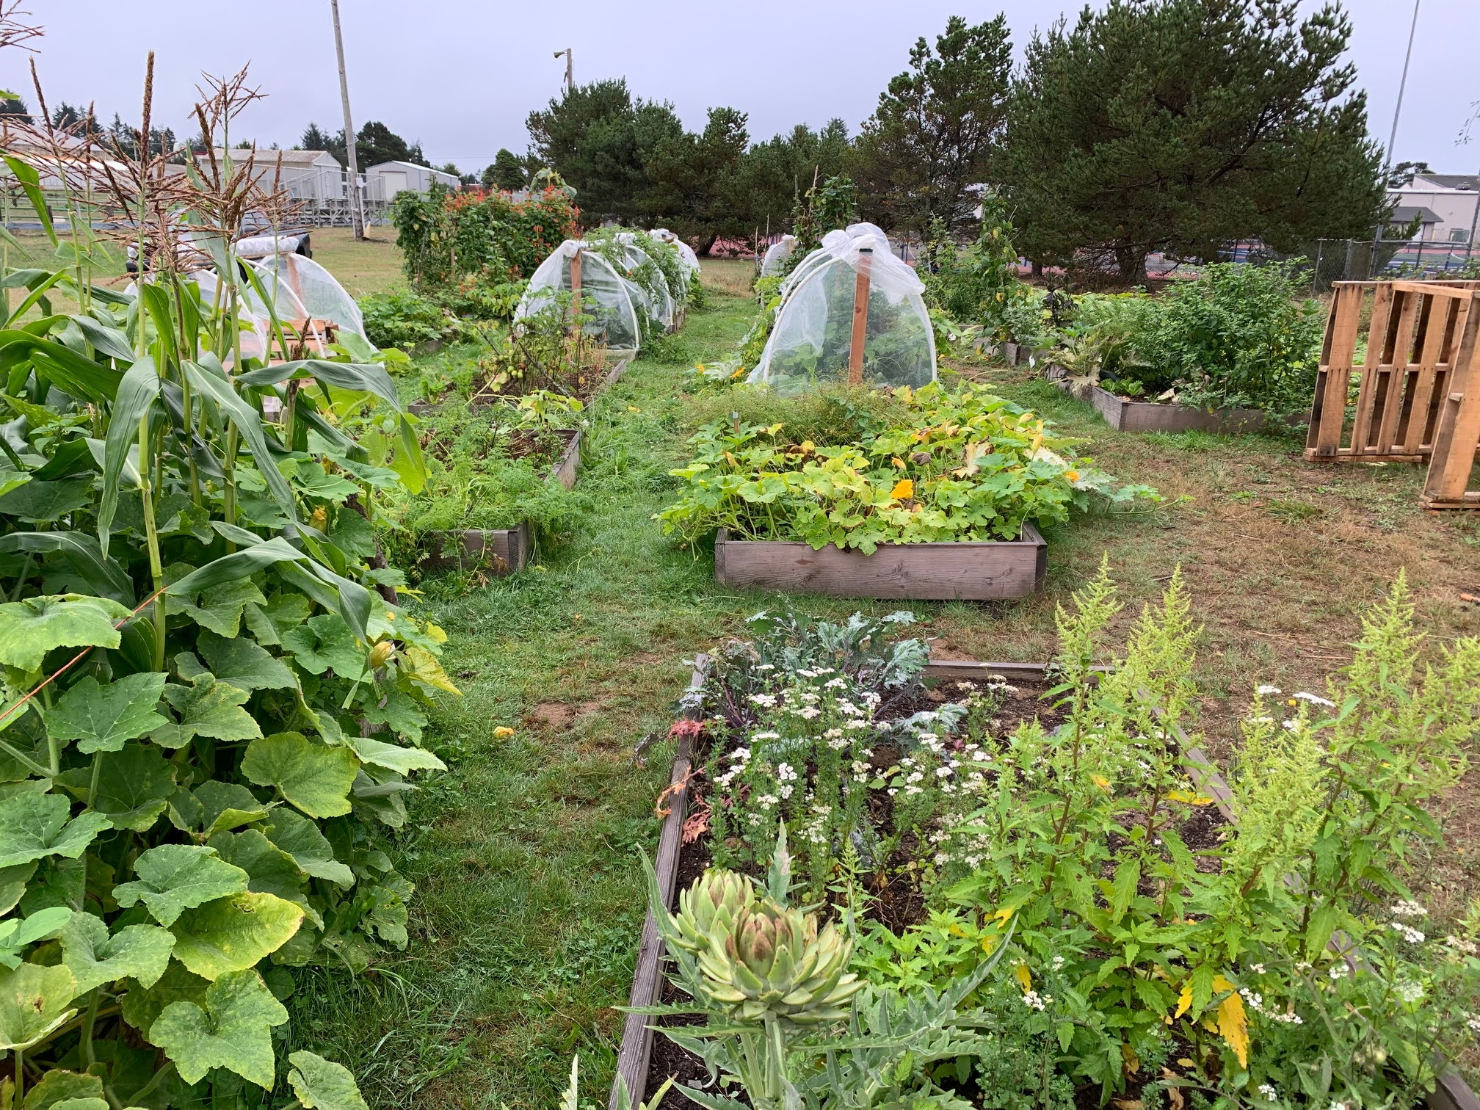
How did we start? Story
Community Outreach, Virtual Classes, Photo Project, and Juntos en Colaboración
Photos: Olalla Center
Photos: OSU Extension

Slide 2
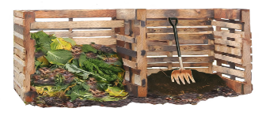

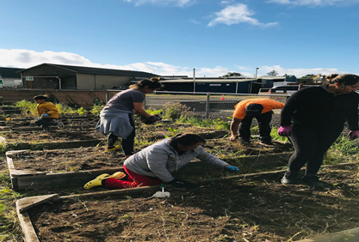
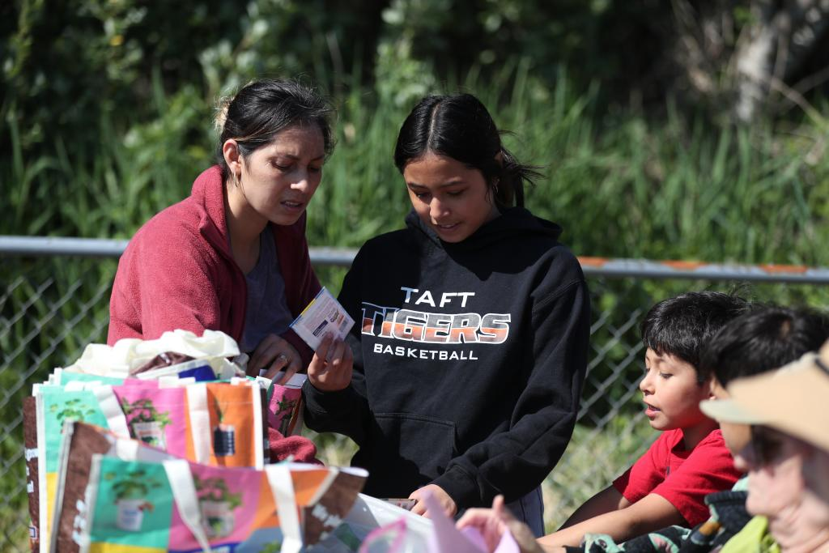
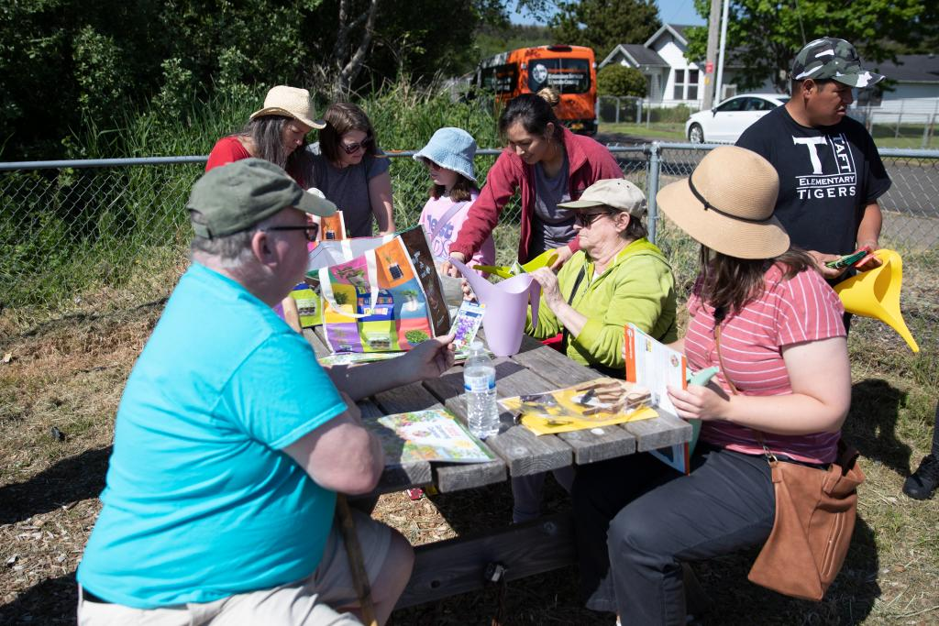


Juntos en el Jardín- Danone
Key Objectives:
Environment friendly
Design new/rejuvenate existing garden spaces
Provide guidance and resources to encourage implementation of sustainable practices
Provide ‘in the garden’ educational activities
Strengthen the regional community food garden network with culturally relevant resources
Credit: Lincoln County Solid Waste District
Credit: Food Hero
Sustainability
Equitable
Social
Credit: Chris Branam
Economic

Slide 3
Juntos en el Jardín
Project timeline:
Months 1-6 (October 2021-March 2022)
Assessment, project organization, hire project assistant, volunteer recruitment, establish audio texting system
Months 5-22 (April 2022-June 2023)
Guided by assessment findings
Break ground on new garden sites and invigorate existing sites
Promote and support sustainable growing practices
Distribute culturally relevant grow kits to community members and toolkits to garden managers
Evaluation activities
Provide/display multilingual signage and resources
Connect community members to available garden plots
Teach multilingual edible garden/nutrition classes
Support and encourage networking between community garden sites and other food system partners
Communicate project achievements to community members, stakeholders, peers and media
Months 23-24 (July 2023 –September 2023)
Complete evaluation activities
Communicate project impacts

Slide 4
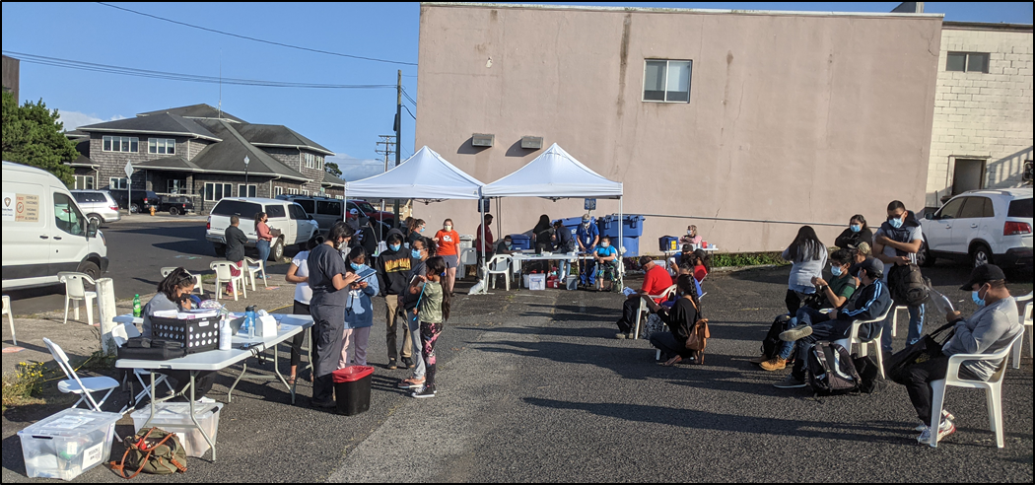

Assessment Results-Danone Project Lincoln City
Gardening Interests
Vegetables Carrots
Tomatoes Herbs
Beans Cilantro
Lettuce Onions
Cucumbers Zucchini
Radishes Cabbage
Chiles Apples
Food Access
Most people access food at grocery stores
82% said they would like access to a garden
Barriers to Gardening
No place to grow food/gardening space; No community garden in the city
Climate
Too many deer
Don’t have time
Educational Interests
Gardening- 90% Cooking- 35% Nutrition- 17%
Environmental Health- 7% Food Preservation- 3%

Slide 5
Juntos en el Jardín
Strengthen the regional community food garden network with culturally relevant resources
Five families have been connected to the City of Lincoln City Taft garden.
Recycling session - Lincoln County Sanitary and Recycling 10/20/22 and summer 2023
Nutrition classes series completed -OCCC/Conexión Fenix 09/22 (attended) and summer 2023
Día de Muertos event at Lincoln City library 10/31/22 (308 attended)
City garden scholarships available to families
High School Career Tech – Cornucopia Garden
Connection with teacher Michelle and students to build new garden site.
Tour to the garden on 5/19 and were students (9) and community partners (8).
Community Outreach
Reach out low-income families to connect with food resources, food pantry, and garden sites.
Offer Food Pantry Food Hero Tasting : October 25th and continuing monthly every third Tuesday. sustainability
OCCC and Ridge Apartments Gardens
Families connected to community gardens (10 families), students (11) and low income housing (10).
Nutrition and Food Hero Seed Events summer 2023

Slide 6
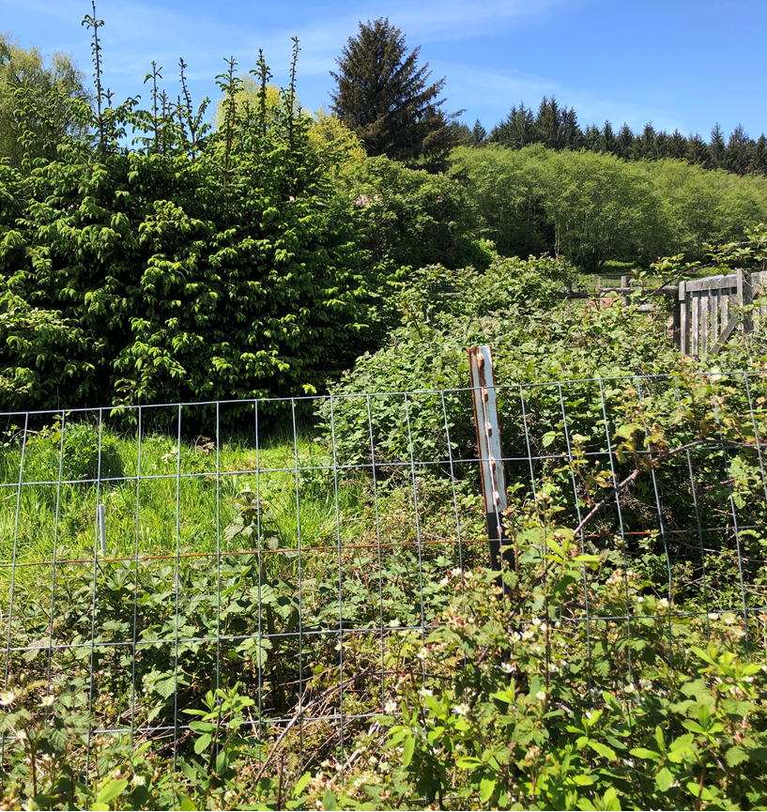
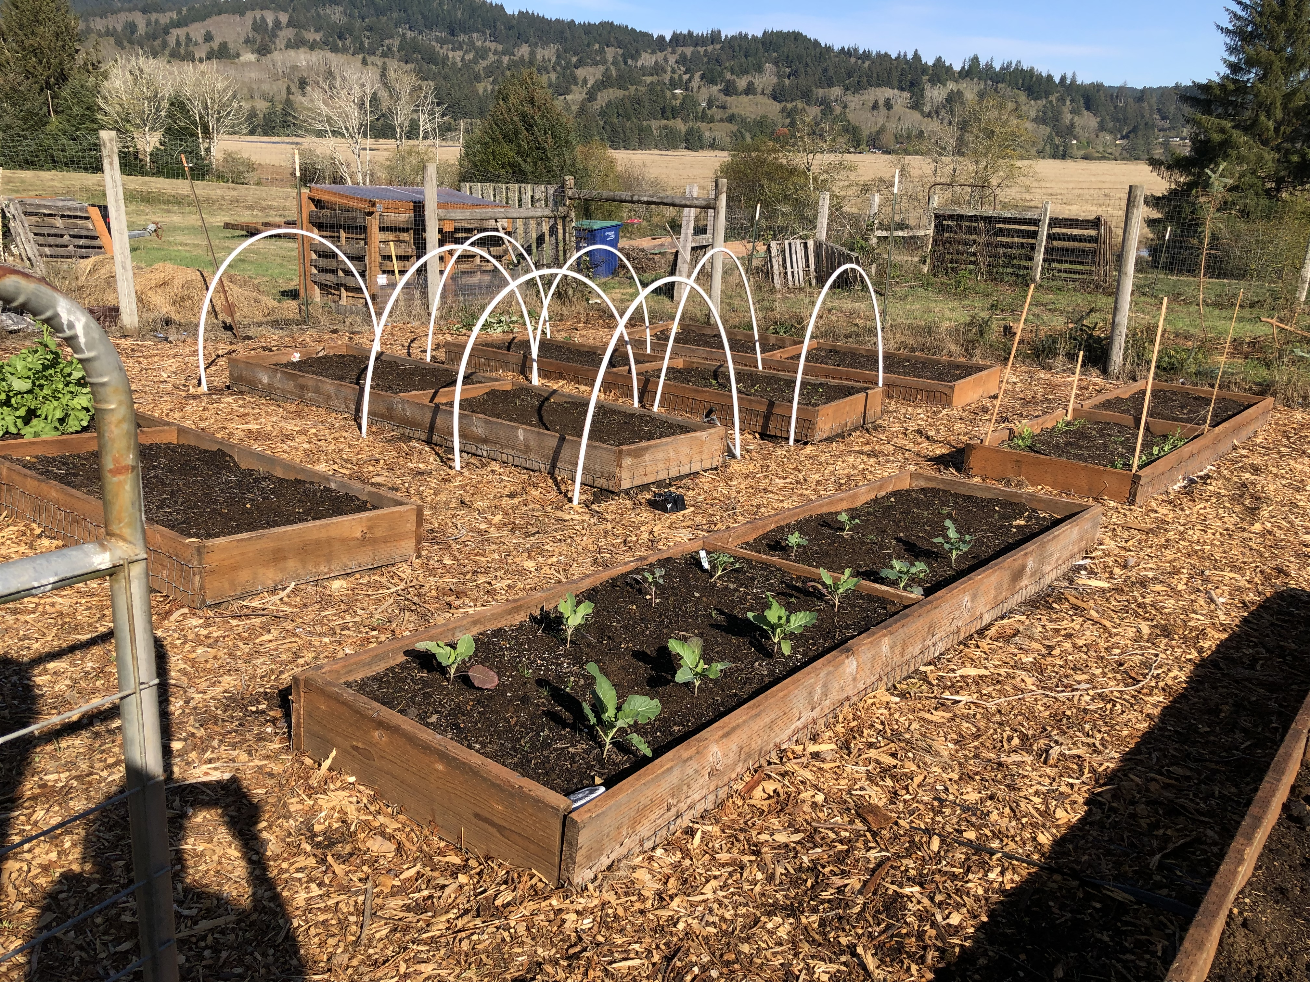
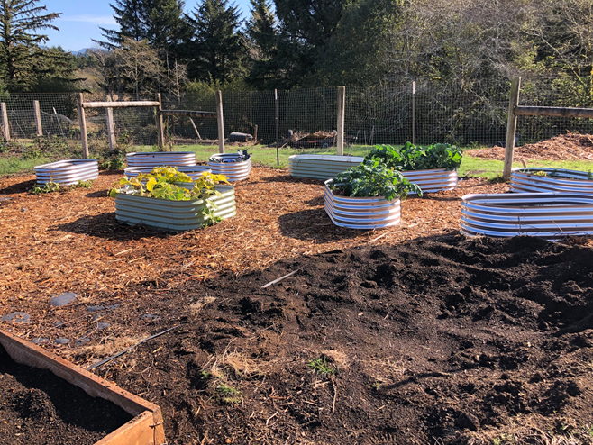
Cornucopia Garden- Career Tech HS
Supported with (10) galvanized metal
raised garden beds and 5 yards of soil

Slide 7
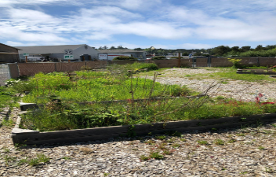
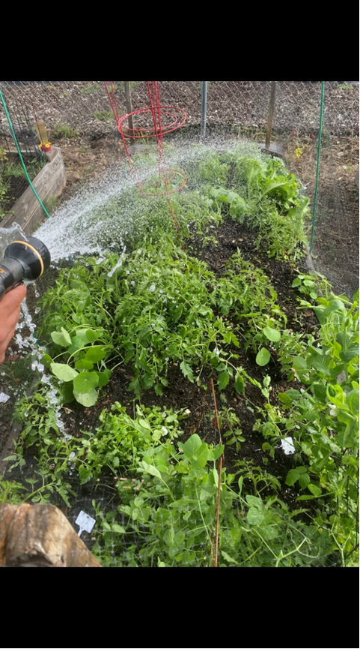
Taft Community Garden
Credit: Jazmin Aguilar
New soil at 4 donated/scholarship
family plots = new growth opportunity

Slide 8
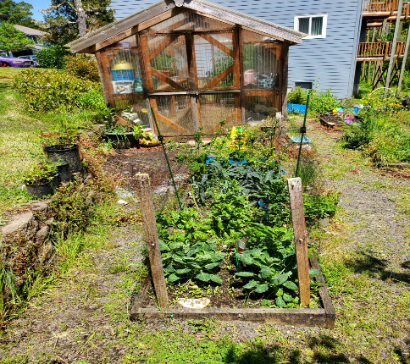
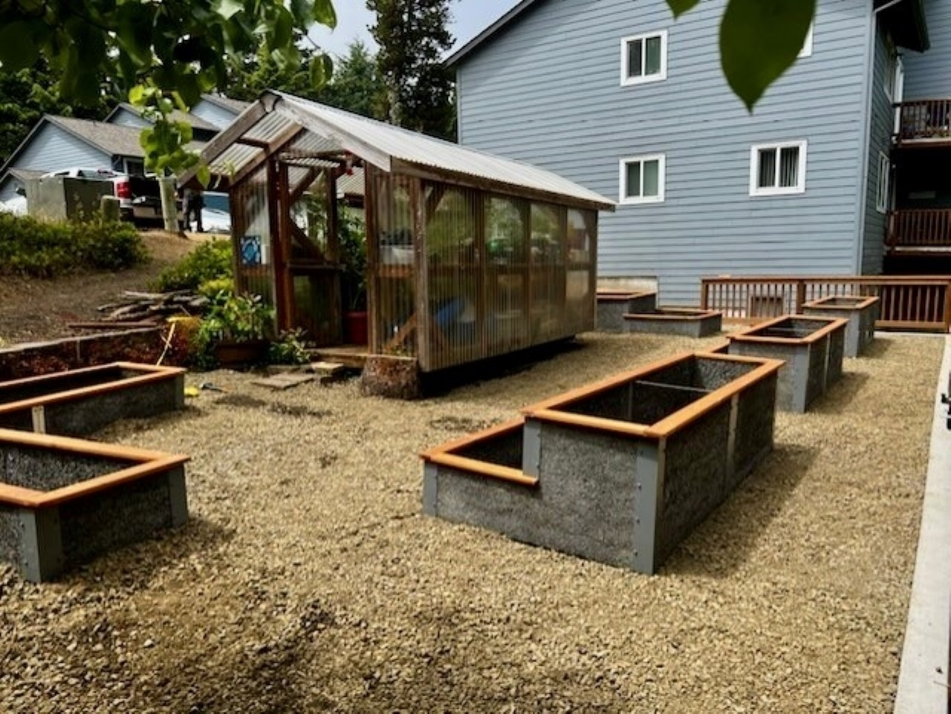
Ridge Apartments
Existing beds have been replaced with (5) 25-year longevity, Durable Greenbeds—adding a sustainability component
Credit: Ridge Apartment Manager

Slide 9
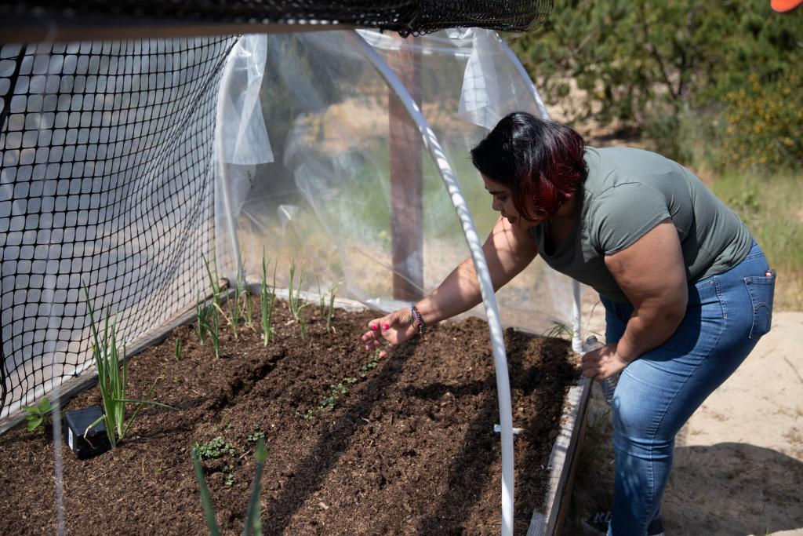
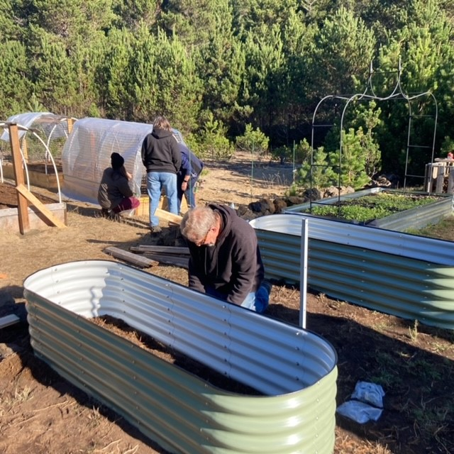
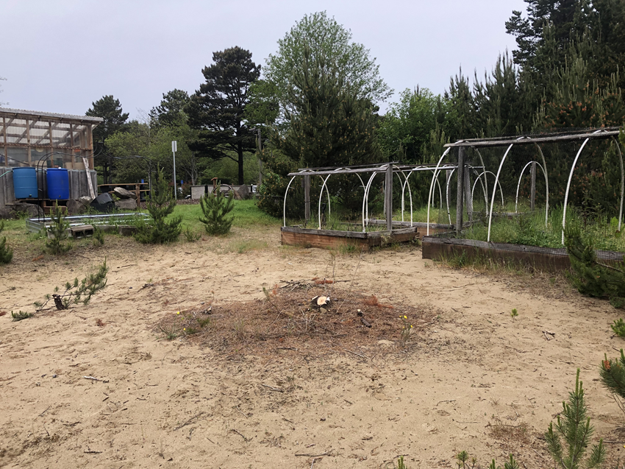
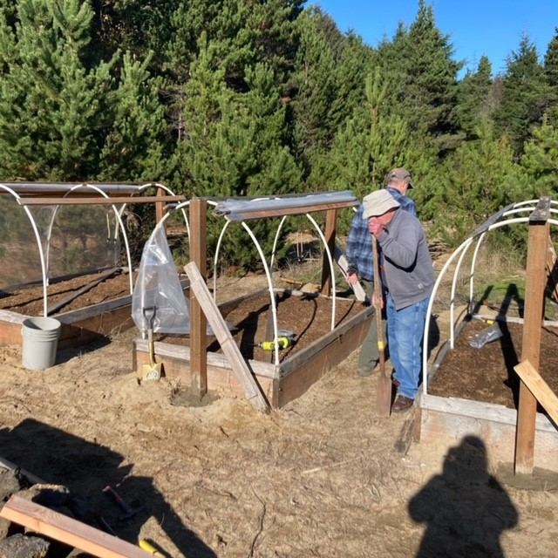
North County OCCC
Refurbished raised beds with cloches for community use, provide material for a 3-bin composter and welcome, Juntos en el Jardin signage entry trellis/tunnel.
Credit: Chris Branam
Credit: Lincoln County Master Garden

Slide 10
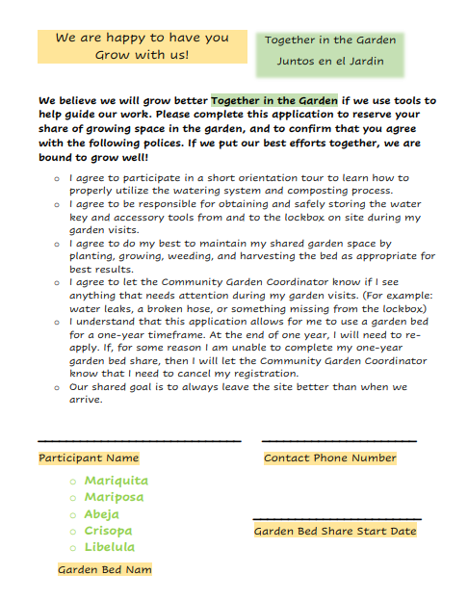
Garden Policy Idea

Slide 11
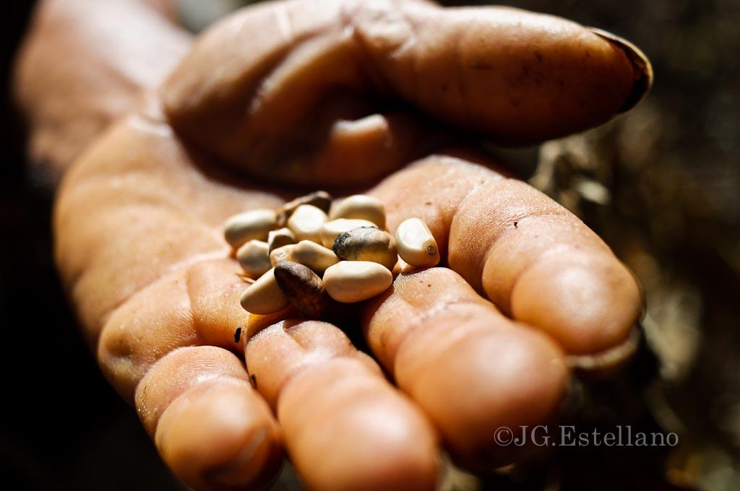

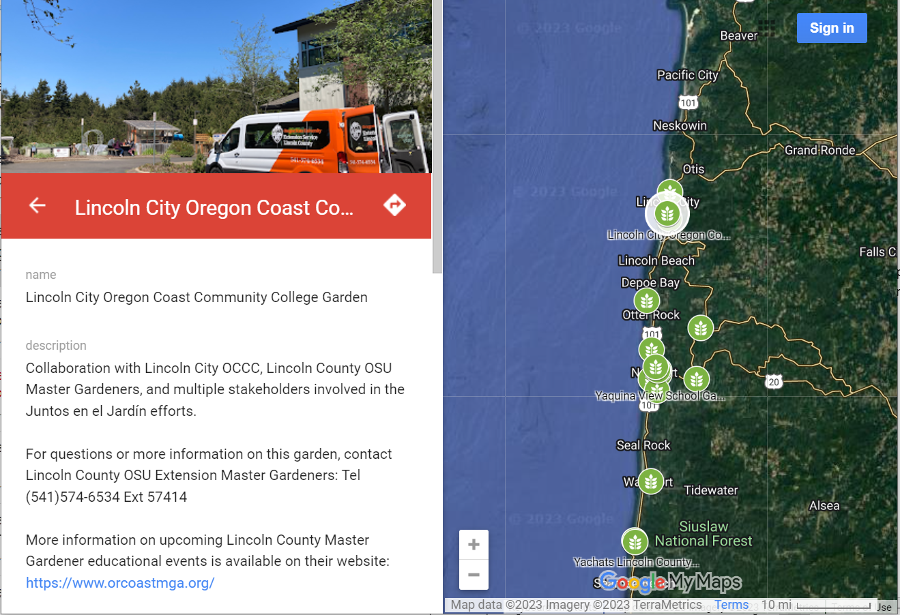
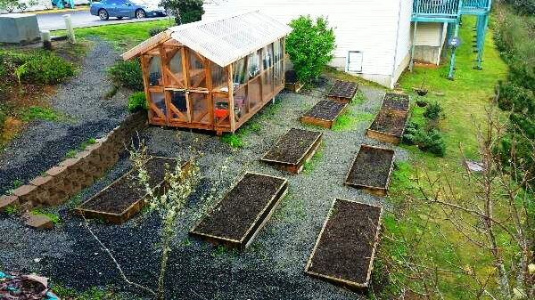
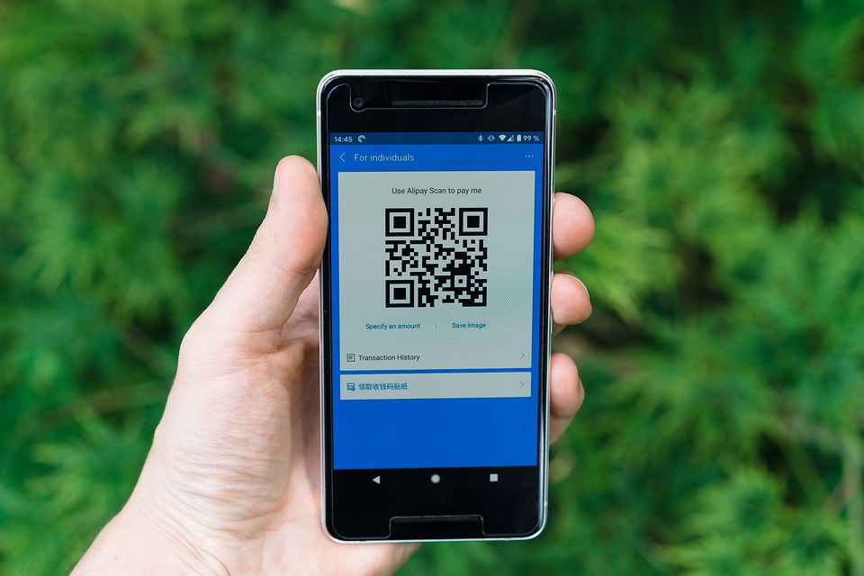

Community Garden Resource Map
translations: https://tinyurl.com/gardenmaplincolnco

Slide 12






Thank you!
Questions?
Community Partners: Lincoln City Park and Recreation, Oregon Coast Community, Career Tech Charter High School, Economic Development Alliance of Lincoln County, Rotary Club, Conexion Fenix and Driftwood Library.

