Slide 1




reaching people where they are
Food Hero social media
Notes:
people are online
on their phones
delivering our info right there, not always making them have to click through

Slide 2

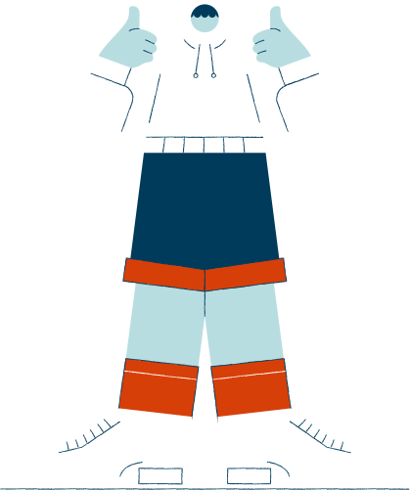

Goal:
More voices represented in our social media
Notes:
thank you for having us today!
our team:
lupita - FB Eng and Esp, Pinterest
kristina - Instagram (also our organizer for the website)
rebecca - newsletters
leann - help guide strategy, gardeni ng content and connect to MG program/hort

Slide 3


FOOD HERO SOCIAL MEDIA CHANNELS
PRIORITY Q1 2023:
  Facebook: English
  Facebook: Spanish
  Instagram
  Monthly Newsletters (English and Spanish)
Notes:
focused work
try something new
how we work together as a team
measure and evaluate

Slide 4
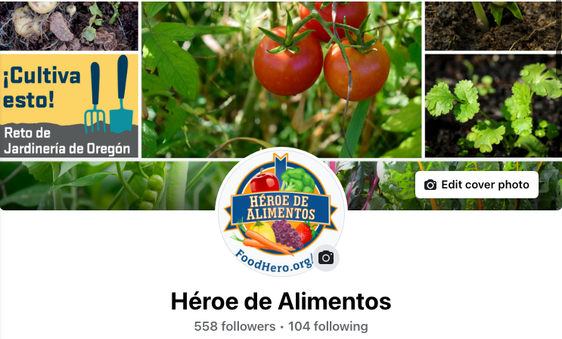
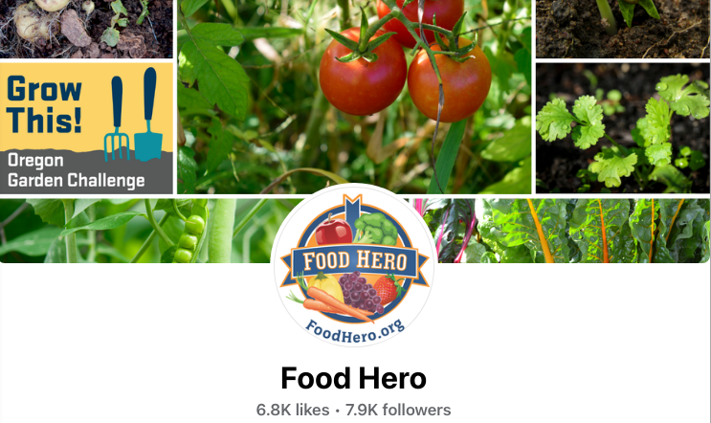
FOOD HERO SOCIAL MEDIA CHANNELS
PRIORITY Q1 2023:
Facebook

Slide 5
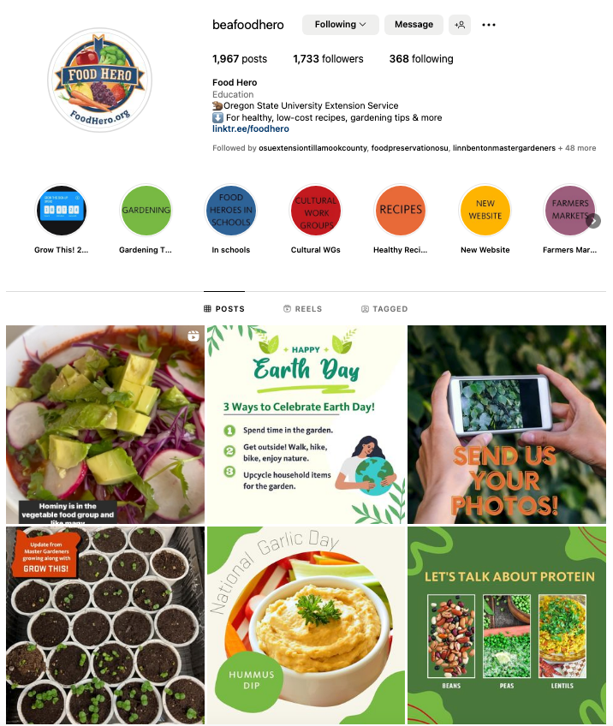
Instagram

Slide 6
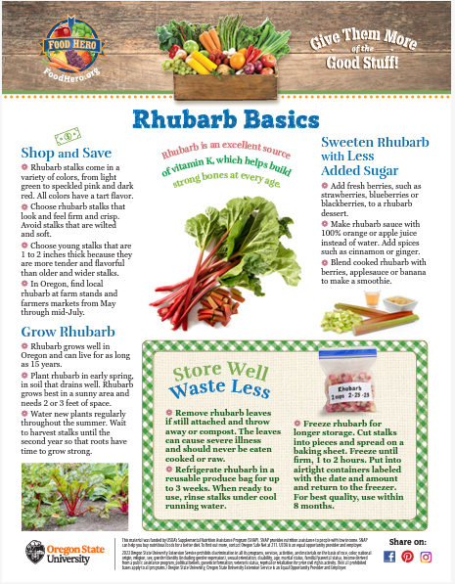
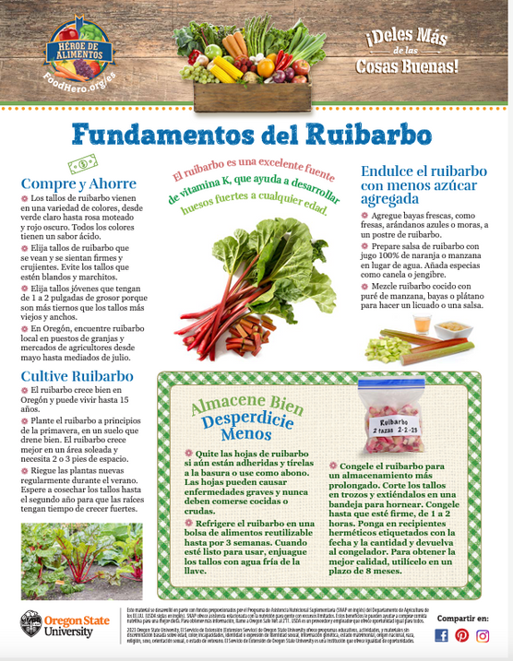

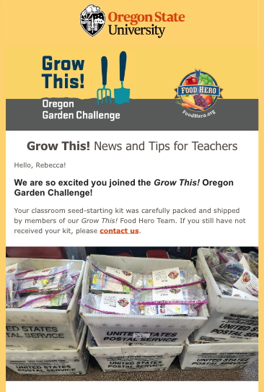
FOOD HERO SOCIAL MEDIA CHANNELS
PRIORITY Q1 2023:
Newsletters

Slide 7
FOOD HERO SOCIAL MEDIA CHANNELS
RE-EVALUATING USE MOVING FORWARD
  YouTube
  Twitter
  Who are our audiences?
  What best practices are used in this channel?
  Is this an appropriate channel in 2023?
Notes:
Look at our other channels and ask how we need to be using them
based upon
knowing what audience uses what channel

Slide 8



FOOD HERO SOCIAL MEDIA CHANNELS
WHO ARE WE MISSING THAT WE MIGHT MEET IN OTHER CHANNELS?
Notes:
There will always be new things we can do. Like...

Slide 9
WHO ARE OUR AUDIENCES?
SNAP-Ed Colleagues
Educators
Organizational partners
AND
intended audiences of low-income Oregonians
Notes:
Our audiences for our social media are complicated
audiences who
-need tools to help them do their jobs
-to pass on to their own audiences and show their connection to us
-the public entity of all of this: low income Oregonians

Slide 10


New focused strategy creates new results
Notes:
doing everything everywhere all at once retired.
use social media for what it's for: to engage people. Share, like, comment, participate, feel a personal connection to, fun

Slide 11
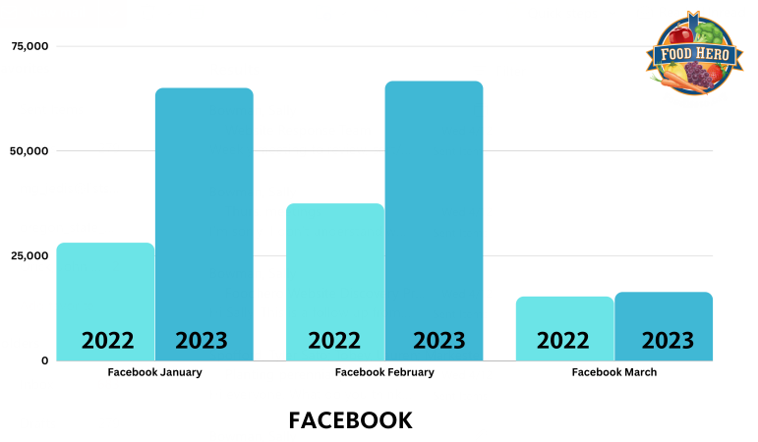
Notes:
Reach: how many people we're reaching
65,000

Slide 12
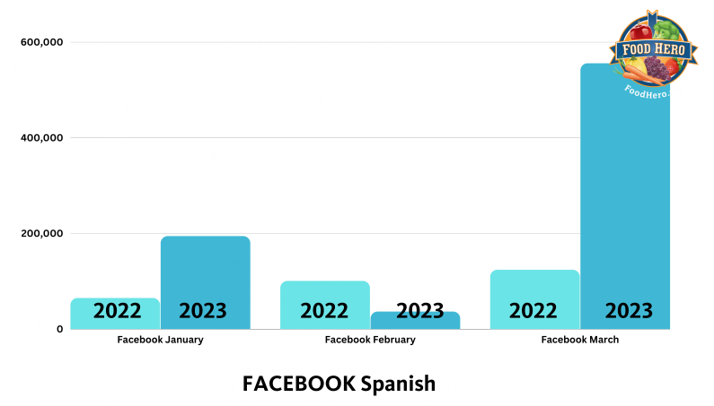
Notes:
200-550 thousand

Slide 13
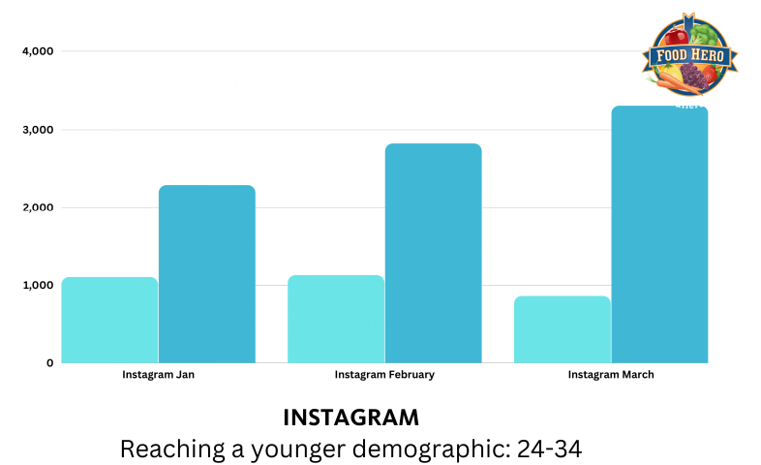
Notes:
25-32,000

Slide 14




01
02
CREATING CONTENT SPECIFIC TO CHANNEL
QUALITY VS QUANTITY
03
04
SOCIAL MEDIA CAN REACH AND ENGAGE
WE ARE ALWAYS LEARNING
Notes:
social media changes: reels, tagging, collaborative posts, short form video,
algorhythm

Slide 15
REPRESENTATION
MATTERS
Collaboration
Notes:
share some ideas
show you a new collaboration we've been doing
get thinking of what we could do together
you may have ideas!

Slide 16
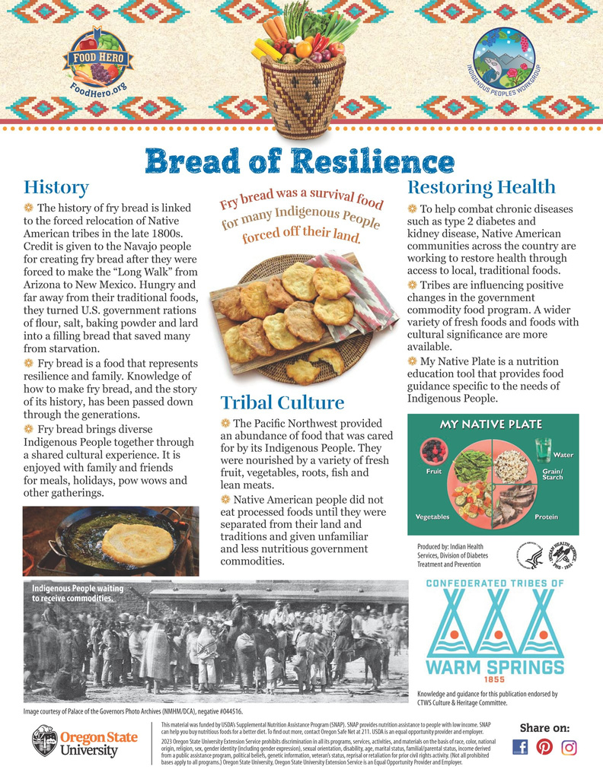
Our Recent Collaboration:
Fry bread posts shared to Facebook and Instagram
Instagram (5 posts)
Total Reach: 1096
Total Likes: 63
Facebook (6 posts)
Total Reach: 5,214
Total Likes: 172

Slide 17

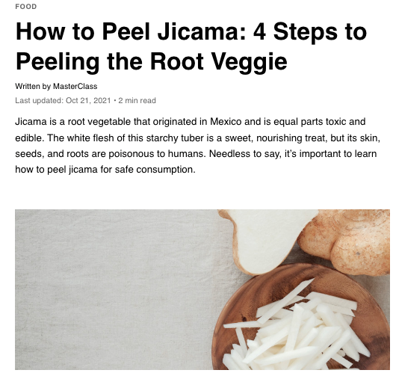


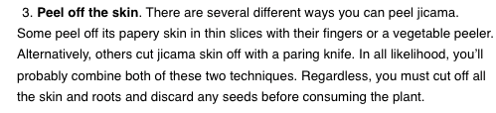

RECIPES OR "HOW TO"

Slide 18
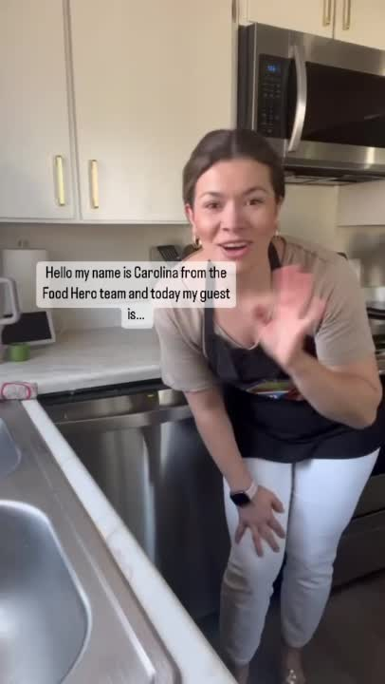
Notes:
kids tasting in schools
blender bike at farmers market
kitchen collaboration
is there an event in Coquille? We can share it.
We are statewide.

Slide 19
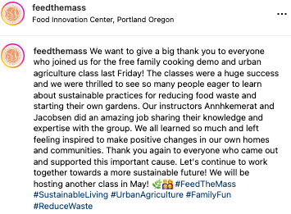
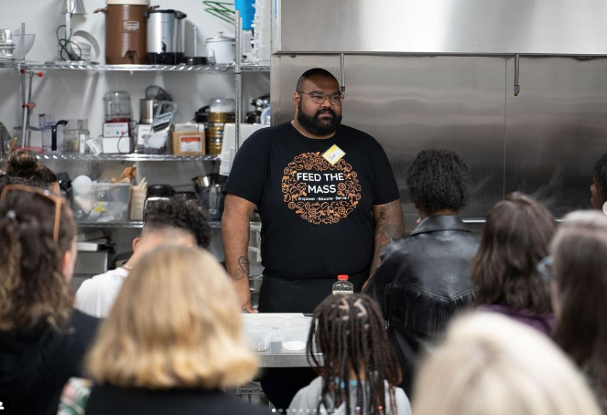
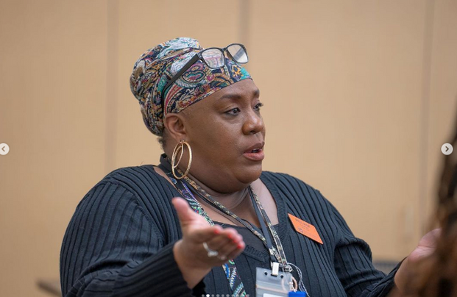
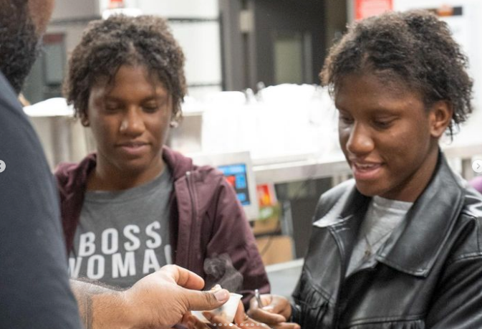
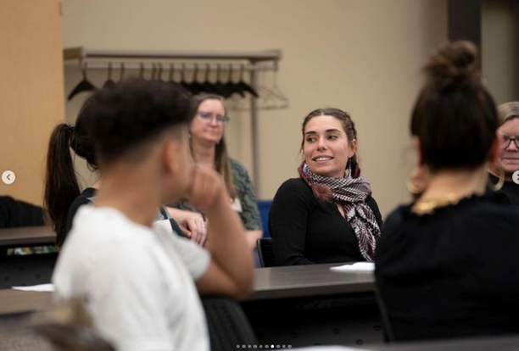
PROMOTING A LOCAL EVENT OR SHARING HIGHLIGHTS FROM RECENT EVENT WHERE FOOD HERO MATERIALS WERE USED

Slide 20


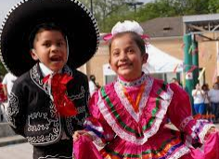
HOLIDAYS
Notes:
Maybe you don't want to create in depth one page content for the website. Maybe you just want to do something short and sweet.
Social media is made for short and sweet.

Slide 21
  WHAT'S A TAKEOVER?
for one day or one week, one person is the voice of the channel
self create the content, multiple posts in a short time
  VIDEO SERIES ON YOUTUBE
  SHORT DEMONSTRATION VIDEOS ON ALL CHANNELS
  LIVE CONVERSATION ON FB AND INSTA LIVE
  ONE WEEK OF THEMED CONTENT
  USE EXISTING CONTENT AND BUILD NEW SOCIAL MEDIA

Slide 22
YOU (COLLABORATORS) CREATE THE CONTENT
  DETERMINE TOPIC
  CAPTION CONTENT/TEXT
  PHOTOS
  RAW VIDEO
(RANGES FROM 24 WORDS TO 119 WORDS)

Slide 23
SOCIAL MEDIA TEAM
  BUILDS THE POST
  EDIT THE VIDEO
  CREATE ADDITIONAL ARTWORK
  BRAND IT AS NECESSARY
  SCHEDULE AND UPLOAD
COLLABORATOR REVIEWS THE FINAL

Slide 24
OUR COMMITMENTS TO COLLABORATORS
  Inclusive
  Listen
  Real
  Helpful
  Creative
  Fun
Notes:
food hero social media needs to better reflect our work, your work
we are here to...

Slide 25
thank you
Questions?
Email us at: foodherosocial@oregonstate.edu

