Slide 1


Rural Libraries and Walking Project
Funded by the National Institutes of Health
Four-year grant awarded to School of Nursing at Oregon Health & Science University
Actual walking program: two years
20 rural Oregon libraries enrolled
Libraries assigned two groups: walking only, and walking plus civic engagement
Notes:
Image: creative commons

Slide 2

Goals of the study:
Increase the capacity of rural libraries to deliver evidence-based health promotion programs
Compare the effects of the walking-only groups with the walking-plus-civic engagement groups
Evaluate how well the program is implemented
Notes:
Image: creative commons

Slide 3
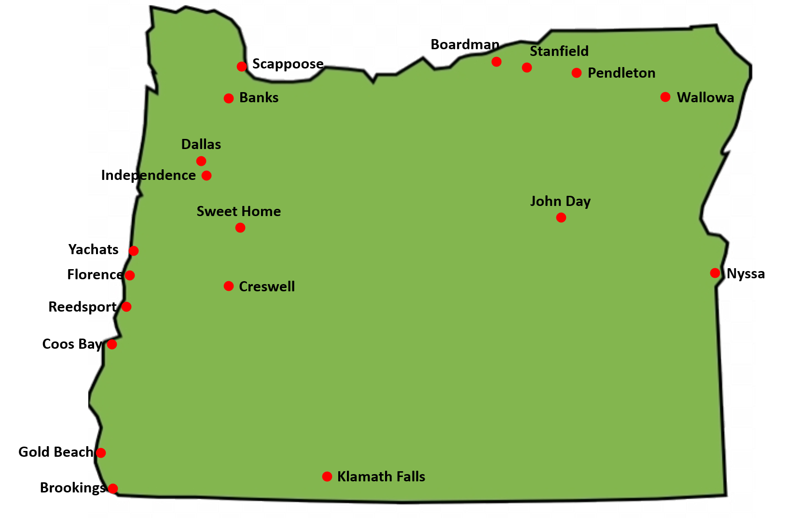
Enrolled libraries
Contact info:
Jim Winkle, MPH
Project Manager
winklej@ohsu.edu
503-720-8605
Notes:
Image: creative commons

