Slide 1
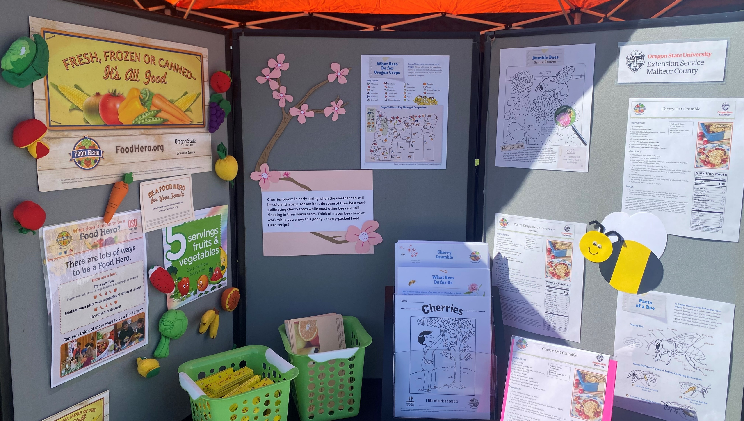
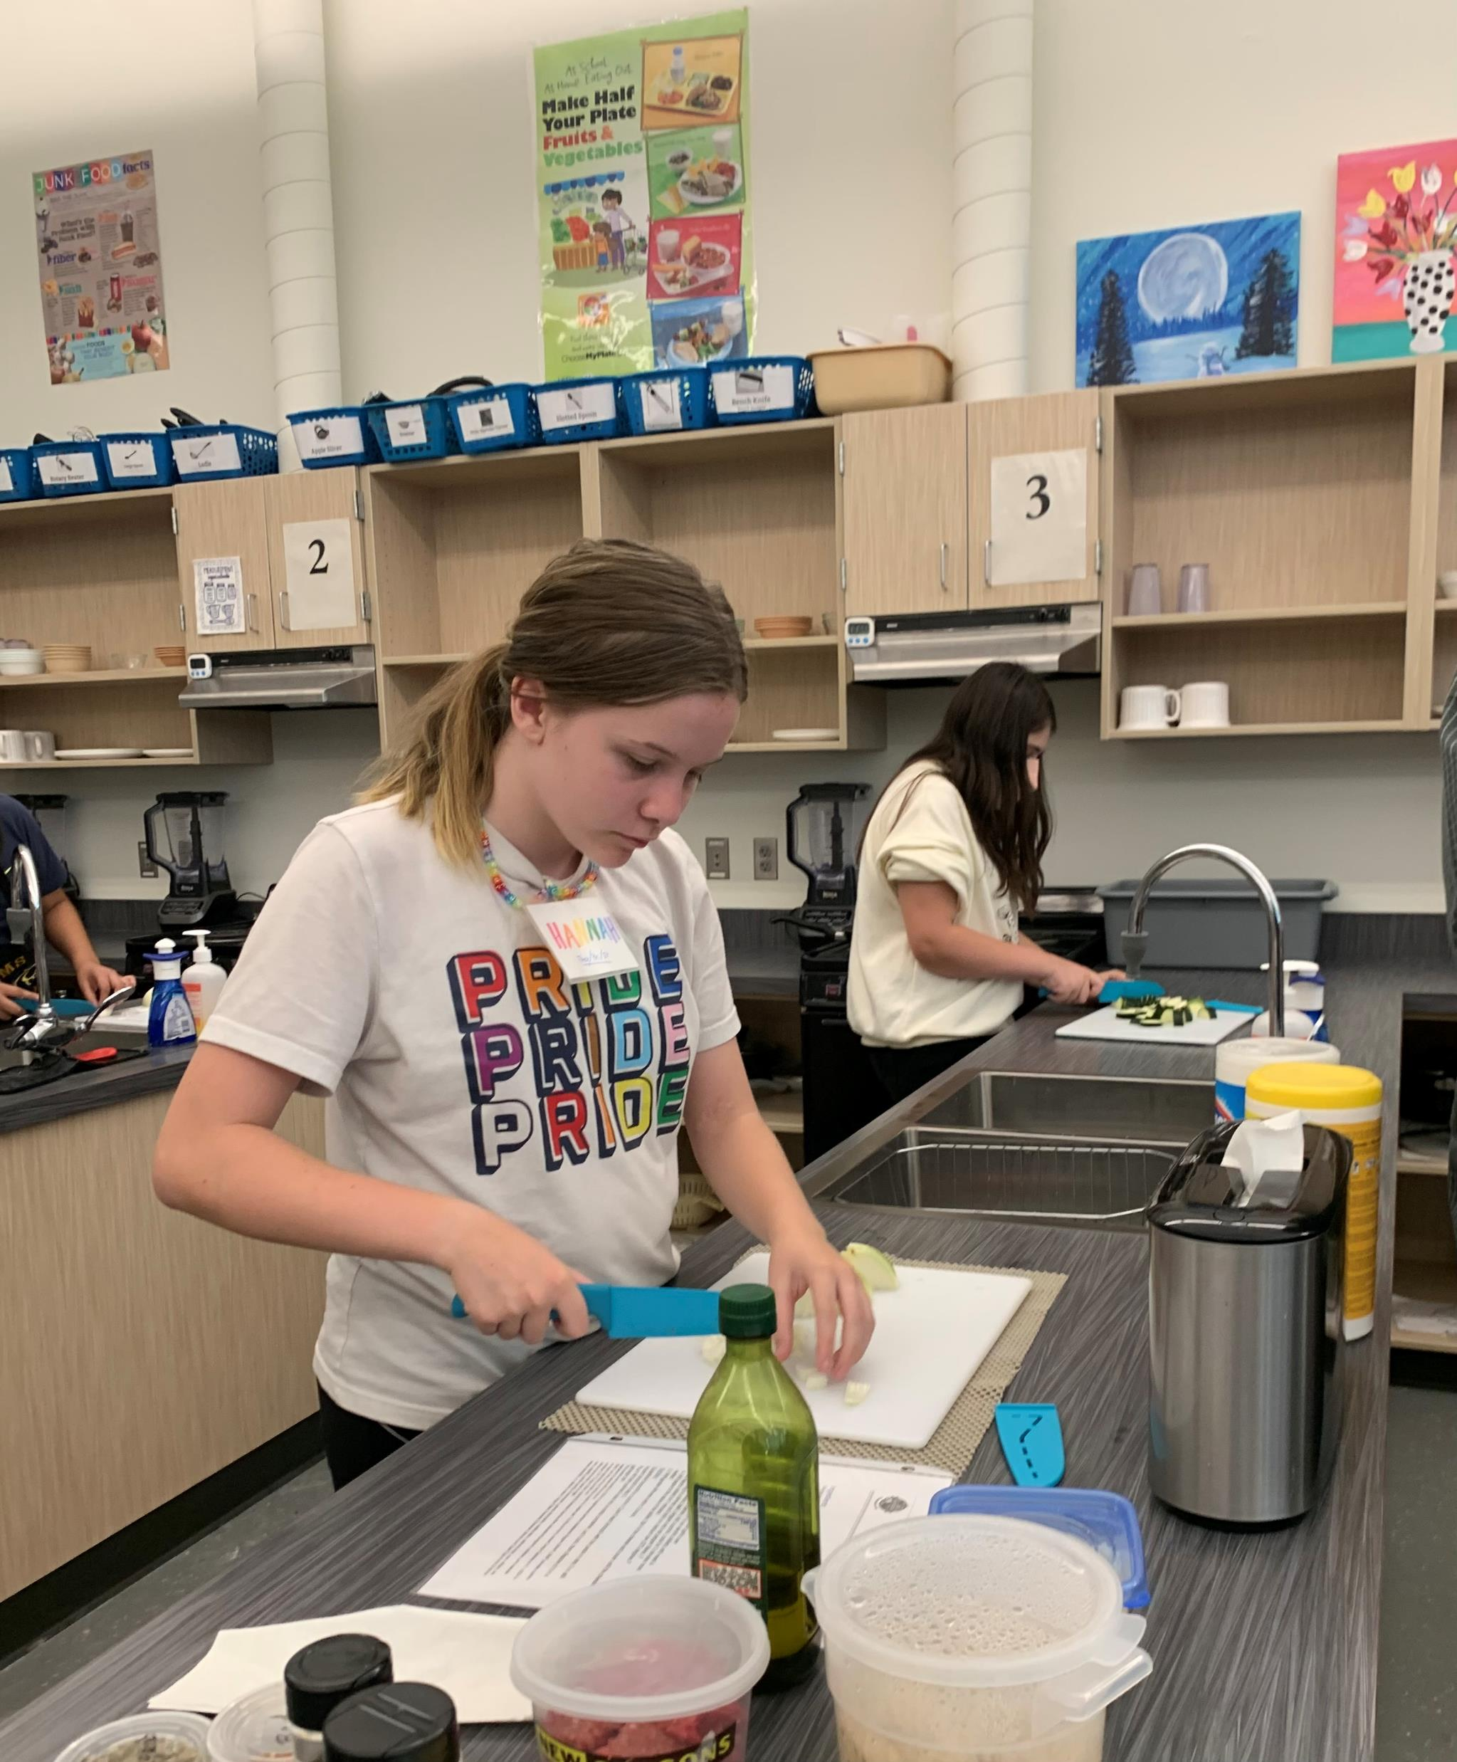
FFY 2022 SNAP-Ed Highlights
February 28, 2023

Slide 2
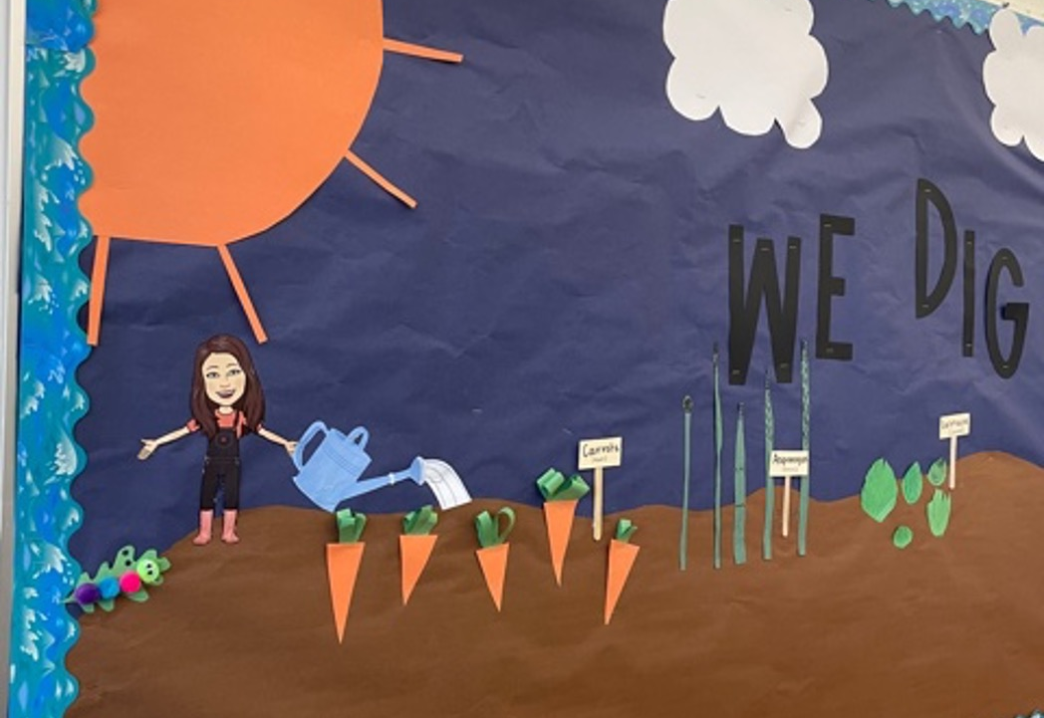
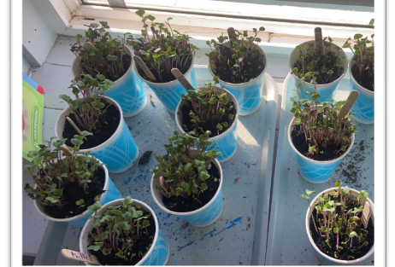
Development of an Interactive Online Education Program– Marion/Polk/Yamhill

Slide 3
Policy, Systems and Environment Activities
Healthy Eating Changes 112 adopted at 35 sites
Physical Activity Changes 35 adopted at 13 sites

Slide 4
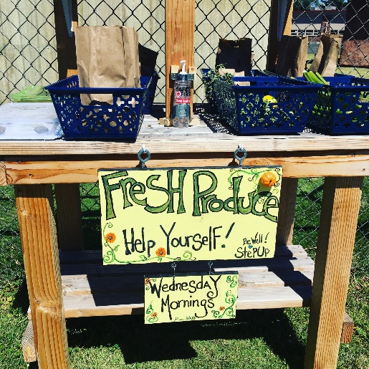
Development of a School Garden Committee – Deschutes County

Slide 5
Multi-Component Interventions
 | 2020 | 2021 | 2022
Direct Ed sites | 249 | 164 | 258
Direct Ed + Additional Activit(ies) | 183 (73%) | 128 (78%) | 173 (67%)

Slide 6
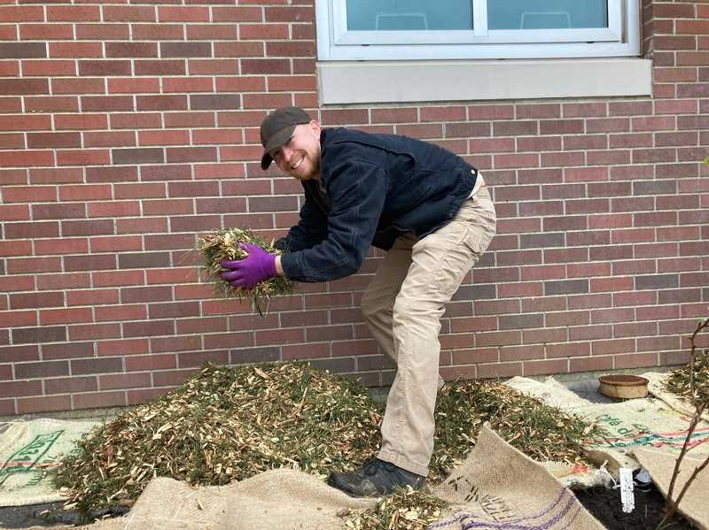
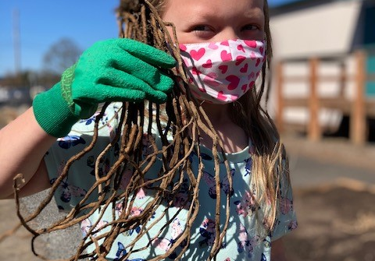
Exploring Oregon’s First Foods

Slide 7
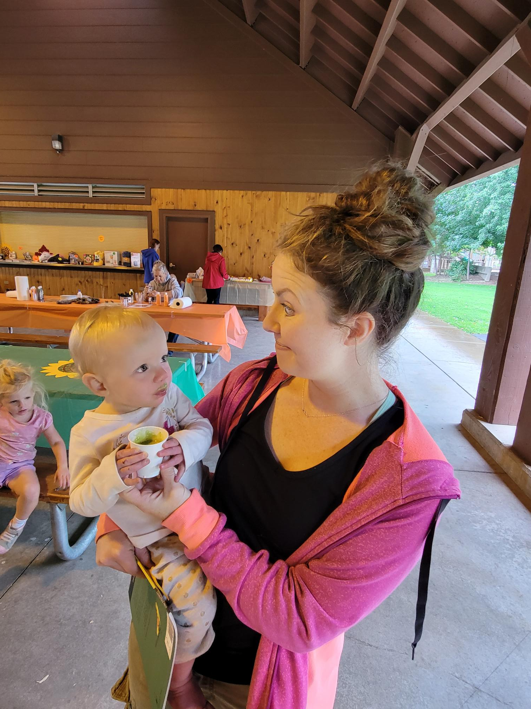
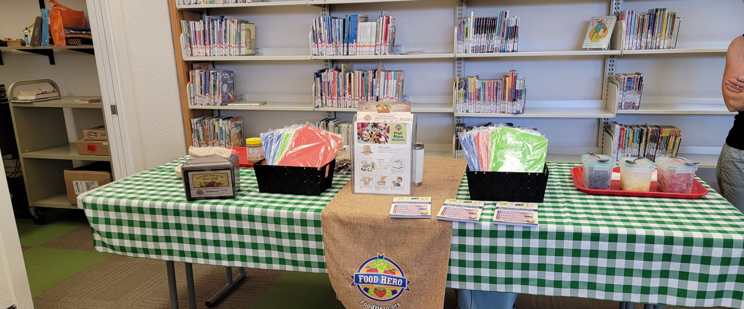
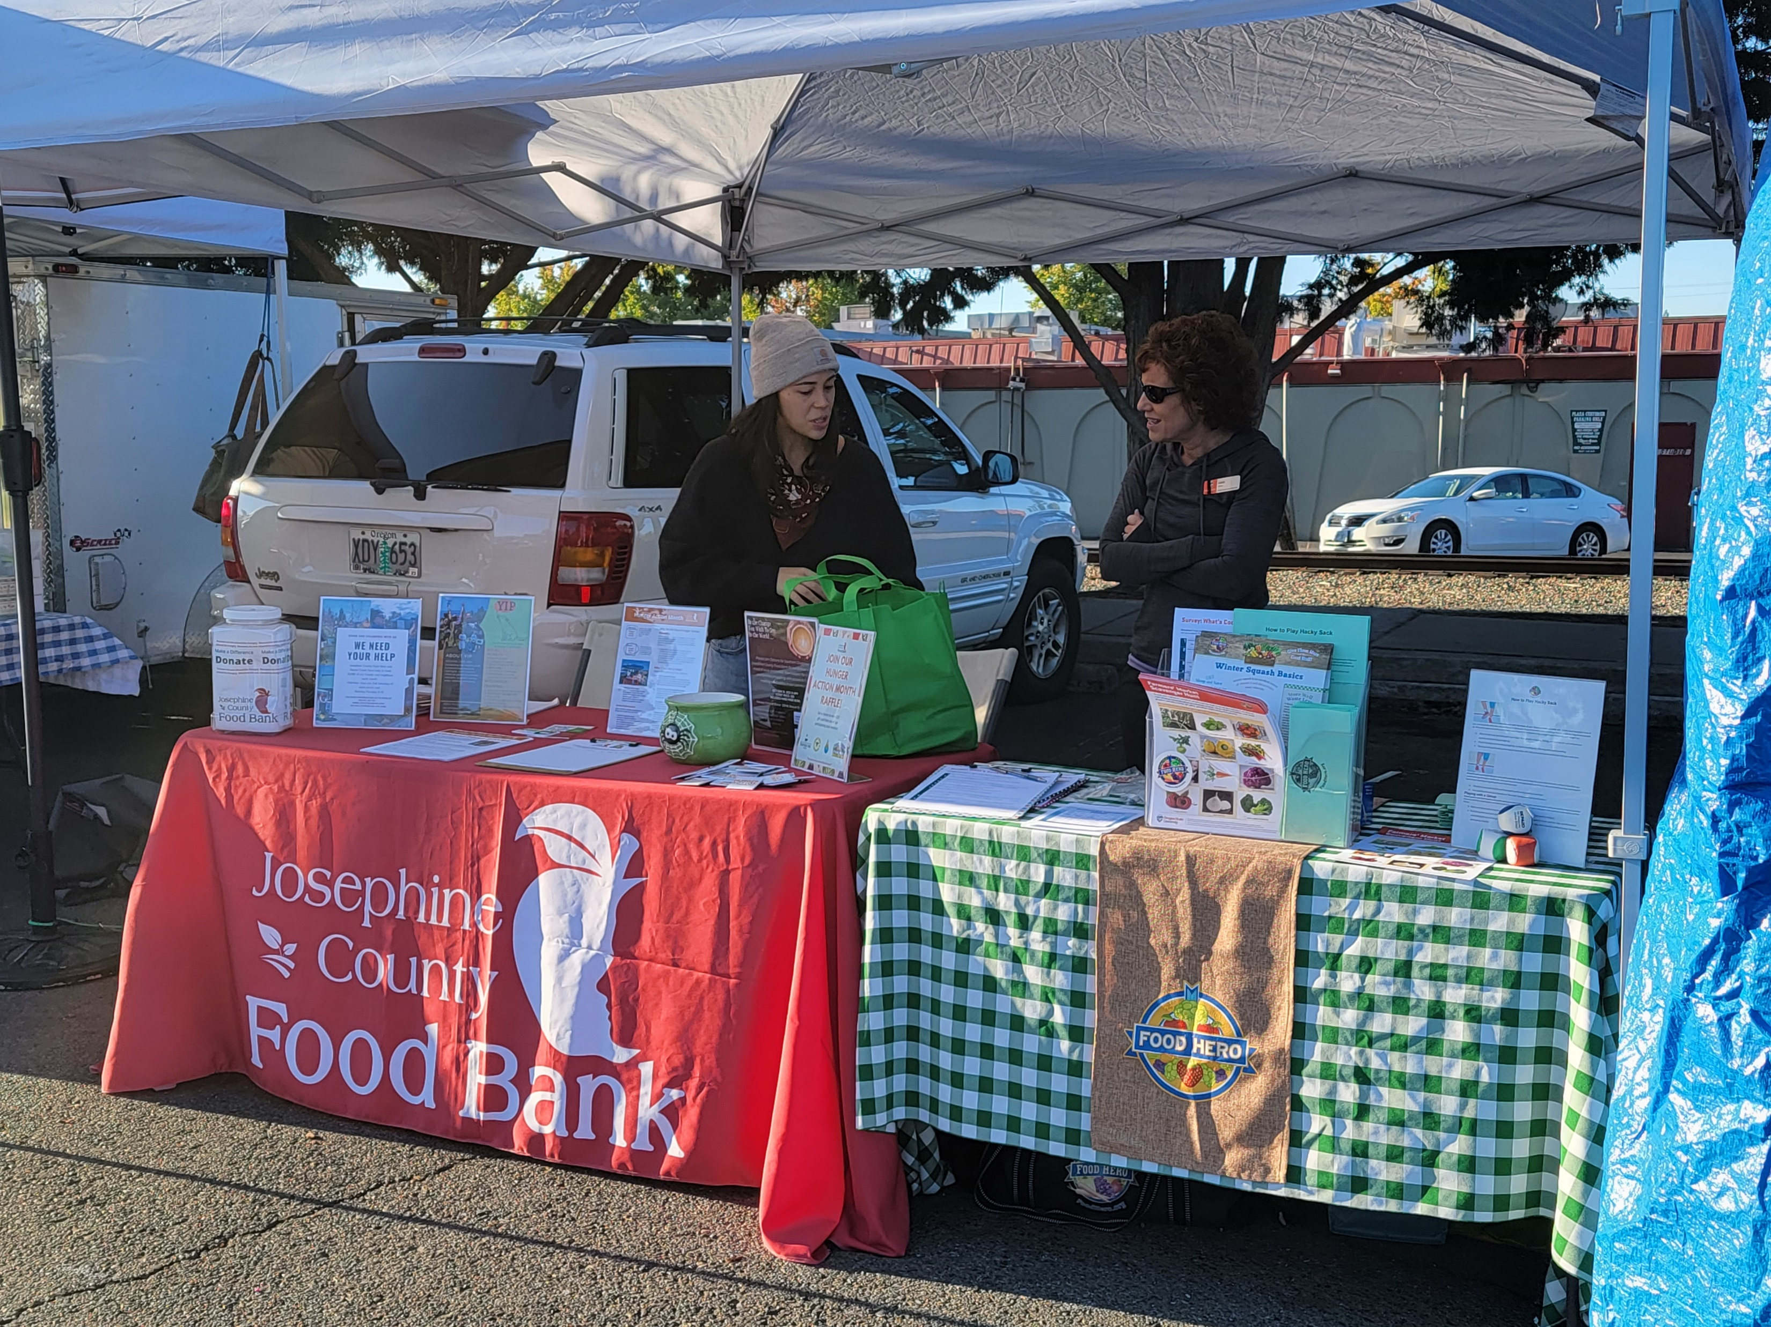
Partnerships Key to SNAP-Ed Success

Slide 8
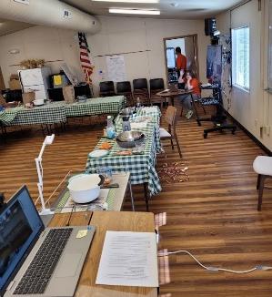
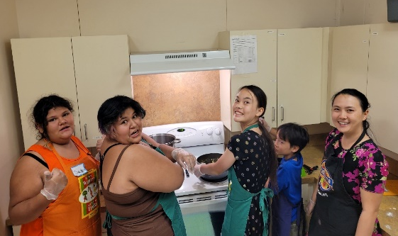
Klamath County Cooking Matters for Teens

Slide 9
Amplified Reach
Leveraged Resources FFYs 2020-2022
 | FFY 2020 | FFY 2021 | FFY 2022
Grants | $914,264 | $608,672 | $568,494
Staffing | $101,000 | $170,057 | $221,741
In-Kind | $34,986 | $12,789 | $113,531
Total | $1,050,250 | $791,518 | $903,766

Slide 10
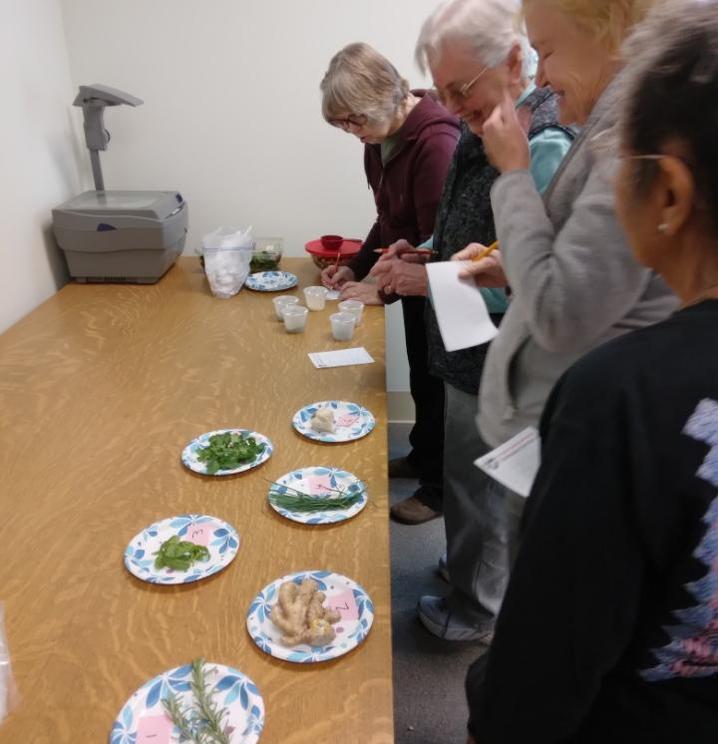
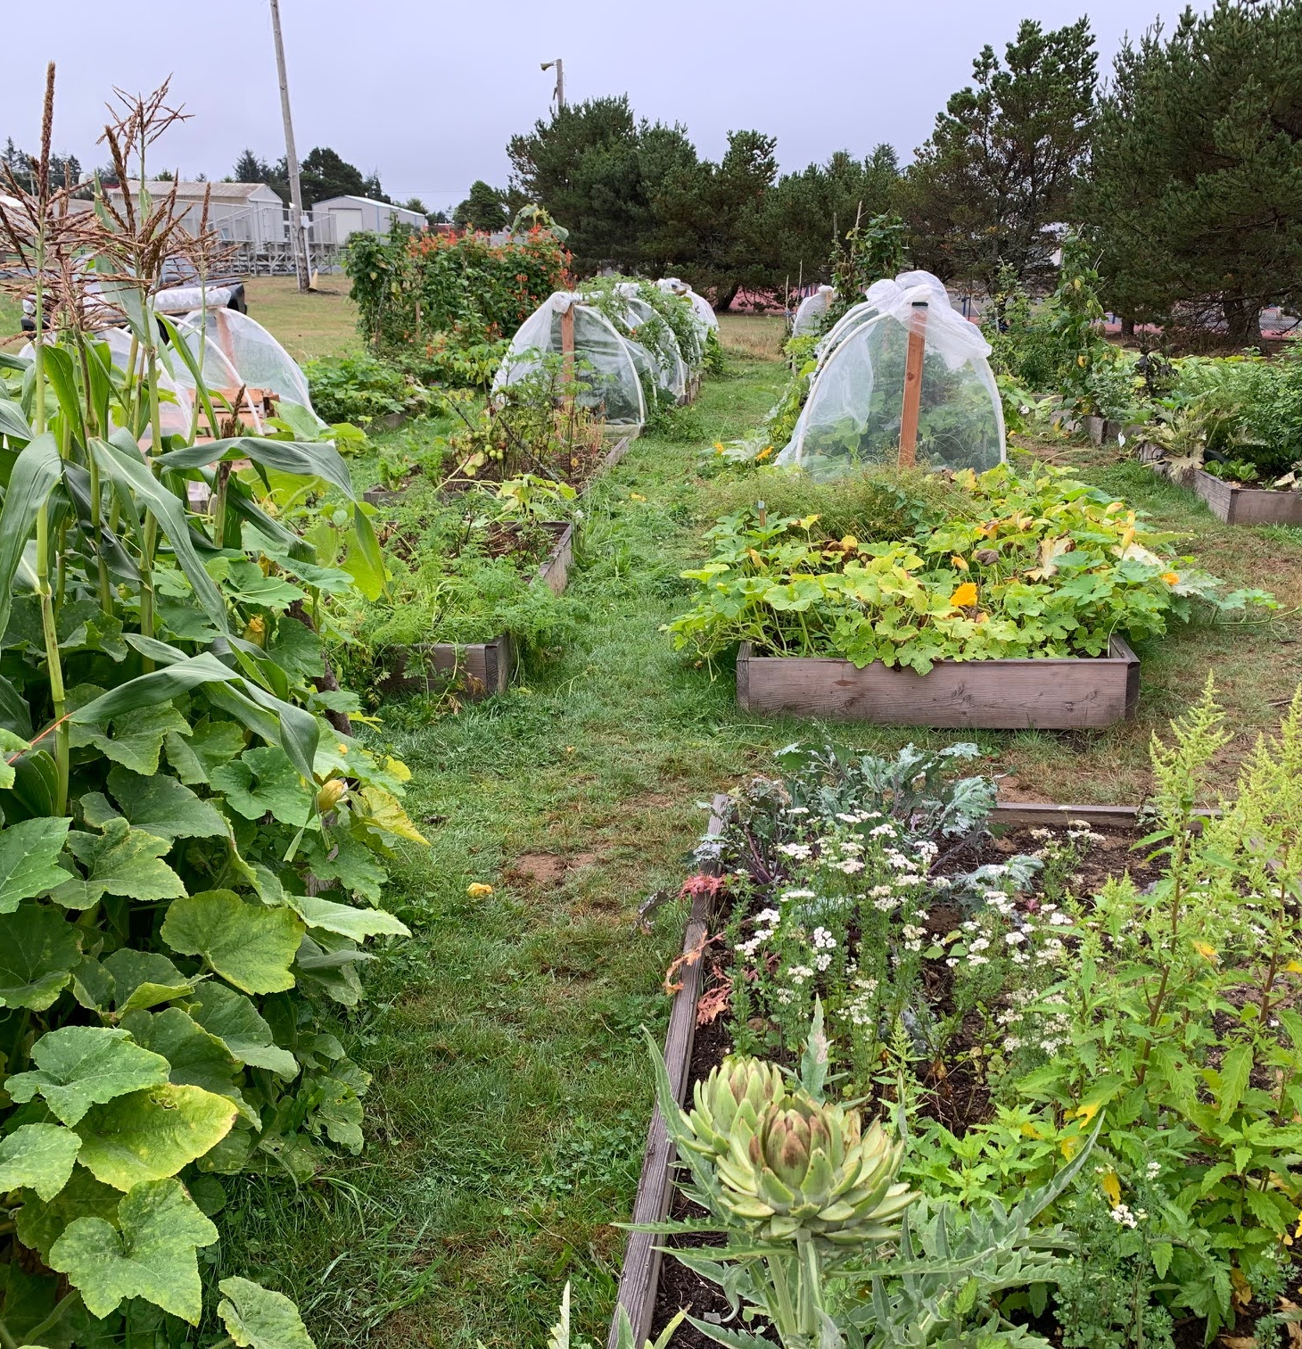
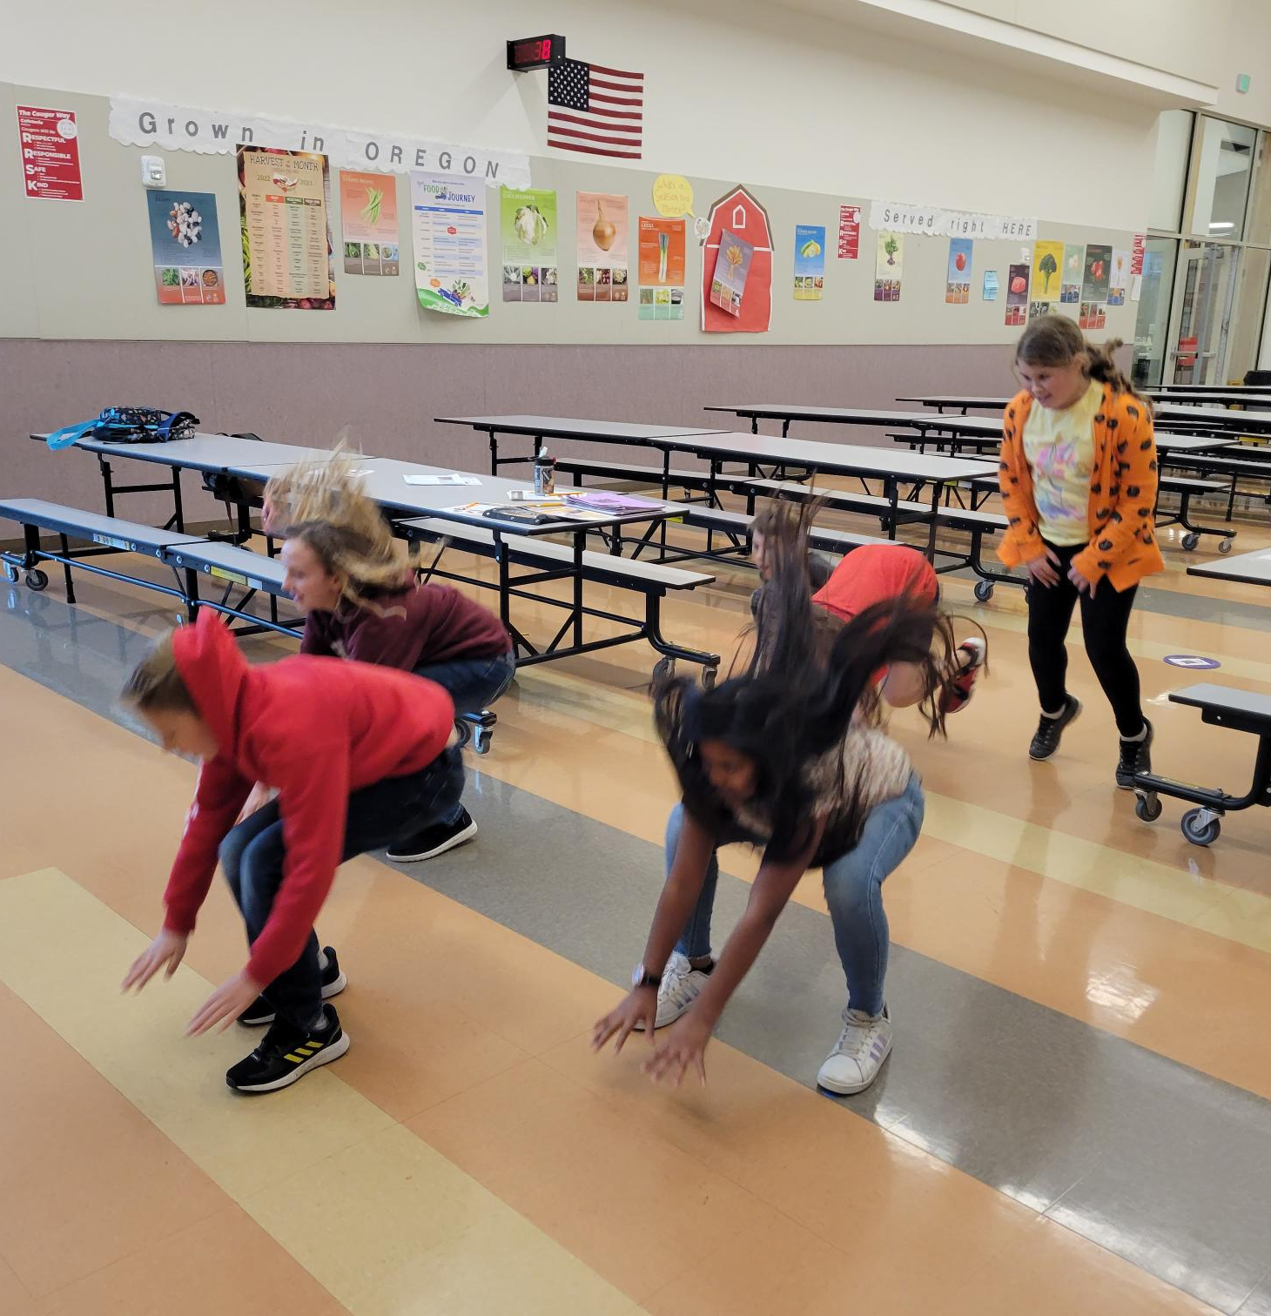
Thank you!

