Slide 1
SNAP-Ed Sunset and Transition
Updates
FCH SNAP-Ed Statewide Meeting
July 28, 2025

Slide 2

SNAP-Ed Programming
To the best of your ability, keep going with programming:
  Classes
  Events
  Food Hero recipes
  Food Hero tastings
  Coalition meetings
  SNAP-Ed programs
  Distribution of materials & reinforcements
Notes:
Sally

Slide 3

Supplies
SNAP-Ed Programming through September 30
  Continue to use supplies, reinforcements, budget for classes, tastings, events, through September 30, as you normally would.
Extra items that won’t be used before
September 30
  It is too early to make decisions yet
  We must wait for instructions from our funders (Oregon Department of Human Services, USDA Food and Nutrition Services)
  You can organize, inventory, and think about usefulness

Slide 4
Inventory Guiding Principles
Purpose: to understand what you have so we can provide guidance for supplies we would have after September 30
Follow the instructions in yellow on each tab of the attached Excel inventory document.
Include items that will remain after September 30.
Only those with useful life left.
In most cases, estimates are fine (e.g. 1 box of measuring cups or approximately 25 assorted kitchen utensils).

Slide 5

Budget & Expenses
Prevent expenses after September 30 on SNAP-Ed indices
Final SNAP-Ed purchases should be made before September 26.

Slide 6

SNAP-Ed Reporting & Evaluation
Continue:
  Entering data into PEARS
  Sending completed surveys to campus
    New address – cover sheet has been updated:
      OSU Extension Family & Community Health
      2591 SW Campus Way, Corvallis, OR 97331
Maintain records:
  Receipts
  Registration forms
  Program documents
Notes:
Rocci

Slide 7
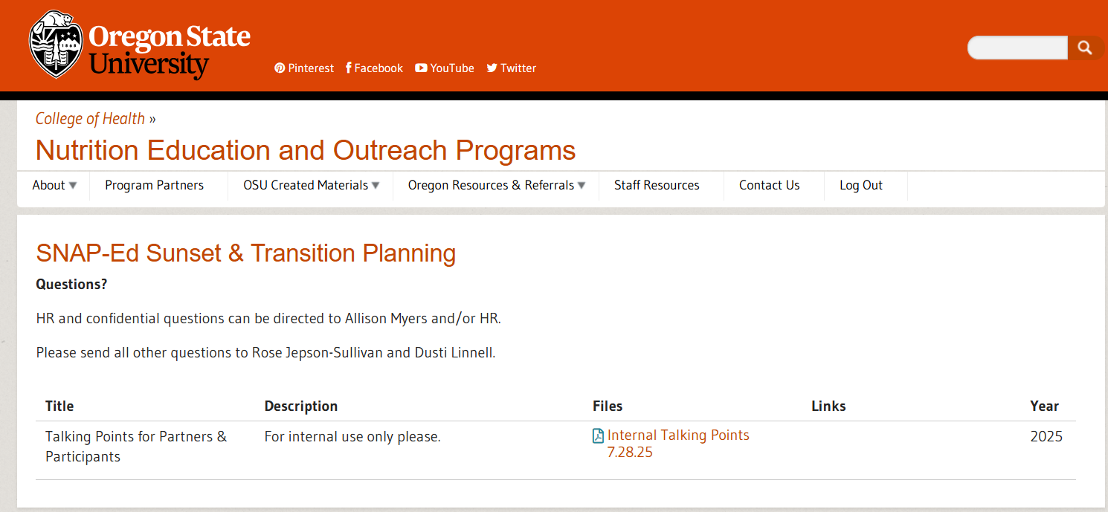
Communications to Partners and Participants
New resource!
Talking points for responding to questions from partners and program participants
Notes:
Rocci

Slide 8


General Guidance for Responding to
Questions from Partners and Participants
It is ok to…
    Answer questions using information in the document, in emails from Allison Myers and Kris Elliott, and as directed by Dusti and Rose.
    Say you are not sure at this time but you will get back to them as soon as possible
    Tell Rose and Dusti that a partner would benefit from a personal in-depth conversation

Slide 9
Key Points
Federal funding for SNAP-Ed will end on Sept. 30, 2025. As a result, OSU must plan with our partners to sunset this impactful program.
Until then, we are continuing current activities.
Nutrition, food security and physical activity education will continue to be part of OSU Extension’s work in Oregon. Understandably, this work will need to look different without SNAP-Ed funding.
We are working to make this transition, though difficult, as smooth as possible and keep as many educational resources available as possible. We are working to ensure nothing disappears suddenly.
We will share specifics as they are available.
OSU continues to pursue opportunities for funding and partnerships to support this essential work.

Slide 10
How to Answer Common Questions
What should I tell my partners?
  At this time, we are continuing current activities through 9/30/25.
  I don’t yet have guidance for activities after 9/30/25 when SNAP-Ed funding ends, but our team is working hard to make those decisions and plans. I will update you as soon as I can.
If I have a partner MOU/agreement that goes beyond 9/30/25 what should I do?
  Make that known to Dusti/Rose.
  Let partner know that because SNAP-Ed funding ends 9/30/25, that you are working with the team to understand how that affects the current MOU/agreement.
What will happen with [[material, online resource, equipment, etc.]]?
  For now…[[please hold onto it/please continue to distribute/etc.]]
  I don’t have guidance on that yet, but our team is aware of this need. I will let you know as soon as I do.
  Our team is working hard to plan, and we appreciate your patience and understanding.
  We are working to ensure nothing disappears suddenly (e.g., curriculum, recipes).

