Slide 1

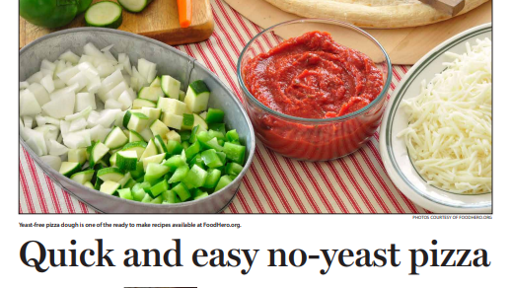
Working with media
Newspaper Articles

Slide 2

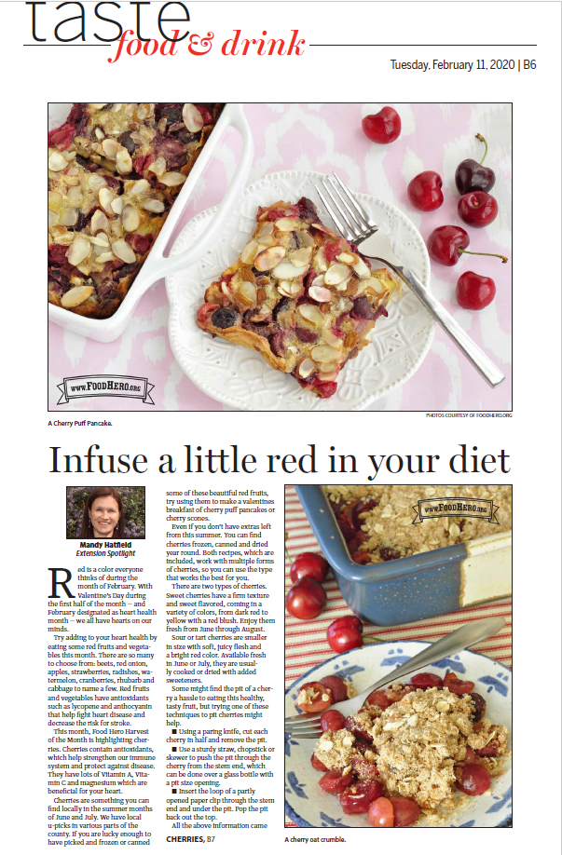
Article Standards
Approximately 500 words
No higher than 8th grade reading level
At least two recipes with a picture – can have three pictures and recipes
Make them personable so they can be relatable.
Provide contact for more information

Slide 3
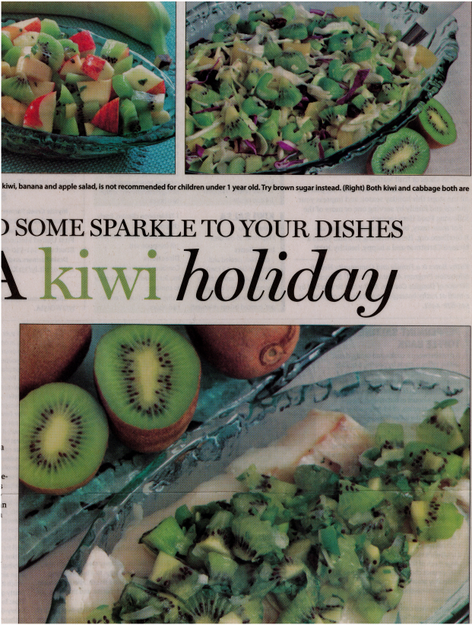
Starting New Projects Its all about connections.
It all starts with connections
The Editor of the paper had a daughter in 4-h
Started as a Sunday column for the Extension Service
Changed for FCH into a Tasty Tuesday column that included recipes and picture with each article
The newspaper editor at the time we started writing articles for the paper had a daughter in 4-H. All of the Douglas County writes article for the paper with the agreement we made with the Newsreview.
Tasty Tuesday was something the editor added to the paper and they moved our column to this section which allowed us to feature more pictures and recipes.

Slide 4
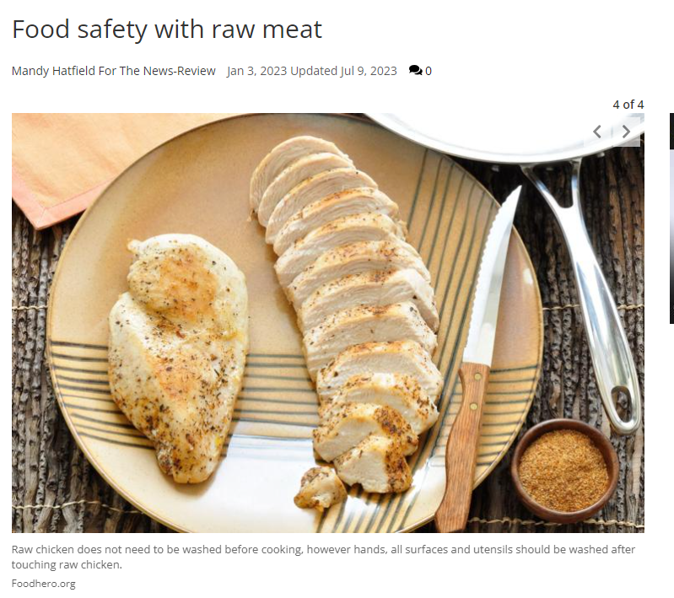
Food Hero Topics
One article a month on the second Tuesday of the month comes from Food Hero related recipes and pictures
One article a month is on food preservation but can include Food Hero recipes and pictures.
Example is this article on food safety of raw meat.

Slide 5
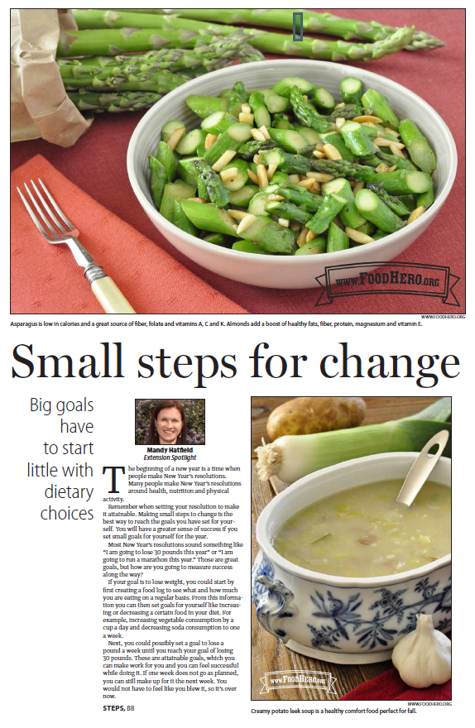
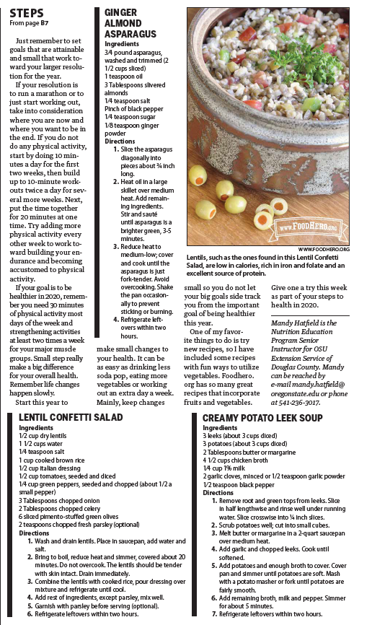
Many Articles span two pages

Slide 6
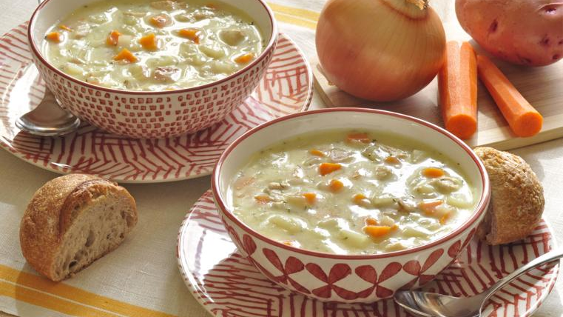
Cooking nutritious meals for one or two people
Once in a while, I find myself at home where I just need a meal for myself and not my whole family. It almost stumps me on what to make because I want to eat something nutritious, but I don’t want a ton of leftovers and time into make something just for me. When those times do happen it's nice to have a few recipes available that are already designed for one or two servings.
I am a huge soup fan, so I enjoy making soup. Usually, I make large batches so I can feed my family and have leftovers but the foodhero.org recipe for chicken chowder for two is designed for just two servings. They have worked out all the math for you to make a smaller batch. They also have breakfast recipes and smoothie recipes that make one to two servings. This is great to take the math out of converting your own recipes to smaller sizes. These recipes are great examples of nutritious meal ideas without lots of time and effort that ends in leftovers and lots of clean up.

Slide 7
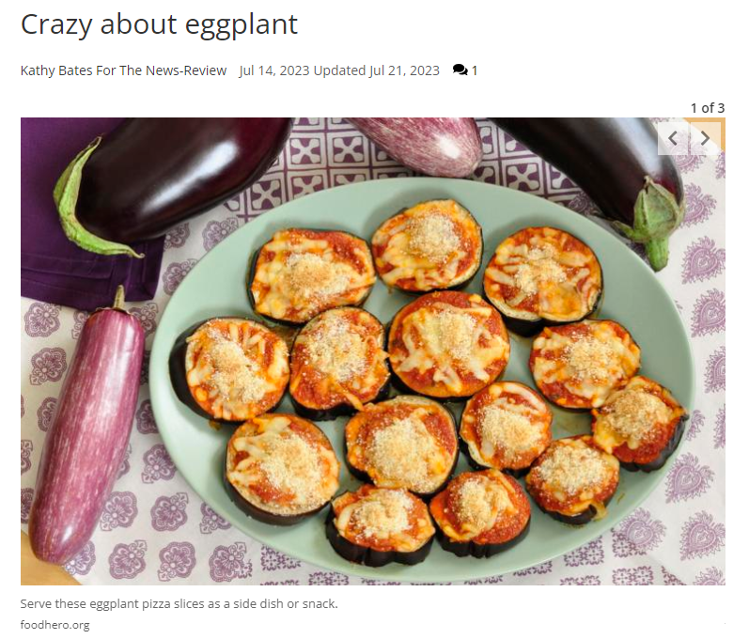
Any Questions?
Mandy Hatfield Kathy Bates

